Slide 1

US Treasury Analysis Project

Slide 2
Contents
US Treasury market summary | 3
Modelling – yield curve basics | 4
Modelling approach and rationale | 5
Trading opportunities | 6
Appendix | 8
Notes:
Check titles

Slide 3




US Treasury market summary
The US Treasury plays a prominent role in day-to-day running of the global economy
The U.S. Treasury, part of the federal government, manages the nation’s finances by collecting taxes, issuing debt to fund government operations, producing currency, and advising the government on economic and fiscal policy
Primary functions
Relevance to TP ICAP
Debt management: Responsible for issuing Treasury securities to raise funds for government spending and refinance debt
Revenue collection: Collects taxes and other revenues through the IRS (Internal Revenue Service)
Currency production: Designs and produces US currency (notes) and coins
Fiscal policy: Provides advice on economic policy, fiscal policy and financial stability
Enforcement & oversight: Enforces laws related to financial crimes ensuring compliance with regulations
Management of finances: Manages the federal government’s cash flow and accounts, including payments & receipts
Core product
US Treasuries are a core product for ICAP brokers
Market benchmark setter
Rates set heavily affect ICAP-traded products
Volatility boosts trade
Yield movements drive client trading, affecting ICAP
REPO collateral
Treasuries are key collateral in the repo market for ICAP

Slide 4
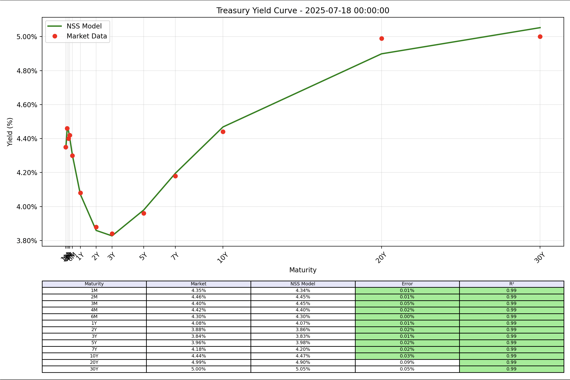


Modelling – yield curve basics
Modelling approach
Modelling approach
A yield curve shows interest rates on bonds with the same credit quality but different maturities
The U.S. Treasury yield curve is the benchmark, as it carries no credit risk and is used to compare other bonds like corporate debt
When looking at the treasury yield curve, there are a few conclusions that can be drawn:
Above the curve = Buy
Below the curve = Sell
Distinct behaviours
Short-term volatility: Driven by Fed policy shifts
Midterm dip: Reflects expectations of future rate cuts
20-year hump: Reintroduced in 2020; higher yields needed due to low demand and liquidity
Key indicators:
LR > SR: Normal curve, signals healthy economy
SR > LR: Inverted curve, signals recession fears
Diagram 1.1: graph and table highlighting the US Treasury yield curve data

Slide 5
Modelling – approach & rationale
Utilised the 13 US treasury yield data points over a 2-year period to create the curve
Modelling approach
Model optimisation
Nelson – Siegel
Economically-driven curve built using parameters β₀, β₁, β₂, and λ₀
Cubic spline interpolation
Fits smooth curves using cubic polynomials & derivatives
Using the Nelson Siegel Svensson model
This algorithm is a derivative-free method that optimises complex parameters by gradually improving a set of points through reflection, expansion, and contraction until the best fit is found
Error functions: Calculates the sum of residuals between observed market yields and NSS model predictions across 13 maturities
Challenges:
Without limits, the model’s values can get too large or become unrealistic, so setting manual limits keeps them within a reasonable range
The algorithm can also get stuck at a “local best” solution, so a fix to this would be by adjusting the lambda values to help the algorithm to search for a better overall fit
Fine Tuning
Adjusting one parameter affects others, so iterative tuning with model knowledge and visual feedback was key to fitting the curve well
Limitations
4 parameters can’t capture short-term volatility & long-term features like the 10Y dip and 20Y hump
Overfits yields due to lack of economic parameters; sensitive to outliers, causing curve oscillations
Nelson – Siegel – Svensson (NSS)
The Nelson-Siegel-Svensson solves the limitations by extending the Nelson-Siegel with 2 extra parameters (β₃, λ₁) for better fitting 13 tenures, balancing long-term yields and short-term volatility

Slide 6
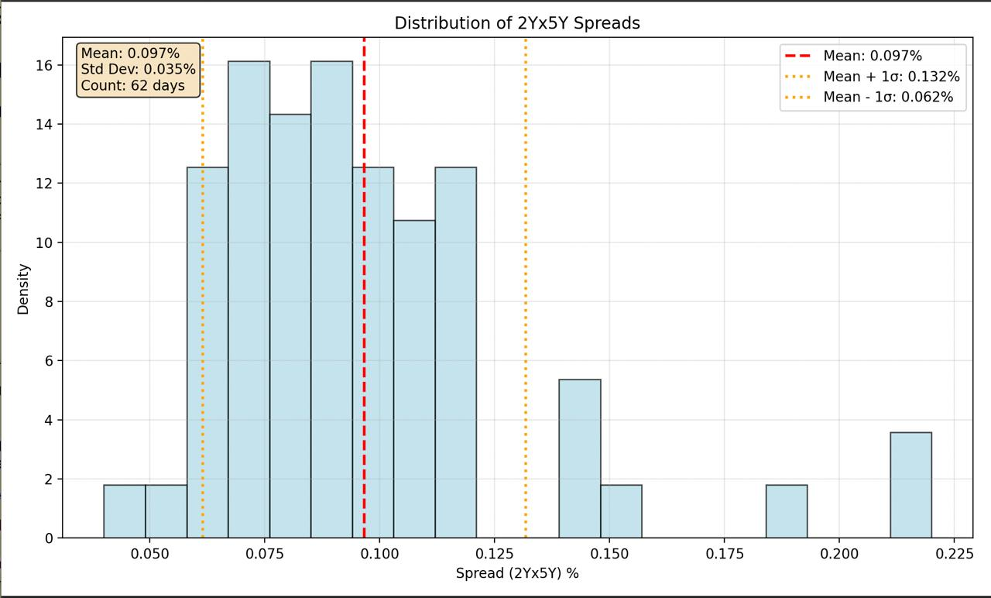
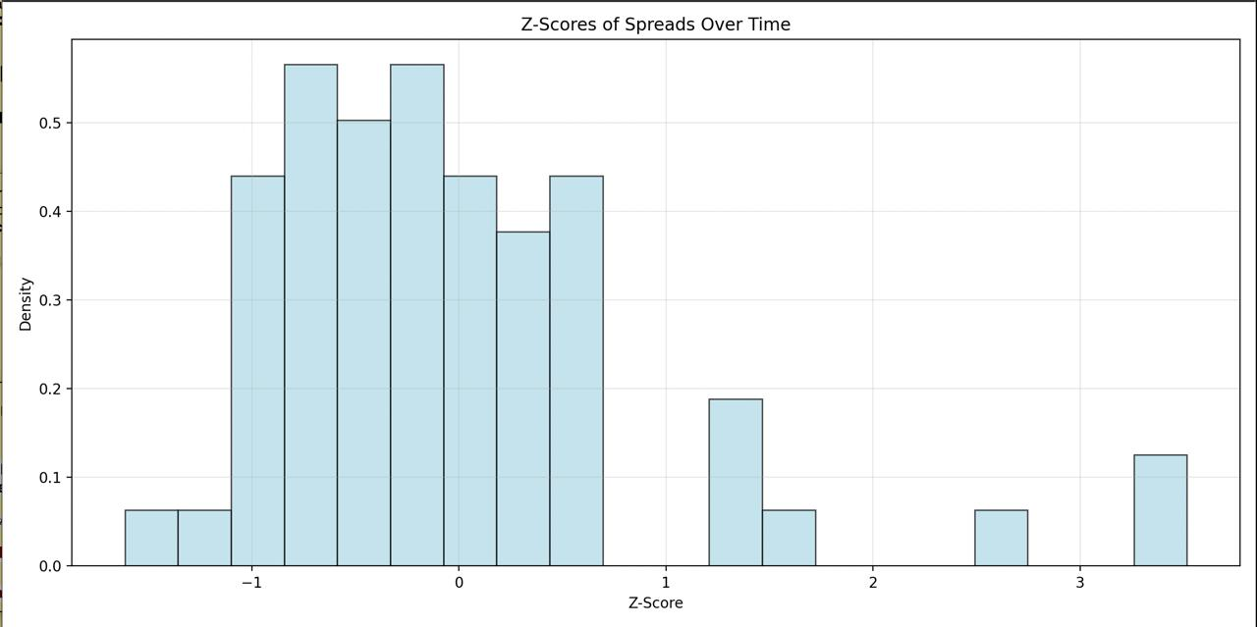
Trading opportunities – statistical findings
Using yield curves, spreads and z-scores to identify potential trade opportunities
Diagram 2.1: graph showing the distributions of 2Yx5Y spreads
Diagram 2.2: graph illustrating the Z-scores of spreads over time
Spread & mean reversion
Z-Score strategy
The spread between 2Y and 5Y yields clusters around 9.7 bps, with most values staying within a standard deviation of ±3.5 bps. This suggests mean reversion, where extremes return to the average
The general consensus is that Z-scores between -1 & 1 are normal. If:
Z > 2.5 → Sell 2Y, Buy 5Y → This indicates the spread is widening
Z < -2.5 → Buy 2Y, Sell 5Y → This indicates that the spread is tightening

Slide 7
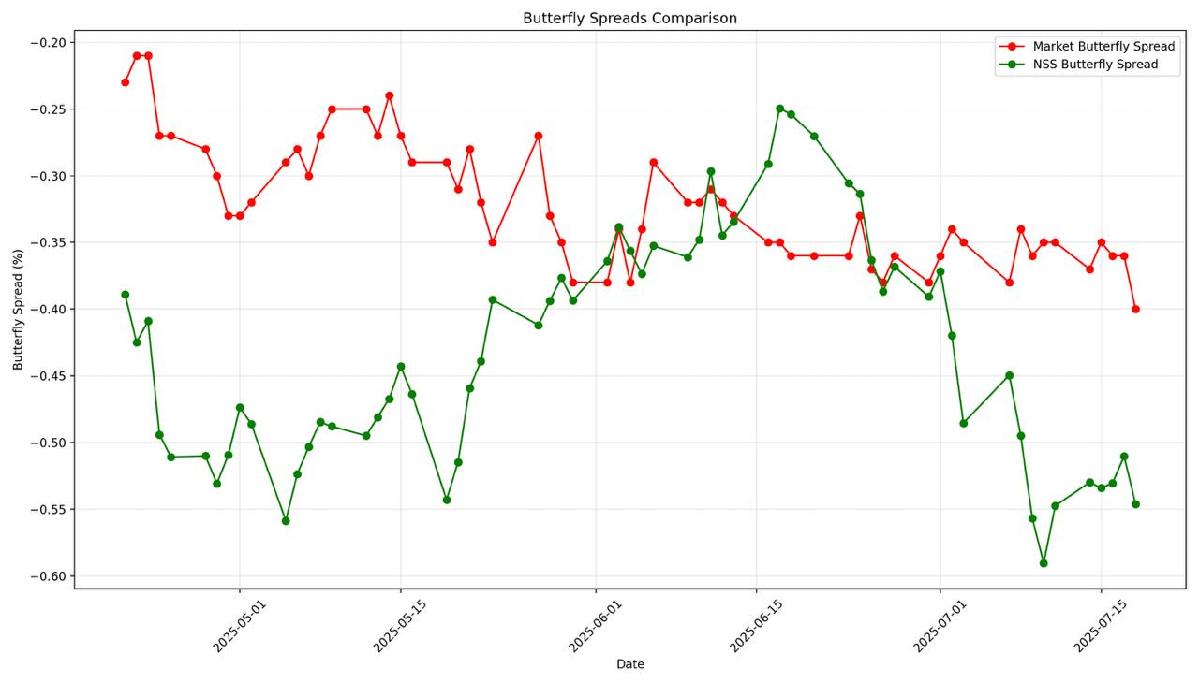
Trading opportunities – butterfly spreads
Butterfly spreads can be used to gain a more comprehensive understanding of ICAP’s position
In the U.S. Treasury market, a butterfly spread is another yield curve strategy using three securities of short, medium and long maturities to isolate and profit from changes in the curvature of the curve
A 2s5s10s butterfly is a fixed income trade that profits from yield curve curvature by comparing the 5Y to the 2Y and 10Y
Using the NSS and market data, two trade opportunities were identified:
If market > NSS: Buy 5Y, sell 2Y & 10Y – more curvature
If NSS > market: Sell 5Y, buy 2Y & 10Y – flatter curve
Hedging
The wings of the butterfly need to be weighted to hedge such risks:
Unit Butterfly: Unit Butterfly: Most common; equal wings, body offsets (e.g., -1, 2, -1)
Durational Risk: Weighted by DV01 to stay duration-neutral and hedge parallel shifts
Directional Risk: Limits exposure to curve steepening/flattening
Regression Optimised: Uses historical data to reduce P&L variance
Traders must choose between hedging duration or direction—can’t do both
Diagram 3.1: Butterfly spread showing the difference between the treasury market and model spreads

Slide 8
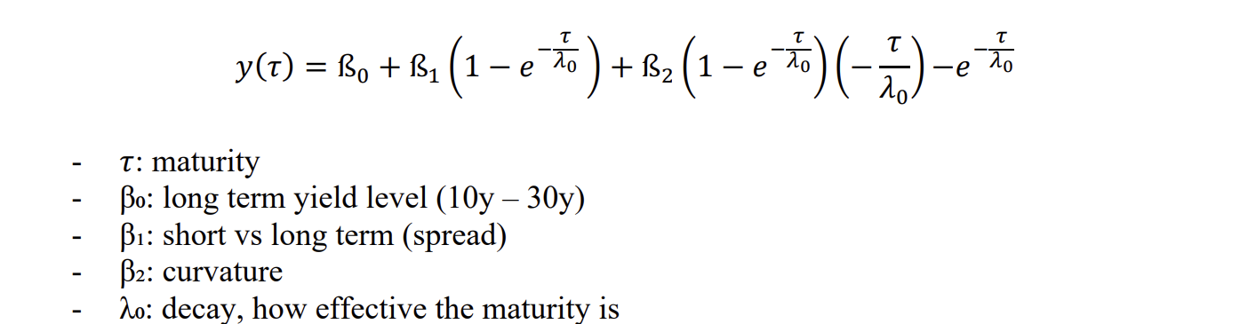
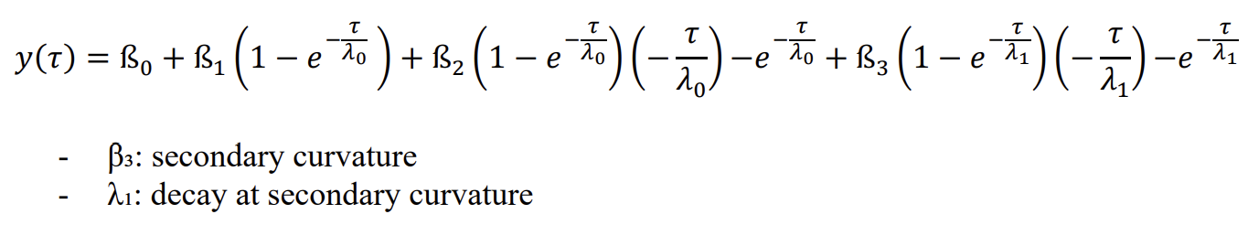
Appendix
Model and techniques
1. Nelson - Siegel Model: A parametric yield curve model using 4 parameters (β₀, β₁, β₂, λ₀) to fit the term structure of interest rates with economic interpretation
2. Nelson Siegel Svensson (NSS) Model: Extended version of Nelson Siegel with 6 parameters (β₀, β₁, β₂, β₃, λ₀, λ₁) providing additional flexibility for fitting yield curves
3. Cubic Spline Interpolation: Mathematical technique that fits piecewise cubic polynomials between data points while maintaining smooth first and second derivatives
4. Mean Reversion: Statistical property where values tend to return to their long-term average over time

Slide 9
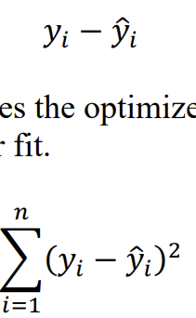
Appendix
Optimisation and algorithms
Nelder Mead Algorithm: Derivative-free optimization method that uses a simplex (geometric shape) to find minimum values of a function
Residual: The difference between an observed value and the value predicted by the model
Error Function: The error function gives the optimiser a single value to minimize. The smaller the error function means a better fit
Simplex: In optimisation, a geometric figure with n+1 vertices used to search for optimal solutions in n-dimensional space
Local Minima: Points where a function reaches its lowest value within a small neighbourhood, but not necessarily the global minimum
Global Minima: The absolute lowest point of a function across its entire domain
Warm Start: Optimization technique where previous solutions are used as starting points for new iterations to improve efficiency
Bounds: Constraints placed on parameters to keep them within economically reasonable ranges

Slide 10
Appendix
Data processing and financial terms
Data processing
Vectorised Operations: Computational technique that applies operations to entire arrays simultaneously, improving efficiency
NumPy Array: Python data structure optimized for numerical computations with lower memory usage than lists
Pandas Data Frame: Python data structure for handling structured data with rows and columns, similar to a spreadsheet
Financial terms
Yield Curve: Graph showing the relationship between bond yields and their time to maturity
Basis Points (bps): Unit of measurement for interest rates, where 1 basis point = 0.01%
Spread: The difference between yields of two different bonds or maturities (e.g., 5y-2y spread)
Relative Value: Investment strategy that identifies mispriced securities by comparing them to similar assets
Tenure: The time remaining until a bond's maturity

Slide 11
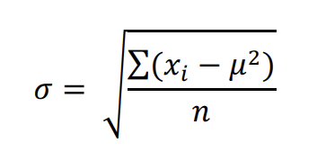
Appendix
Statistical measures
Residual: The difference between observed values and predicted values from a model
Standard Deviation: Statistical measure of the amount of variation in a dataset
Z Score: Standardised score indicating how many standard deviations a data point is from the mean
Error Function: Mathematical function that measures the difference between predicted and actual values
R²: This is a statistical measure that represents the proportion of the variance in the dependent variable that is explained by the independent variable(s) in the model which essentially tells you how well the model's predictions fit the actual data

Slide 12
Appendix
Market terms
2y, 5y, 10y, 20y: Common abbreviations for 2-year, 5-year, 10-year, and 20-year Treasury bonds
Undervalued/Overvalued: Securities trading below or above their fair value respectively
Trade Opportunities: Market conditions that present potential for profitable trading
R² (R-squared): Coefficient of determination that measures the proportion of variance in the dependent variable explained by the model, ranging from 0 to 1
Sum of Squared Residuals (SSR): Total squared differences between observed and predicted values; measures model error
Total Sum of Squares (TSS): Total squared differences between observed values and the mean; measures total variation in data
Linear Regression: Statistical method for modelling the relationship between variables using a straight line
Slope: In regression analysis, indicates the rate of change in the dependent variable per unit change in the independent variable
Trending vs. Oscillating Markets: Trending markets show persistent directional movement (high R²), while oscillating markets show mean-reverting behaviour around an average (low R²)

