Slide 1
AirlineReservation

Slide 2
Why we chose this project
In the old days, when technology was not so advanced, the options for buying tickets were either by phone or at an agent's counter.
But nowadays, with the rapid development of technology, more and more people are using online shopping, and the purchase of air tickets has become more convenient and user-friendly.
So we chose to make a simulator for buying airline tickets

Slide 3
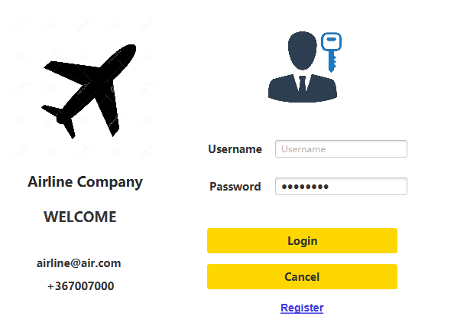
Login and Register
The first part of the project is a login session.
For example, regular users can log in directly using username and password. The database we use here is a SQL database
If you click on the software by mistake and want to exit, you can click on cancel and the software will close automatically.

Slide 4
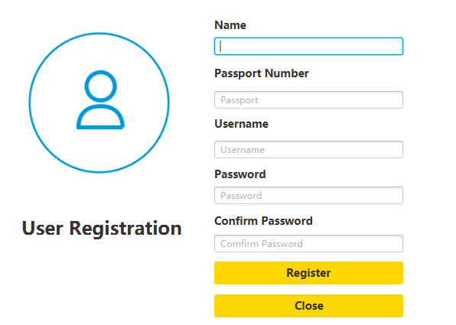
Login and Register
For new users, you can simply click on the registration screen below. Once clicked the software will jump to the registration screen and all the information filled in will be saved

Slide 5
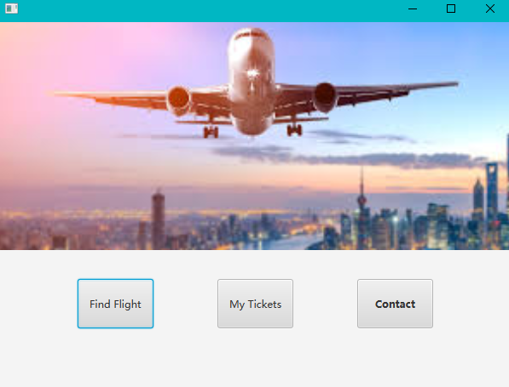
Select screen(demo) Sorry for Ugly
Once the user has successfully logged in, they will be redirected to a new selection screen, where they can choose to find flights, manage their purchased tickets and select a third contact button if they have questions.

Slide 6
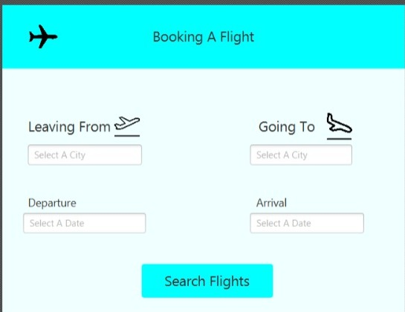
Booking A Flight
If the user selects the first button, the project will jump to the booking page. The corresponding program will contain two search algorithms, the first one using the address, e.g. if the user enters the departure and destination, the program will output the appropriate aircraft. The second search algorithm is the search by time, for example the user enters the corresponding time

Slide 7
Target
This project has only completed the first step, user login and registration. Before the final presentation, we have to complete the search for flights and the booking section, and can manage orders, such as cancellations. Regarding the contact part of the selection screen, it is possible to add a chatbot part to the program later, similar to the embedded system, or to change it to something else

