Slide 1
December 2024
Presented by: The Analytics Team
Q4 2024 Performance Analysis
Review
uarterly Business

Slide 2
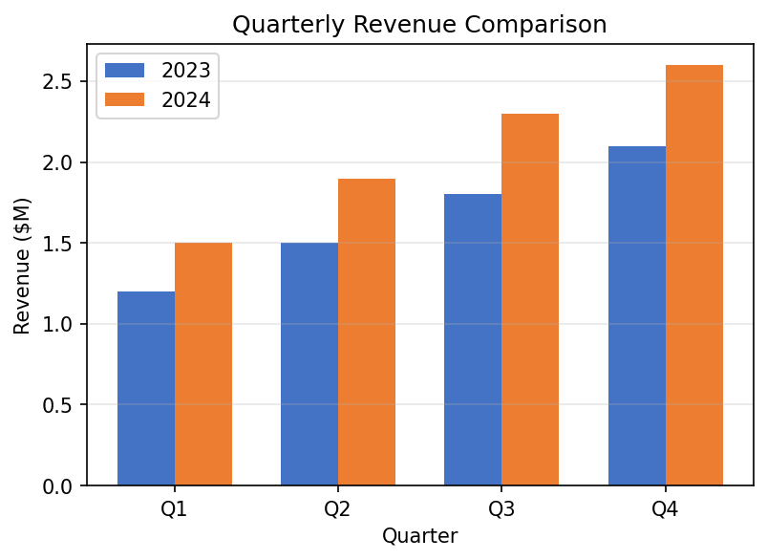
This represents a 24% increase year-over-year.
Our revenue has shown consistent growth throughout 2024, with Q4 reaching an all-time high of $2.6M.
evenue Performance

Slide 3
size due to strategic focus on mid-market segment.
Highlights:
Strong growth in customer acquisition and satisfaction. Slight decrease in average deal
Customer Satisfactio
4.2/
4.5/
+7%
Average Deal Size ($K
15
15
-2%
Customer
1,45
1,68
+16%
Revenue ($M
2.
2.
+13%
Metri
Q3 202
Q4 202
Change
ey Performance Metrics

Slide 4
4. Increase marketing investment in key regions
3. Improve customer onboarding process
2. Launch new product vertical
1. Expand enterprise sales team
Q1 2025 Priorities:
(cid:127)
Team Expansion:
Grew team by 15% to support growth
(cid:127)
Product Innovation:
Launched 3 major features in Q4
(cid:127)
Customer Growth:
Successfully expanded customer base
(cid:127)
Strong Performance:
Exceeded revenue targets by 8%
ummary & Next Steps

