Slide 1

NBA Performance analysis
Youssef Bastawy BSAN 360-001 3/19/2026 https://github.com/ybastawy1/BSAN360-Final-Project

Slide 2
Dataset Overview
NBA team and player statistics (2024–2025 season)
Source: database_24_25.csv
Observations: 4892
Variables: 10
Unit of analysis: NBA teams/players

Slide 3
Key Variables
Predictor Variables:
Shooting Performance:
3P (3-point shots made)
3PA (3-point attempts)
Ball Control:
TOV (Turnovers)
Rebounding:
ORB (Offensive Rebounds)
Playmaking & Defense:
AST (Assists)
STL (Steals)
BLK (Blocks)
Game Involvement:
MP (Minutes Played)
PF (Personal Fouls)
Outcome Variable:
Team Success (Wins)

Slide 4
Research Questions
Which statistical categories best predict team success across an NBA season?
Which individual statistics are most strongly correlated with team winning percentage?
Do shooting efficiency metrics have a stronger impact on winning than turnovers and rebounds?

Slide 5
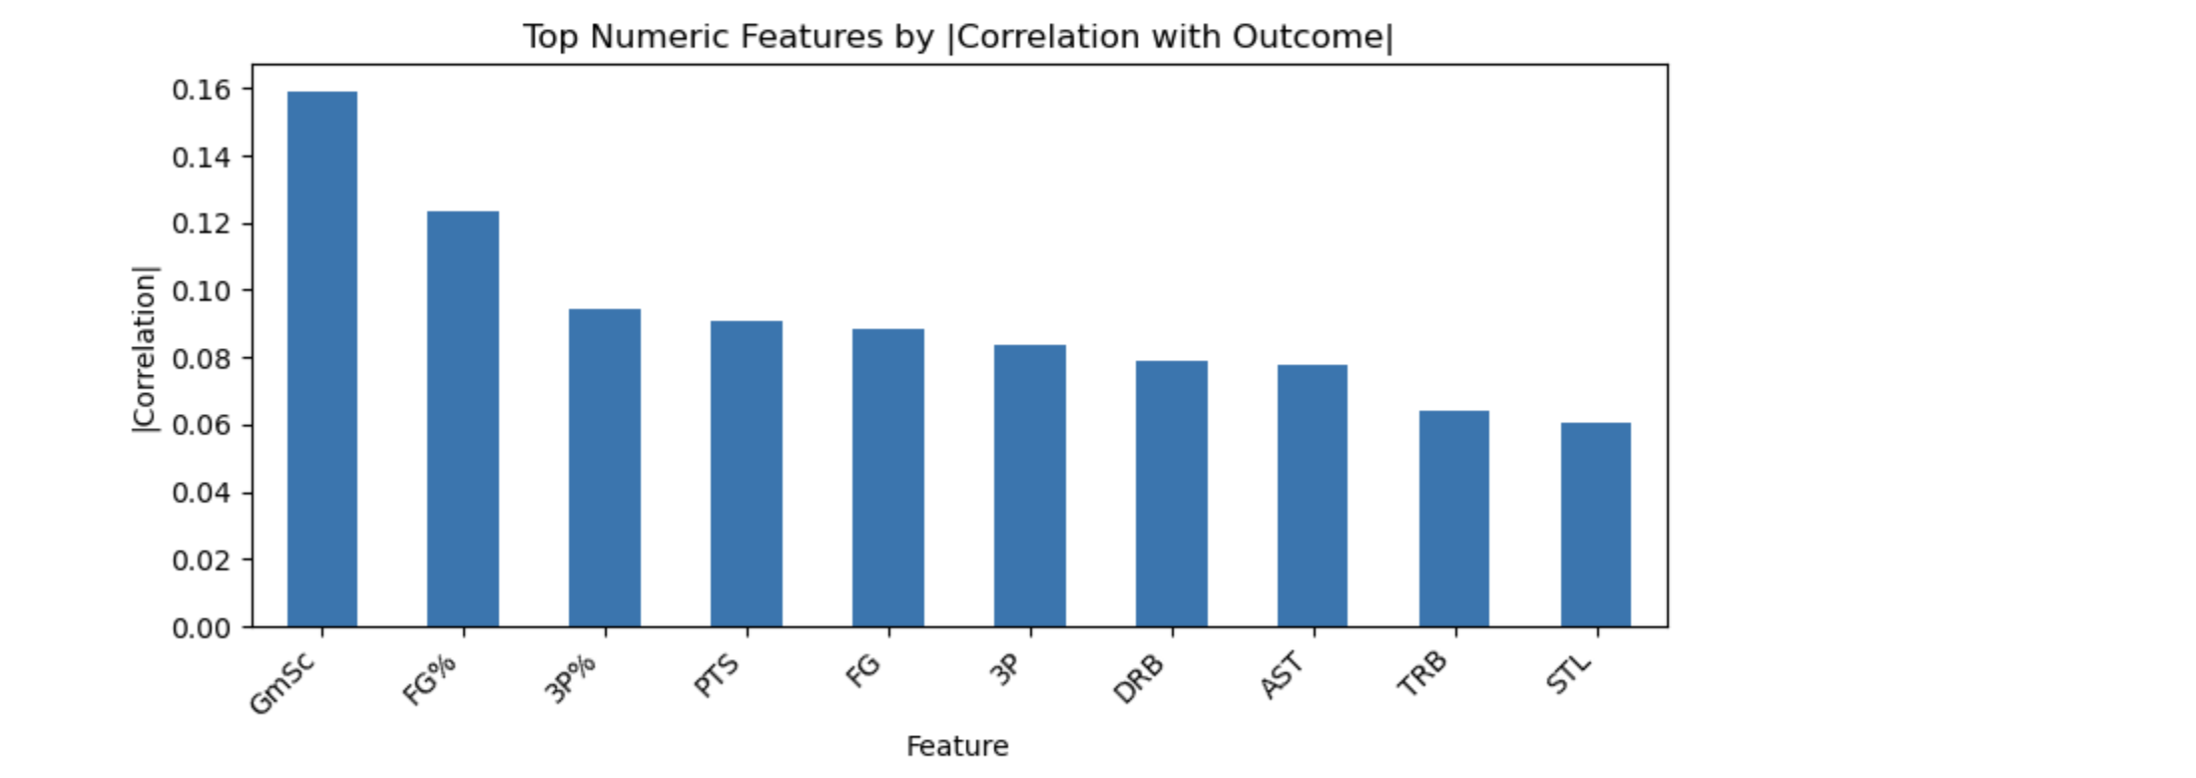
Correlation with Winning Percentage
Top variables:
GmSc ≈ 0.16
FG% ≈ 0.12
3P% ≈ 0.09
Game Score (GmSc) shows the strongest positive correlation with team success (~0.16)
Shooting efficiency metrics such as FG% and 3P% are also positively associated with winning
Other variables like assists and rebounds show weaker but still positive relationships

Slide 6
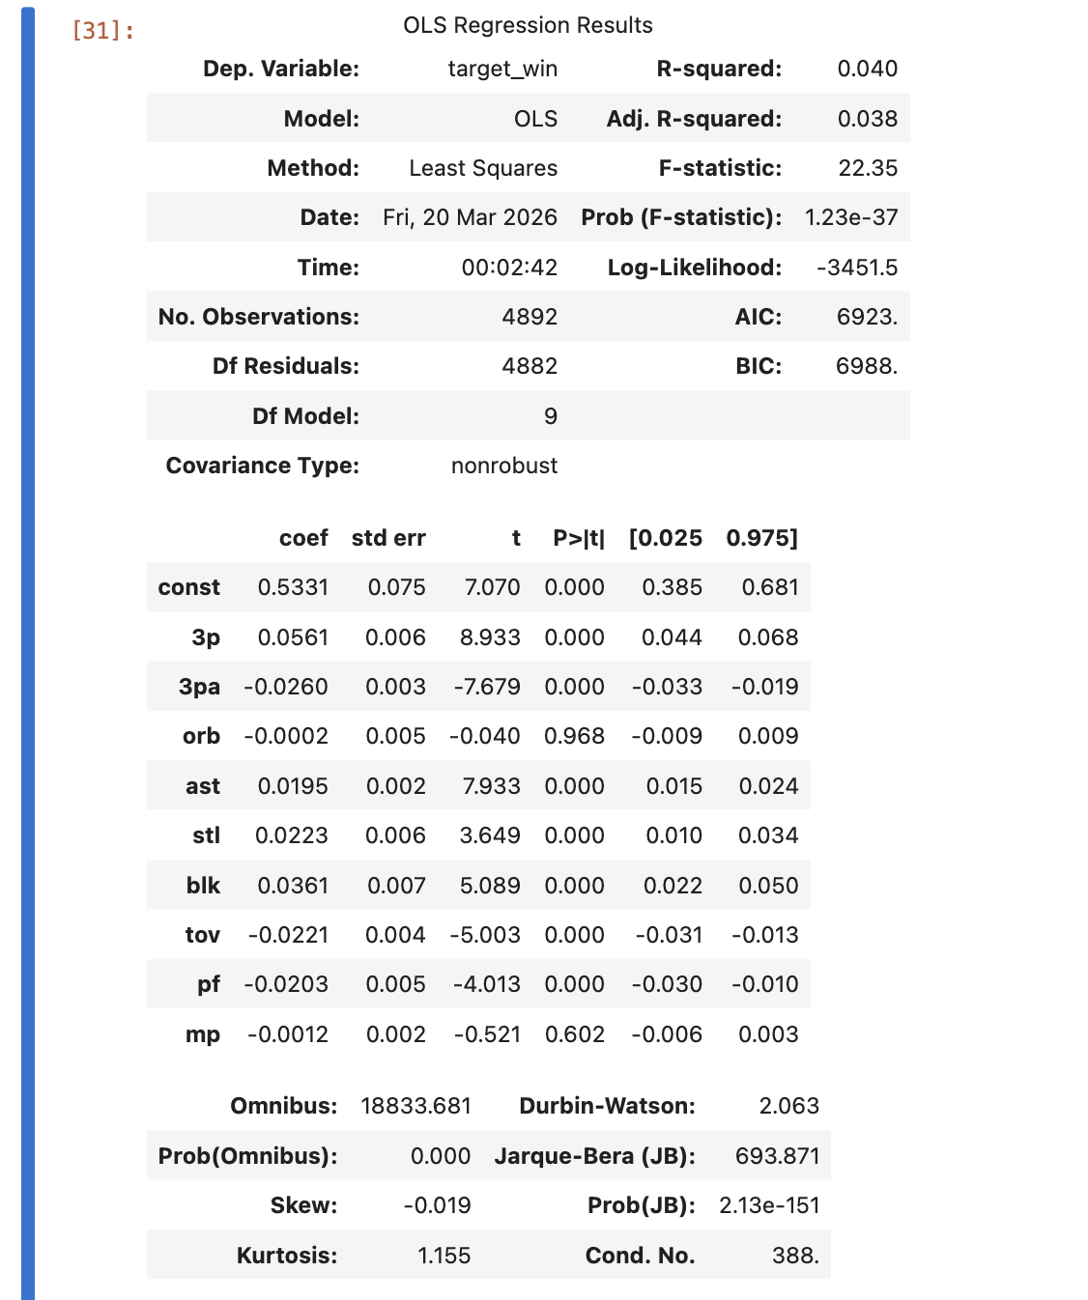
Regression Results
Shooting efficiency variables are statistically significant predictors of winning
Turnovers have a negative and significant impact
Rebounds have a smaller or less consistent effect
The model explains 4.0% of variation in team success (R² = 0.04)
Three-point shots made (3P) and assists (AST) have a positive and significant impact on winning
Turnovers (TOV) and personal fouls (PF) have a negative and significant effect
Attempting more three-pointers (3PA) is negatively associated with winning
Some variables, such as offensive rebounds (ORB) and minutes played (MP), are not statistically significant

Slide 7
Comparing Performance Factors
Shooting Performance (3P, 3PA):
3P has a positive impact on winning (coef = +0.056, p < 0.001)
3PA has a negative impact (coef = -0.026, p < 0.001)
Efficient scoring matters more than shot volume
Turnovers (TOV):
Negative impact on winning (coef = -0.022, p < 0.001)
Teams with fewer turnovers perform better
Statistically significant predictor
Rebounds (ORB):
No meaningful impact (coef = -0.0002, p = 0.968)
Not statistically significant
Weak predictor of team success

Slide 8
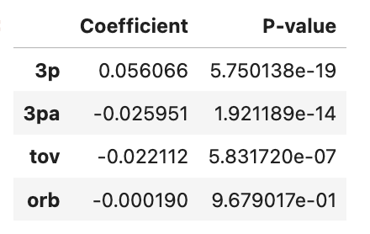
Key Insights
Shooting performance is a key driver of team success
(3P coef = +0.056, p < 0.001; 3PA coef = -0.026, p < 0.001)
Turnovers significantly reduce winning probability
(TOV coef = -0.022, p < 0.001)
Rebounds have little impact on team success
(ORB coef = -0.0002, p = 0.968)
Offensive efficiency is more important than shot volume
(3P positive vs. 3PA negative relationship)

Slide 9
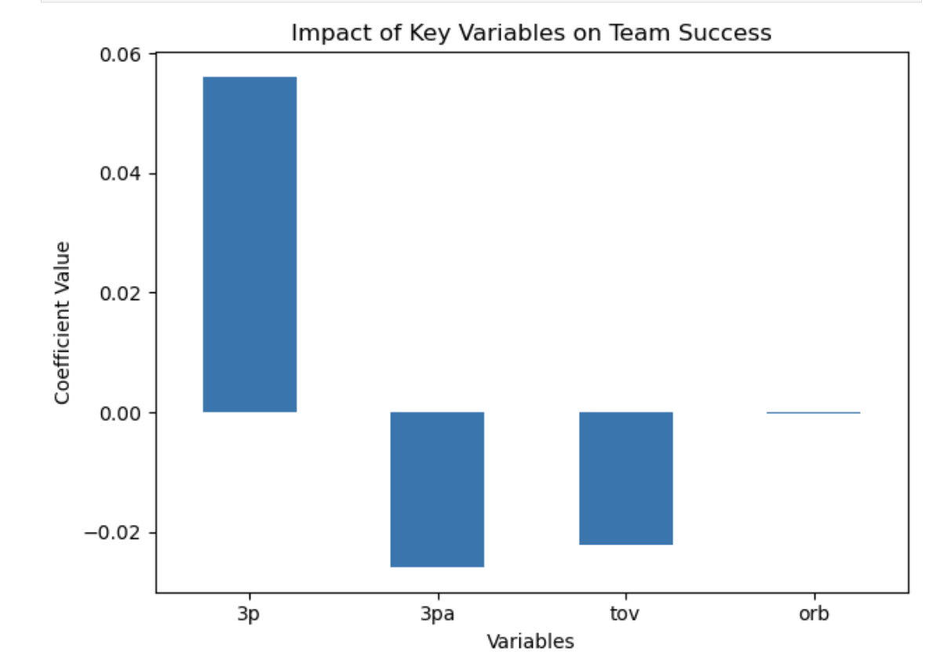
Recommendations
Prioritize efficient scoring strategies, especially improving shot selection
Focus on reducing turnovers through better decision-making and ball control
Avoid over-reliance on shot volume without efficiency
Use data analytics to optimize offensive strategies and performance
Focus less on volume stats and more on efficiency metrics

Slide 10
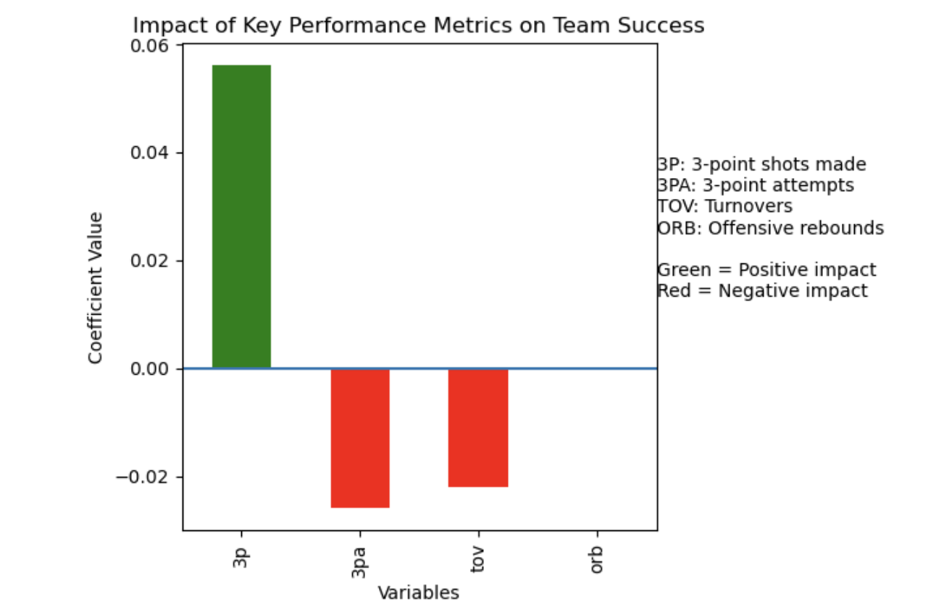
Conclusion
Shooting efficiency metrics are the strongest predictors of team success in the NBA. While turnovers negatively impact performance and rebounds provide some value, efficient scoring remains the most important factor for winning games.
These results highlight that modern basketball success is driven more by efficiency and decision-making than by volume-based statistics.

