Slide 1
Lock Violation for Fault-tolerant Distributed Database System
Hua Guo
School of Information
Renmin University of China
Xuan Zhou
Shanghai Engineering Research Center of Big Data Management
East China Normal University
Le Cai
Alibaba Group

Slide 2
Geo-Replicated Distributed Database(GDDB)
2-layers architecture
Sharding for scalability
Geo-replication for availability

Slide 3
GDDP use 2PL and 2PC
Locking Concurrency Control(2PL)
Atomic Commit(2PC)
Many chatty message round trips
2PC and Consensus amplify lock duration
LAN RTT << WAN RTT
LAN 0.1~0.2 ms
WAN 30~200 ms

Slide 4
Our Goal
Shorten critical path
Increase concurrency when encounter lock conflict
Both performance and correctness

Slide 5
Idea, Consolidate lock wait

Slide 6
Related Work
Existing Work:
Controlled Lock Violation (Goetz Graefe et al.)
Our Work:
Extend CLV to distributed and geo-replication
Distributed Lock Violation(DLV) for GDDB
Find a proper violation time
Adapt to deadlock handling technique
Evaluation performance

Slide 7
DLV Correctness Criteria
Recoverability
Serializability
Not necessarily be strict
Not Strict But Correct Example：

Slide 8
DLV Design
Violation Timing
Dependency Tracing
Register and Report Dependency
In memory dependency maintenance
Cascade Abort
Combine with deadlock handling
Append only storage, easy to recovery

Slide 9
When to enable violation
DLV0:
violation can be any time
DLV1:
first phase of 2PC
finishing local data accessing
DLV2:
the second phase of 2PC
DLV1x:
after test global serializability
preventing possible abort
We call that:
DLV0, DLV1 early violation
DLV2, DLV1x late violation

Slide 10
Dependency Tracing, Register
Each RM maintains:
in-dependency count in
records the number of transactions it depends on that RM.
out-dependency set out
records all the transactions have a dependency on that RM.
RM {
in integer
out set<>
}
When a transaction T violates another transaction S ’s lock,
register the commit dependency
adding T to the corresponding out set of S
and incrementing the corresponding in of T by one.
T = {in:0, out:<>}, S = {in:0, out:<>}
After register dependency, S → T
T = {in:1, out:<>}, S = {in:0, out:<T>}

Slide 11
Dependency Tracing, Report
RM will not prepare commit(1st pahse of 2PC)
if its in dependency count is greater than 0
Not all dependencies(rw, wr, ww) are necessarily for all violation time.
T = {in:1, out:<>}, S = {in:0, out:<T>}
T cannot commit(or prepare) before S commit
A transaction commit,
It test all transaction in out set and decrease each in
If whose in is 0, then reporting it stop waiting
A transaction aborts,
it notifies all transaction in out set transactions to abort
Cascade abort

Slide 12
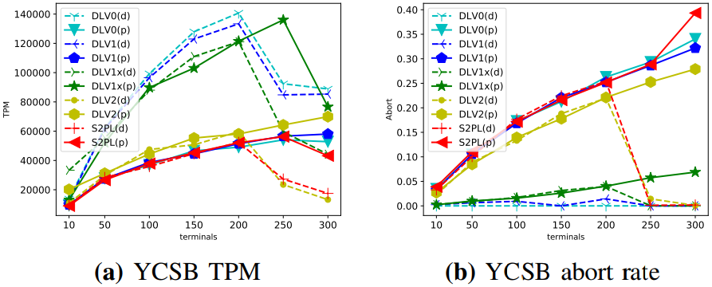
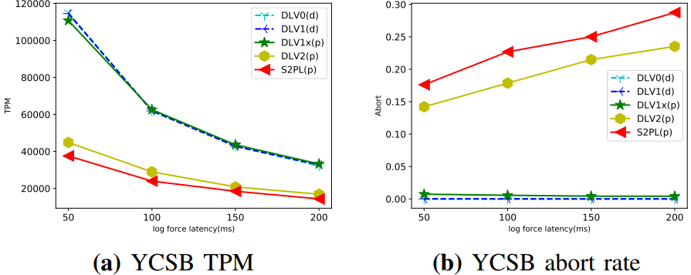
Evaluation, YCSB Workload
YCSB performance when increasing terminal numbers, deadlock detection(d) and deadlock prevention(p) approach.
YCSB workload performance, impact of replication latency

Slide 13
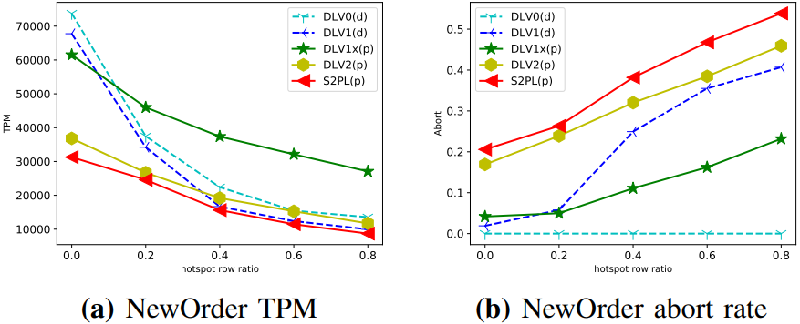
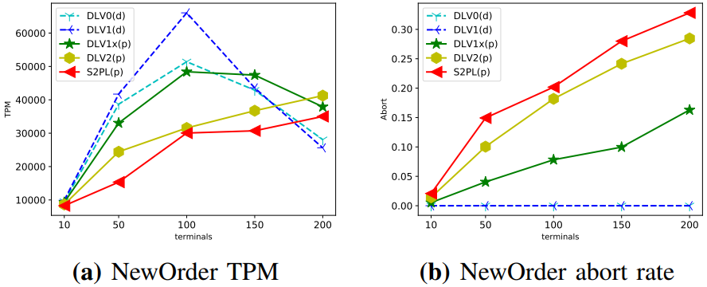
Evaluation, TPC-C Workload
TPC-C workload, impact of contention(Hot Spot)
TPC-C NewOrder performance when increasing terminal numbers

Slide 14
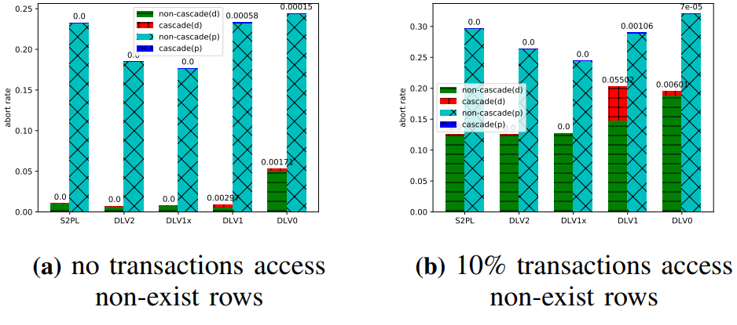
Evaluation, Cascade Abort

Slide 15
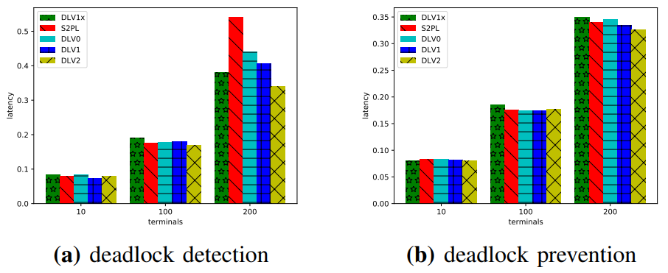
Evaluation, Transaction Latency

Slide 16
Conclusion
Geo-replication could have a big negative impact
The prolonged lock blocking time is a main contributor to the degraded performance.
Lock violation could be an effective measure to shorten the critical path and boost the performance of GDDB.
It is important to find the right time to violate the locks to harness the benefit of lock violation.

Slide 17
Q&A

