Slide 1
Distributed Lock Violation
Many chatty message round trips
Lock duration overlaps message flow
2PC and Consensus amplify lock duration
LAN RTT << WAN RTT
Distributed transaction for ACID
Geo-replication for availability
2-layers architecture+ Locking CC

Slide 2
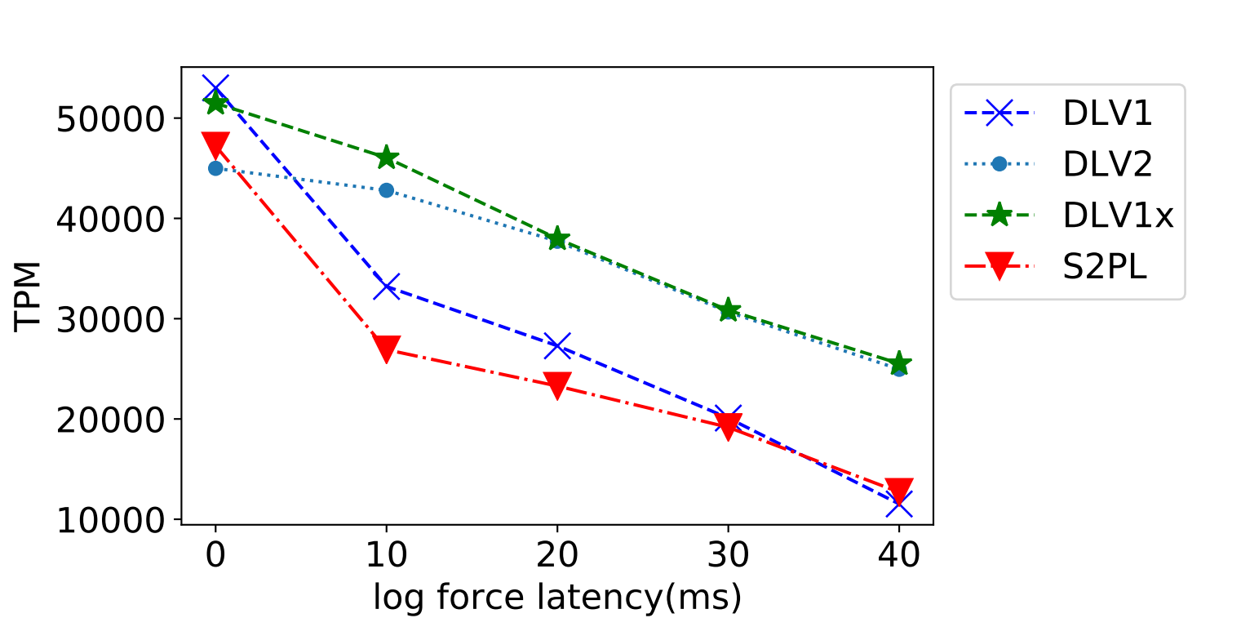
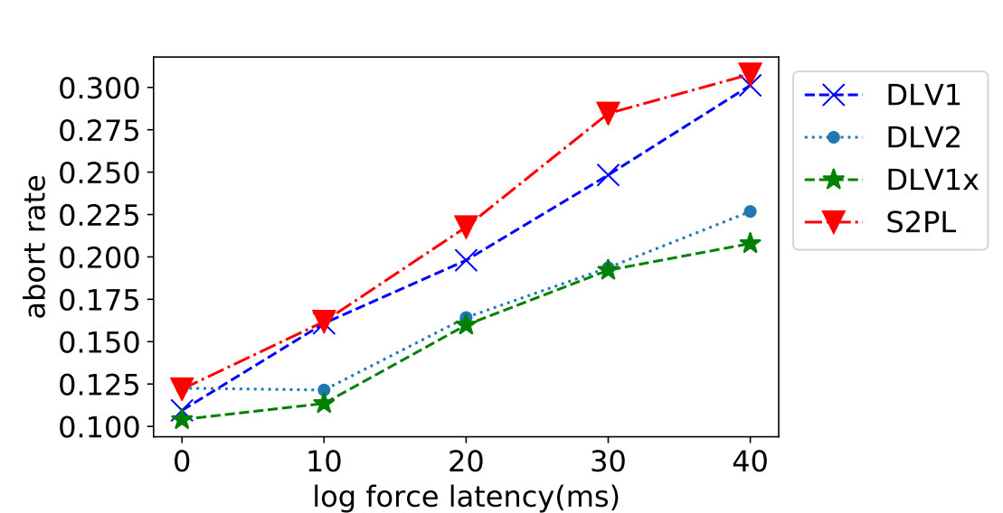
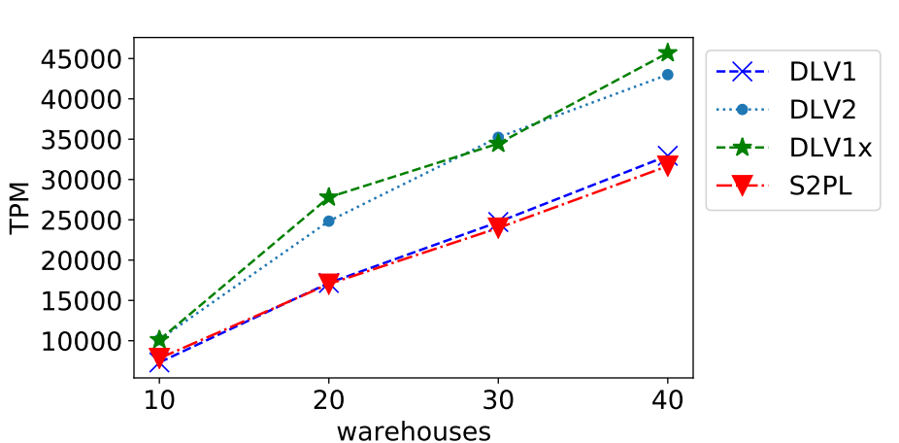
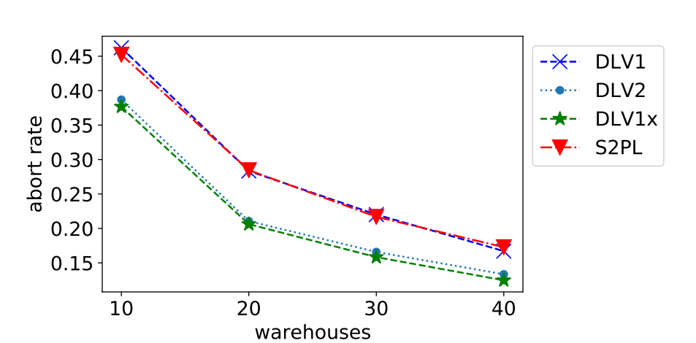
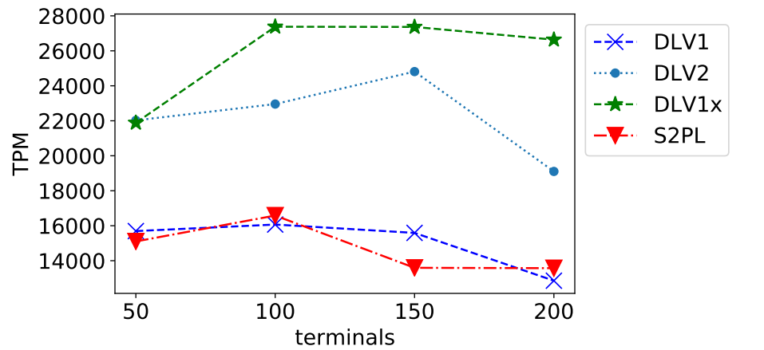
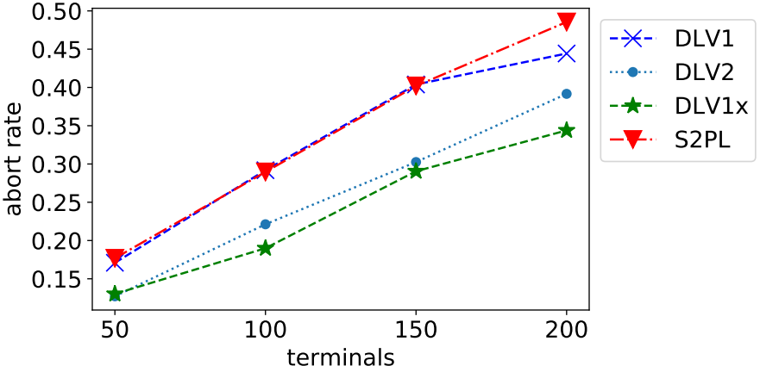
Distributed Lock Violation
Goal:
Exploit speculation
Shorten critical path
Increase concurrency
Both performance and correctness
Evaluation:
4 shards and 3 replicas
Comparation DLV and S2PL
DLV1(violate at 1 phase)
DLV2(violate at 2 phase)
DLV1x(violate after preventing possible abort)
TPCC workload

