Slide 1
Distributed Lock Violation

Slide 2
Geo-Replicated Distributed Database
2-layers architecture
sharding for scalability
geo-replication for availability

Slide 3
GDDP use 2PL and 2PC
Locking CC(2PL)
Atomic Commit(2PC)
Many chatty message round trips
2PC and Consensus amplify lock duration
LAN RTT << WAN RTT
LAN 0.1~0.2 ms
WAN 30~200 ms

Slide 4
Our Goal
Shorten critical path
Increase concurrency when encounter lock conflict
Both performance and correctness

Slide 5
Related Work
Existing Work:
Controlled Lock Violation (Goetz Graefe et al.)
Our Work:
Extend CLV to distributed and geo-replication
DLV for GDDB
Find a proper violation time
Adapt to deadlock handling technique
Evaluation performance

Slide 6
DLV, Correctness Criteria
Recoverability
Serializability
Not necessarily be strict

Slide 7
DLV, Technique
Consolidate many lock wait with many final wait
Register and Report Dependency
In memory dependency maintenance
Cascade Abort
Append only storage, easy to recovery

Slide 8
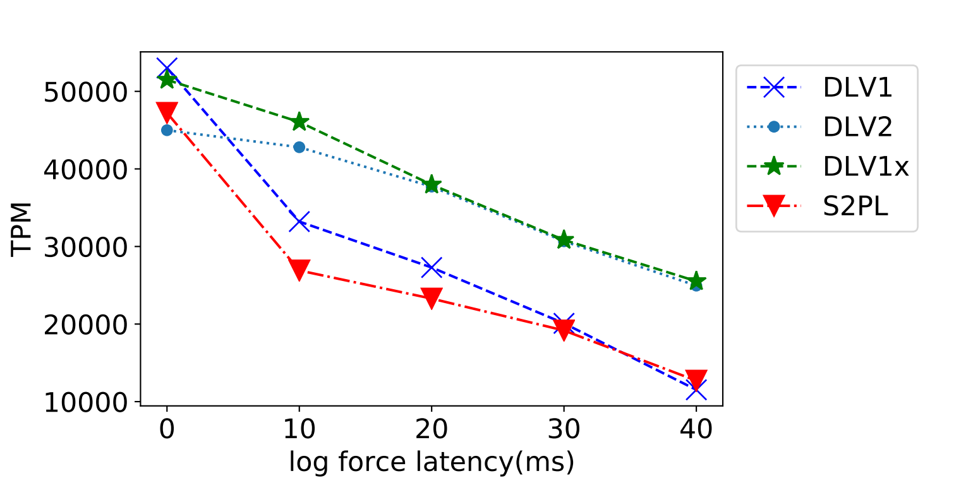
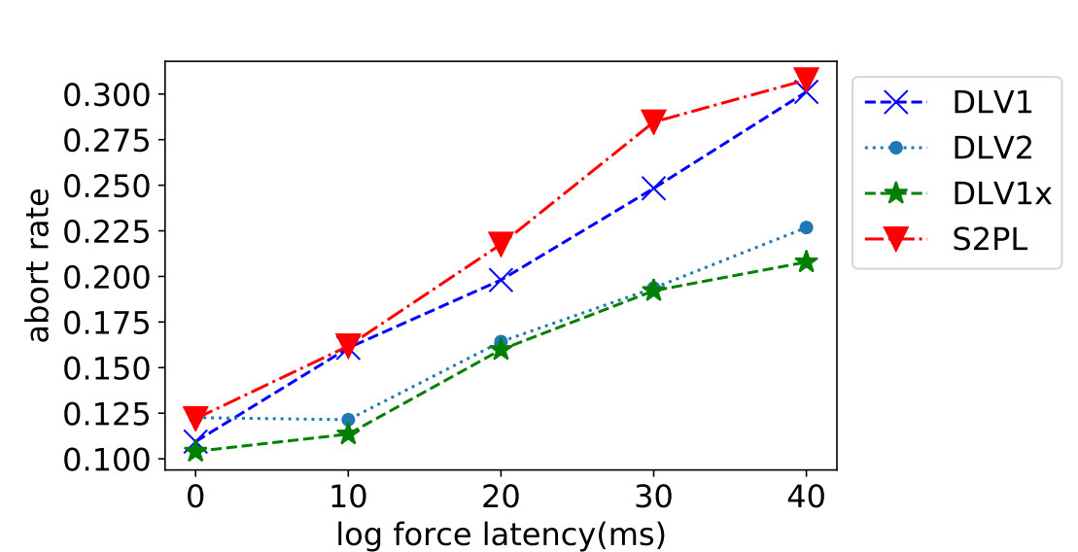
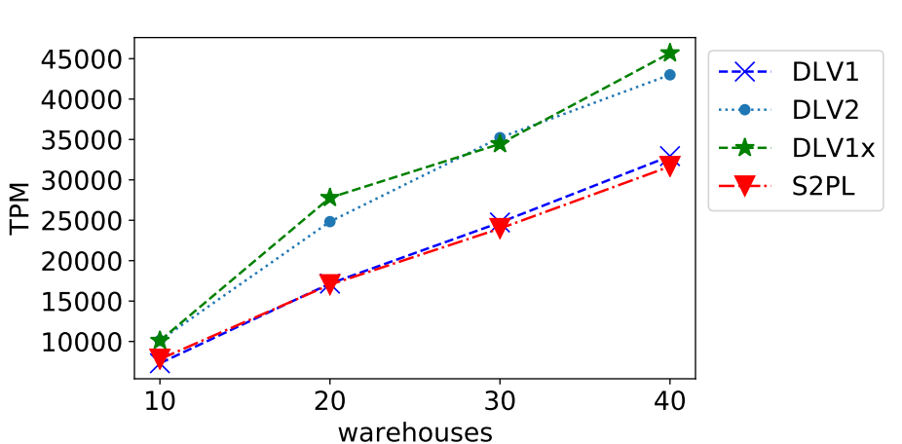
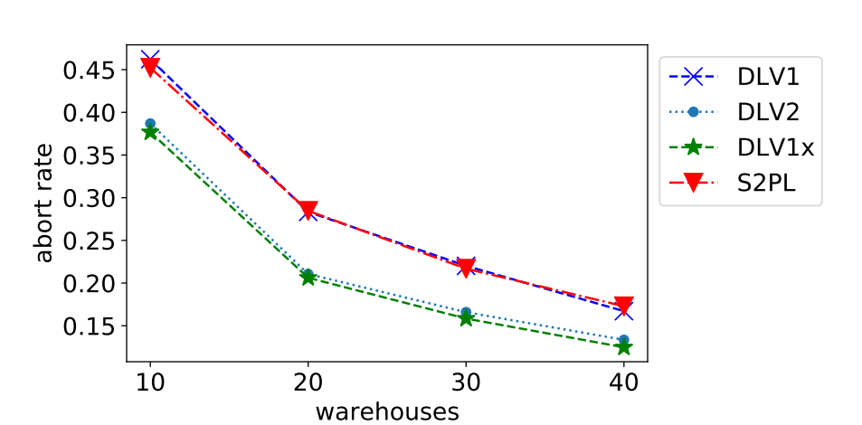
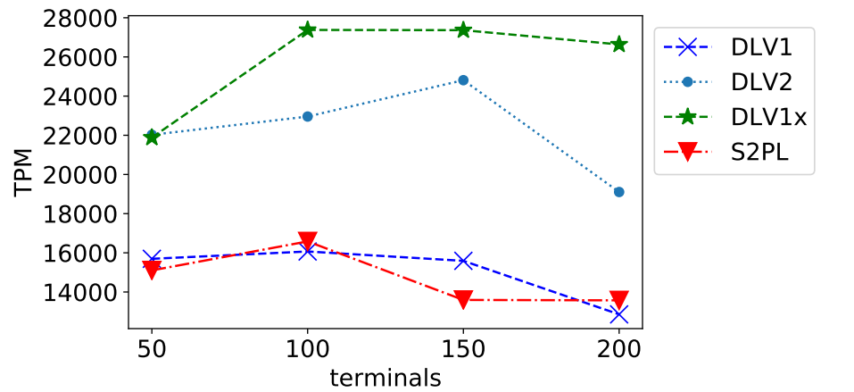
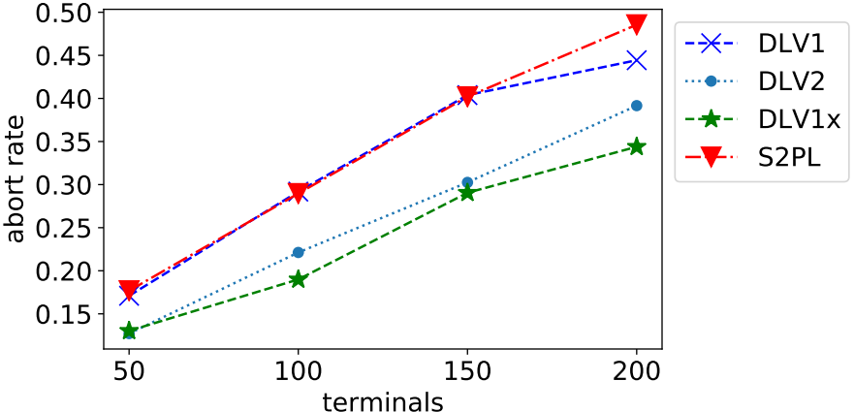
Distributed Lock Violation
Goal:
Exploit speculation
Shorten critical path
Increase concurrency
Both performance and correctness
Evaluation:
4 shards and 3 replicas
Comparation DLV and S2PL
DLV1(violate at 1 phase)
DLV2(violate at 2 phase)
DLV1x(violate after preventing possible abort)
TPCC workload

