Slide 1







<Programmimg Languages>
楊秉宸 Ping-Chen Yang
10-28-2024

Slide 2



OUTLINE
Executive Summary
Introduction
Methodology
Results
Visualization – Charts
Dashboard
Discussion
Findings & Implications
Conclusion
Appendix

Slide 3

EXECUTIVE SUMMARY
Introduction
Methodology
Result
Discussion
Conclusion

Slide 4

INTRODUCTION
Trends of Programming Languages
Trends of Databases
Shows the majority softwares in the future
For people who wants to enroll courses about Programming Languages and Databases

Slide 5

METHODOLOGY
Respondents
PROGRAMMING LANGUAGE TRENDS(Now vs Next year)
DATABASE TRENDS(Now vs Next year)
Multiple DASHBOARDS
Data from respondents in multiple countries

Slide 6
RESULTS
Let’s see the following pages for the results

Slide 7
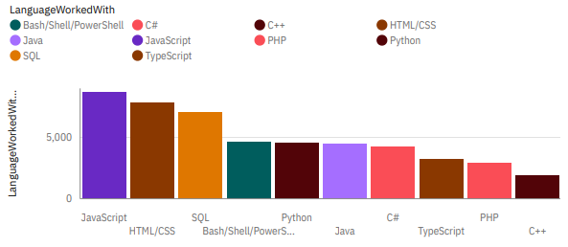
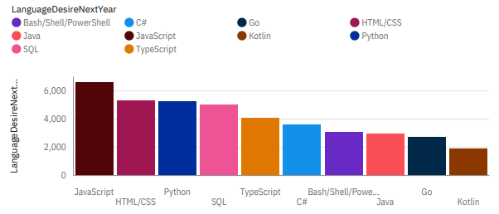
PROGRAMMING LANGUAGE TRENDS
Current Year
Next Year

Slide 8
PROGRAMMING LANGUAGE TRENDS
Findings & Implications
JavaScript & HTML/CSS remains Top 2 of progamming laguages
Python becomes more significant than SQL in the future
New languages grow up(TypeScript, Go, Kotlin…)

Slide 9
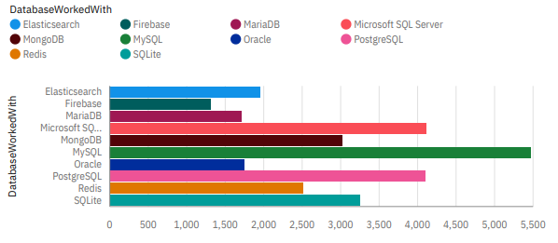
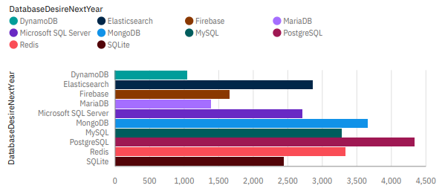
DATABASE TRENDS
Current Year
Next Year

Slide 10
DATABASE TRENDS
Findings & Implications
PostgreSQL goes up to the most used database
Dynamo DB replace Oracle in the Top 10 chart
MySQL decrease a lot in just one year

Slide 11

DASHBOARD
https://github.com/ybc0123/Data-Analysis

Slide 12
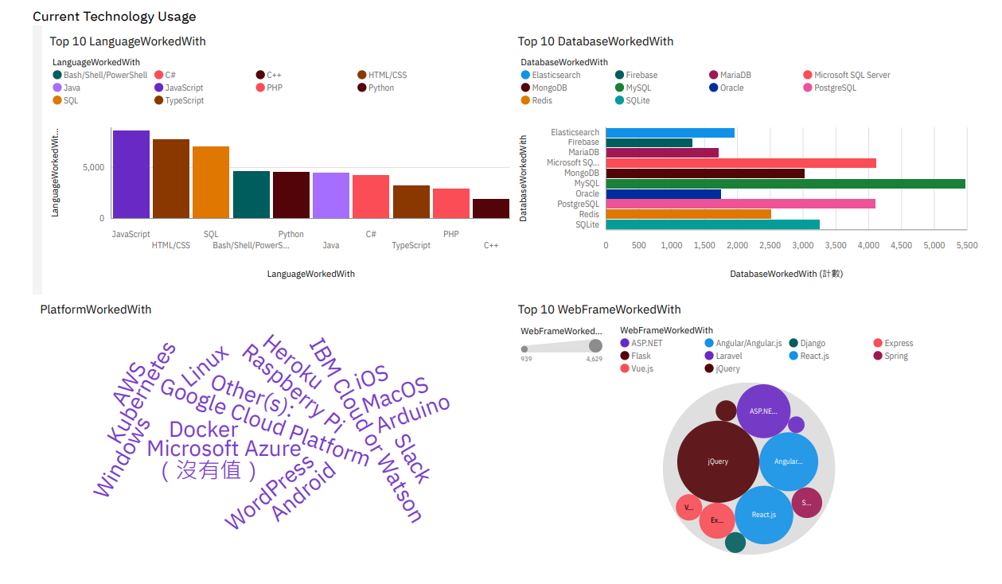
Current Technology Usage

Slide 13
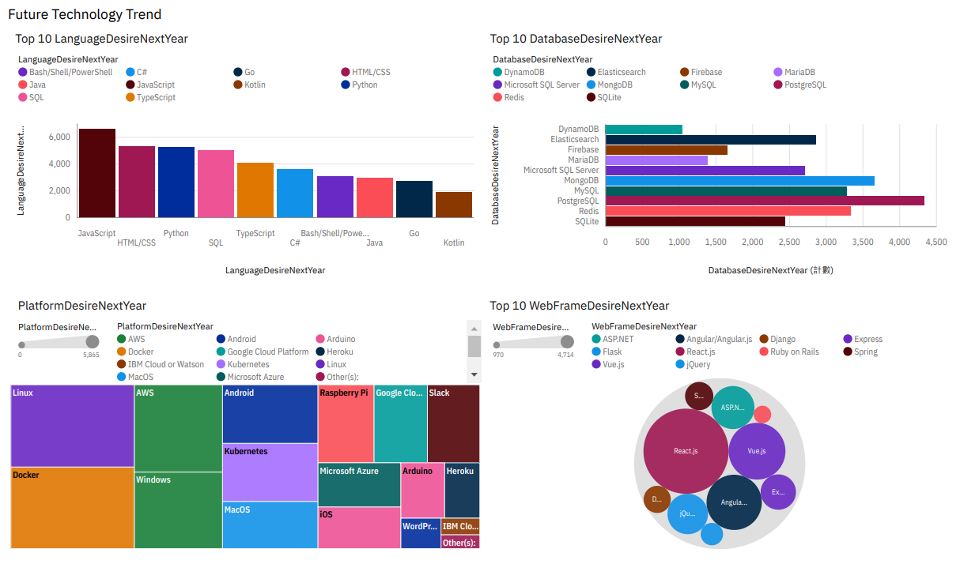
Future Technology Trend

Slide 14
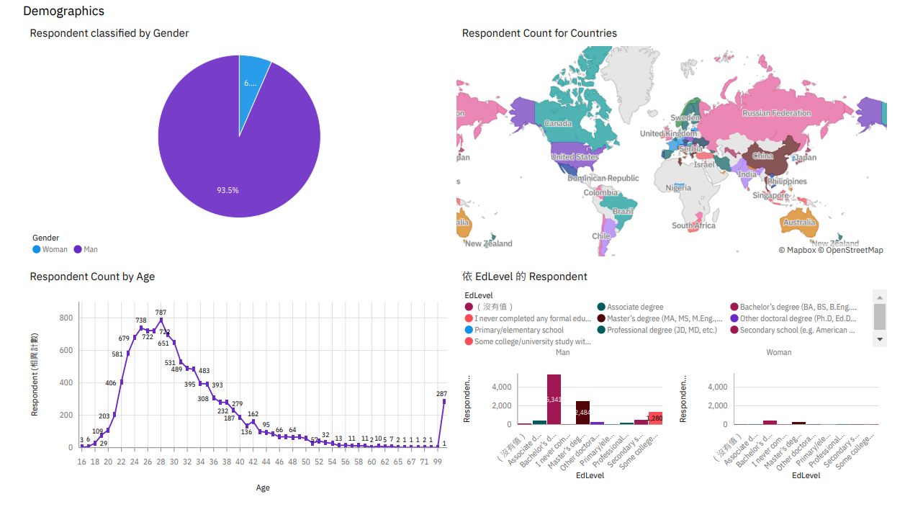
Demographics

Slide 15
DISCUSSION
What we found?

Slide 16
OVERALL FINDINGS & IMPLICATIONS
Findings & Implications
Progamming Languages & Databases become more disperse
Dashboard Demographics shows that men are majority of users
Ages from 24 to 28 are majority of users

Slide 17

CONCLUSION
JavaScript & HTML/CSS are still popular
Python has a potential in Languages
MySQL drop rapidly
Databases have more variety in choice

Slide 18

APPENDIX

Slide 19
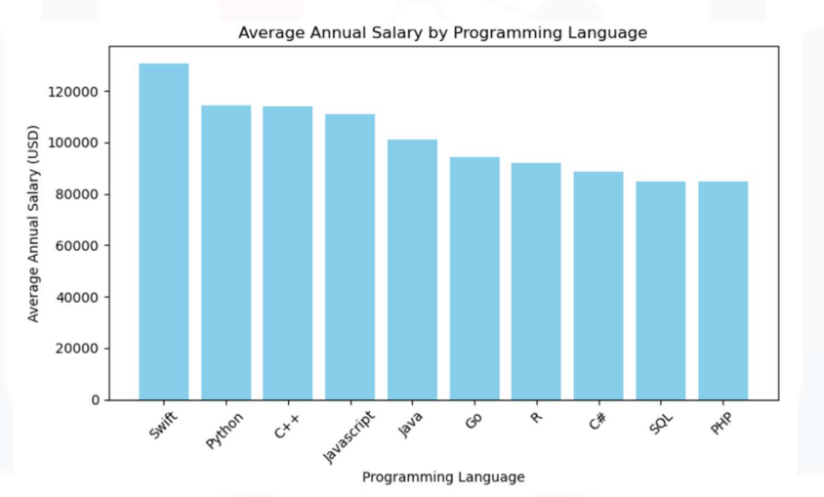
JOB POSTINGS

Slide 20
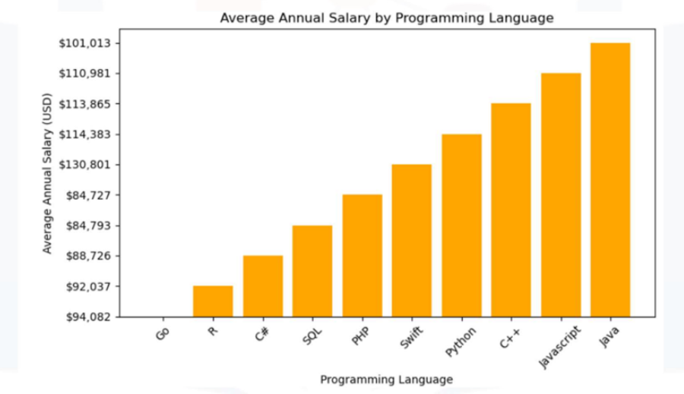
POPULAR LANGUAGES

