Slide 1
Image Similarity
Longin Jan Latecki
CIS Dept. Temple Univ., Philadelphia
latecki@temple.edu

Slide 2
Image Similarity
Image based,
e.g., difference of values of corresponding pixels
Histogram based
Based on similarity of objects contained in images,
requires image segmentation

Slide 3
Mathematical Representation of Images
An image is a 2D signal (light intensity) and can be
represented as a function f (x, y).
coordinates (x, y) represent the spatial location of
point (x, y) that is called pixel (picture element)
value of f (x, y) is the light intensity
called gray value (or gray level) of image f
• Images are of two types: continuous and discrete
A continuous image is a function of two variables,
that take values in a continuum.
E.g.: The intensity of a photographic image recorded on
a film is a 2D function f (x, y) of two real-valued
variables x and y.

Slide 4
• A discrete image is a function of two variables,
that take values over a discrete set (an integer grid)
E.g.: The intensity of a discretized 320 x 240
photographic image is 2D function f (i, j) of
two integer-valued variables i and j.
Thus, f can be represented as a 2D matrix I[320,240]
A color image is usually represented with three matrices:
Red[320,240], Green[320,240], Blue[320,240]

Slide 5
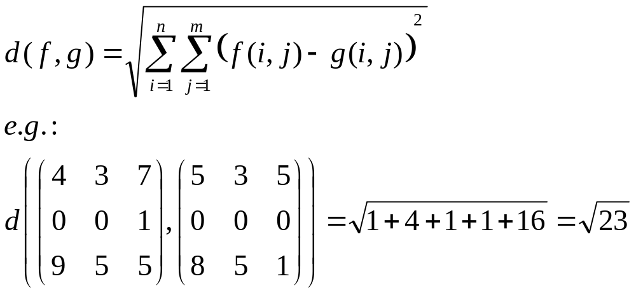
Pixel based image similarity
Let f and g be two gray-value image functions.

Slide 6
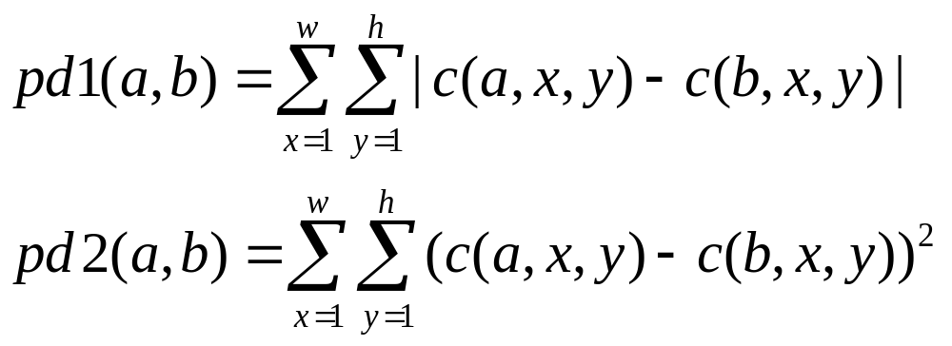
Let a and b bet two images of size w x h.
Let c be some image characteristics that assigns a number
to each image pixels, e.g., c(a,x,y) is the gray value of the pixel.
Pixel to pixel differences:

Slide 7
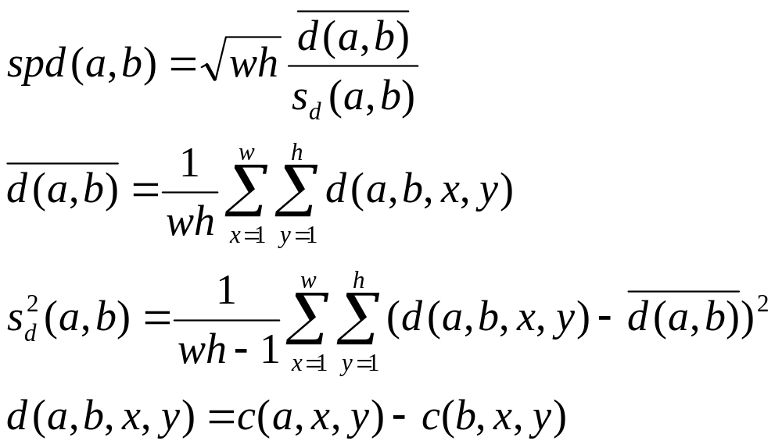
We can use statistical mean and variance to add stability to
pixel to pixel image difference:

Slide 8
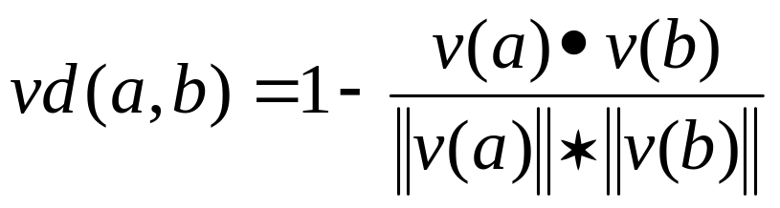
Let v(a) be a vector of all c(a,x,y) values assigned to all pixels
in the image a.
Image similarity can be expressed as normalized inner products
of such vectors. Since it yields maximum values for equal frames,
a possible disparity measure is

Slide 9
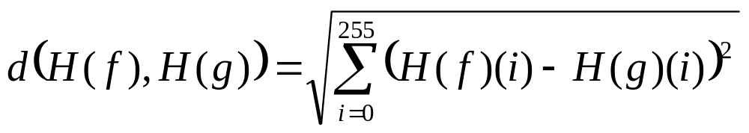
Image histogram is a vector
If f:[1, n]x[1, m] → [0, 255] is a gray value image,
then H(f): [0, 255] → [0, n*m] is its histogram,
where H(f)(k) is the number of pixels (i, j) such that
F(i, j)=k
Similar images have similar histograms
Warning: Different images can have similar histograms

Slide 10
Image Histogram
(3, 8, 5)

Slide 11
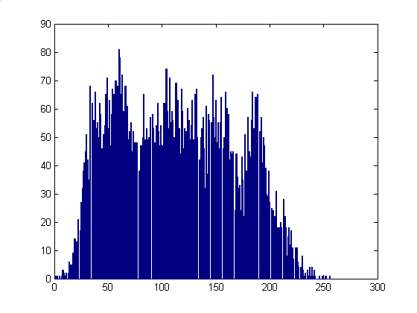

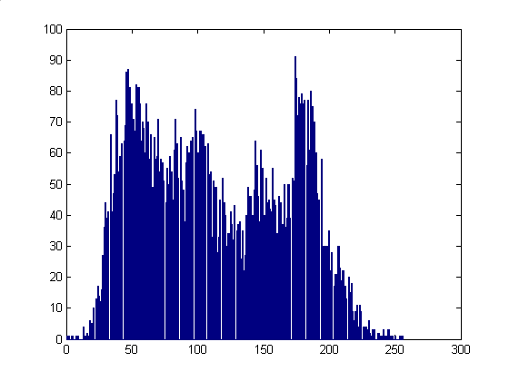
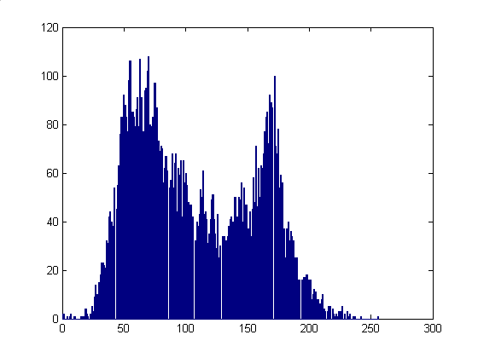
Hr
Hg
Hb

Slide 12
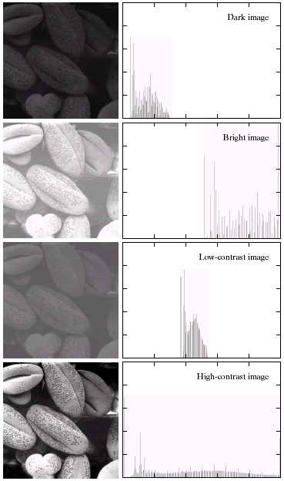
Histograms
Histogram Processing
1
4
5
0
3
1
5
1
Number of Pixels
gray level

Slide 13
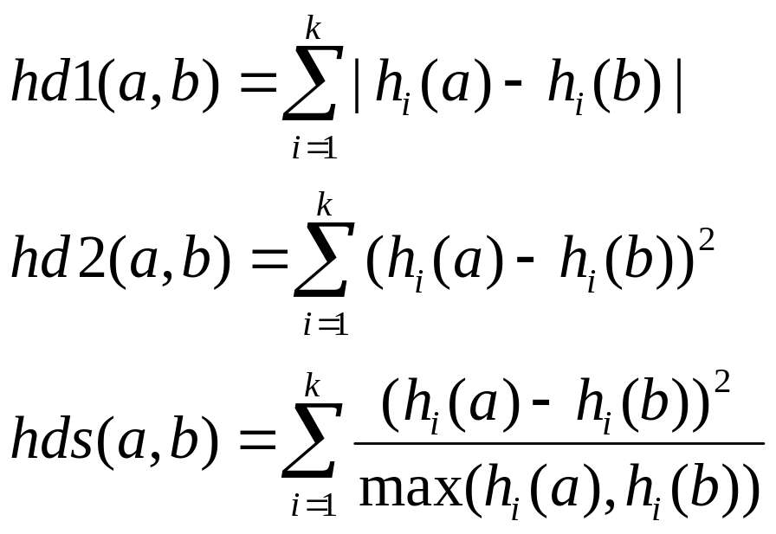
Histogram-based image similarity
Let c be some image characteristics and h(a) its histogram
for image a with k histogram bins.

Slide 14
Homework 5
Implement in Matlab a simple image search engine (no GUI needed).
Simply compare the performance of at least two image distances on a small set of images.

