Slide 1
California Housing and Predictability Models
Eli Lobato
Yannick Befidi
Bryce Jones

Slide 2
The Data
Production averaged less than 80,000 new homes annually over the last 10 years, and ongoing production continues to fall far below the projected need of 180,000 additional homes annually.
Overall homeownership rates are at their lowest since the 1940s.
California is home to 12 percent of the nation’s population, but a disproportionate 22 percent of the nation’s homeless population.
For California’s vulnerable populations, discrimination and inadequate accommodations for people with disabilities are worsening housing cost and affordability challenges.

Slide 3
Our Analysis
Housing prices are appearing to drop over the next 2-3 years
California is looking at a major recession that is preventing many people from getting housing in the state due to the cost of living.
Housing will continue to be fluctuating in value in California
Many people outside of the state are able to get an opportunity to take advantage of the housing decline in California.

Slide 4
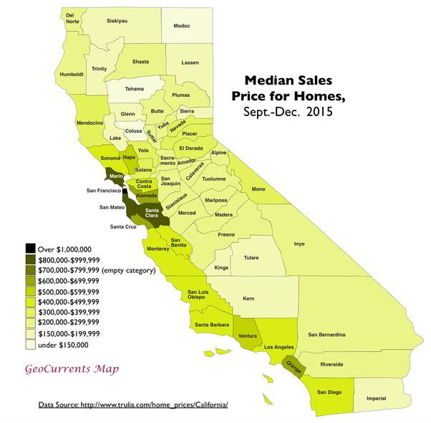
Some Visualizations

Slide 5
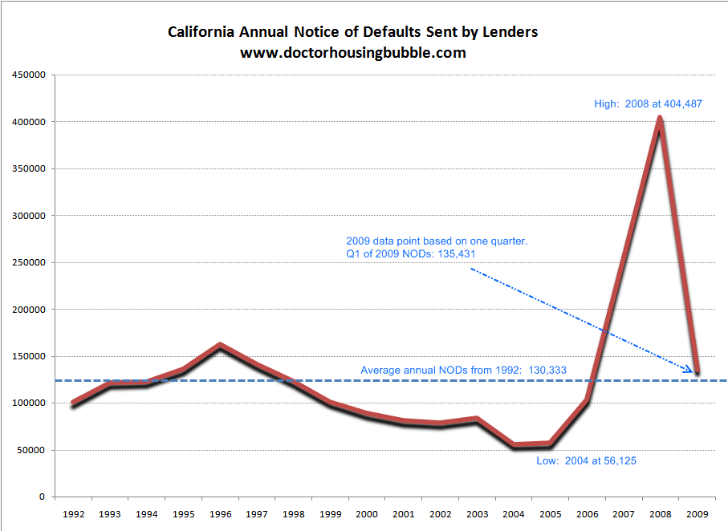
Notice of Defaults in CA

Slide 6
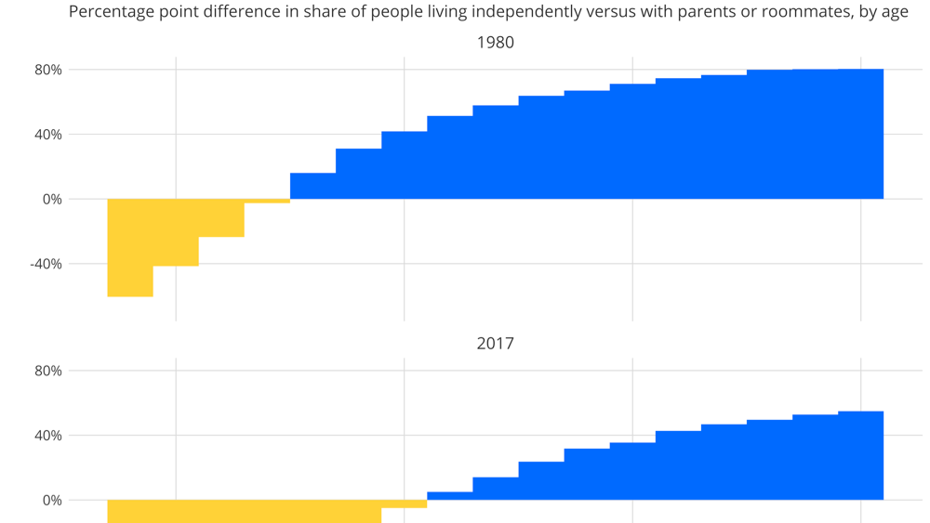

Slide 7
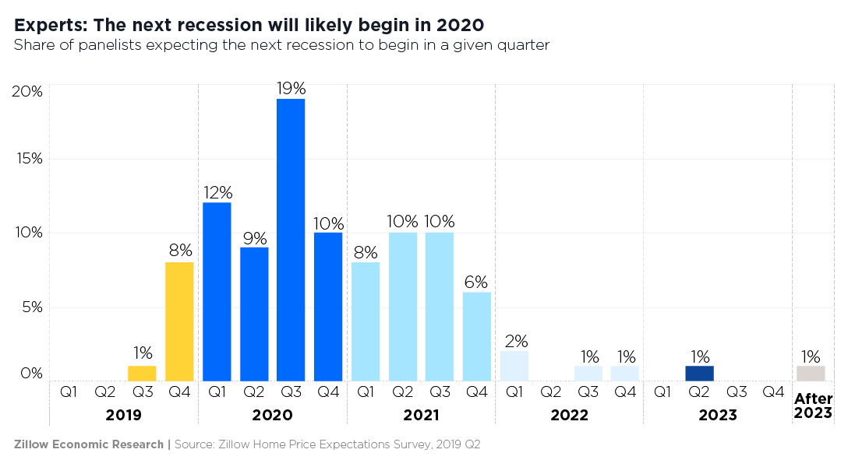
The Future

