Slide 1

Spring Core and Spring Boot
Yulia Bensman, 2023

Slide 2
Goals:
Getting to know Spring and Spring Boot
Why do we want to use it?
How do we use it? – basic features.
Be able to write a REST microservice using Spring, including:
Testing,
Configuration,
Validation,
Error Handling
Hands On…

Slide 3


Who am I?
Name: Yulia Bensman
13 years in AT&T
Mother tongue: C++
Experience in Java and Spring – since 2018
Currently: scrum master at Self-Service Productplace (SSP) at .NET department
Hobbies: Historical Books

Slide 4
What we will learn in the course:
Day 1: Spring and Spring Boot
Inversion of Control and Dependency Injection
Spring Boot
Day 2: Spring Boot for REST Microservice
How to write microservice using Spring Boot
How to test microservice
Exception Handling
Day 3: Spring Boot for REST Microservice (cont.)
Configuration with Spring Boot
Validation in Spring
Additional Spring features

Slide 5
Spring
Spring is an umbrella of projects, that aim to solve and ease common problems in day-to-day development of enterprise applications
Spring Data
Spring Security
Spring Cloud
Spring….
Spring
Spring MVC
Spring Test
Spring Batch
Spring for Kafka

Slide 6
The Spring Framework: History and Motivation
The first version of Spring was written by Rod Johnson in October 2004. Spring Boot 1.0 was released in April 2014.
The purposes of its creation was to make Java server-side development easier and to allow dev teams to more quickly create their applications.
Prior to Spring, Java developers relied on traditional Java EE to create their applications. This led to three main problems:
Developers had to draw on countless configurations.
Developers had to hard-code all the dependencies each component required.
All of Java EE's features were supported, and thus needed to be configured. This led to very bloated code that slowed down applications.
Notes:
JEE – A standard – collection of specifications that define JEE Application Server, Not just Web-server (includes JavaMail, JMS, JavaEESecurity etc.) Tomcat implements the WebServer part but it’s not JEE certified.
JEE implementations – JBoss, WebLogic, WebSphere

Slide 7
Inversion of Control and Dependency Injection
Part 1

Slide 8
Inversion of Control (IoC)
Inversion of Control is a principle which transfers the control of objects or portions of a program to a container or framework.
In traditional (procedural) programming, our custom code makes calls to a library,
In IoC, a framework can take control of the flow of a program and calls to our custom code.
IoC inverts the different kinds of control:
Control Over the Flow of a Program
Control Over the Dependent Object Creation

Slide 9
The Inversion of Control (IoC) - patterns
Note: IoC is a principle, not a pattern. It just gives high-level design guidelines but does not give implementation details. The following patterns (but not limited) implements the IoC principle:
Callbacks
Event loops
Factory pattern
Dependency Injection
Etc.

Slide 10
Purposes of IoC:
To focus a module on the task it is designed for
To free modules from assumptions about how other systems do what they do, rely on contracts.
To decouple the execution of a task from its implementation
Greater modularity of a program
Greater ease in testing a program by isolating a component or mocking its dependencies

Slide 11
Lets create a class using traditional OOP programming approach
In traditional OOP programming, upon creation of the object (e.g., Computer), it will also create (new) its dependent classes (e.g., Processor, RAM instances):
public class Computer {
private final Processor processor;
private final RandomAccessMemory randomAccessMemory;
private final GraphicsCard graphicsCard;
private final Coolers coolers;
public Computer() {
processor = new Processor(paramCpu1, paramCpu2);
randomAccessMemory = new RandomAccessMemory(paramRam1, paramRam2, paramRam3);
graphicsCard = new GraphicsCard(paramGDI1, paramGDI2);
coolers = new Coolers(paramCool1);
}
}

Slide 12
What could be the problems with this implementation:
Tight coupling between the Computer and its components:
We must know how to create every component, and what parameters exactly should be used in the constructor.
If I want to create a computer with a new CPU, I should create another class for the Computer.
How will I test my class, how I will inject mocks there?
Poor polymorphism
Leads to implementation-based design.
CPU
Computer
Wheel
Wheel
Wheel
Coolers
GPU
…

Slide 13
IoC with the Factory pattern
class GraphicsCardFactory { public static GraphicsCard getNVidiaGraphicsCard() { return new NVidiaGraphicsCard(); } } public class Computer { private GraphicsCard graphicsCard; public Computer() { this.graphicsCard = GraphicsCardFactory.getNVidiaGraphicsCard(); } }
Now Computer uses the GraphicCardFactory to get an object of graphicCard. Thus, we have inverted the the control of creating an object of a dependent class to the Factory.
But – now the Computer class uses the concrete GraphicCardFactory class. So – we have not achieved fully loosely coupled classes.

Slide 14
Dependency Injection
Dependency Injection (DI) is a design pattern used to implement IoC. It allows the creation and binding of dependent objects outside of a class and provides those objects to the class through different ways.
The injector class injects the service (dependency) to the client (dependent).
Notes:
Note: Dependency injection is one of the SOLID object-oriented principles.

Slide 15
Dependency Injection illustrated
Instead of having the Computer object control its dependencies (new’ed them), let’s supply (inject) them for him!
CPU
Box CPU
CPU
Computer
Factory
RAM
RAM
Box RAM
GPU
Here Factory (the injector) creates an objects of CPU, RAM, GPU etc. and injects them to the Computer class. In this way, the DI pattern separates the responsibility of creating an objects of these classes out of the Computer class.

Slide 16
By using DI, we can rewrite the example without specifying the implementation of the components that we want:
public class Computer {
private final Processor processor;
private final RandomAccessMemory randomAccessMemory;
private final GraphicsCard graphicsCard;
private final Coolers coolers;
public Computer(Processor processor,
RandomAccessMemory randomAccessMemory,
GraphicsCard graphicsCard,
Coolers coolers) {
this.processor = processor;
this.randomAccessMemory = randomAccessMemory;
this.graphicsCard = graphicsCard;
this.coolers = coolers;
}
}

Slide 17
Spring Framework
Part 2

Slide 18
Part 2: Spring Framework
IoC and DI in Spring
Spring Terminology:
Application Context
Spring Beans Configuration
@Autowire
Constructor vs. Field vs. Setter injection

Slide 19
Inversion of Control (IoC) and Dependency Injection (DI) in Spring
The core of the Spring is the IoC (Inversion of Control) Container. It creates the objects, configures and assembles their dependencies, and manages their entire life cycle.
The Container uses Dependency Injection(DI) to manage the components that make up the application. It gets information about the objects from the Java Code and Annotations.

Slide 20
Spring Terminology
Bean – the managed object (instance) by Spring.
Spring manages bean creation\destruction
Spring manages bean dependencies (by injection)
Spring manages bean scope (singleton or prototype)
Container – is the core of Spring. It creates the objects (Beans), configures and assembles their dependencies, manages their entire life cycle.

Slide 21
ApplicationContext
ApplicationContext is the Spring interface representing the IoC container. ApplicationContext holds all beans and manages them.
To obtain a bean from ApplicationContext, use the getBean() function and specify bean ID or interface\class. In case of no ambiguity – Spring will automatically know which bean to extract for you…
ApplicationContext ctx = new AnnotationConfigApplicationContext(
"com.att.course.spring.demo.components");
MyBean bean1 = ctx.getBean(MyBean.class);
MyBean bean2 = ctx.getBean(“MyBean”);

Slide 22
Spring IoC
Application Context
(IoC Container)
Java Code
Bean
F
Bean
A
Bean
B
Bean
C
Bean
G
Bean
H
Bean
E
Bean
D

Slide 23
Spring Beans configuration
An application should provide the bean configuration to the ApplicationContext container. A Spring bean configuration consists of one or more beans definitions.
Spring supports different ways of configuring beans:
@Bean-annotated methods within a @Configuration class
@Component-annotated classes

Slide 24
Beans configuration: @Bean-annotated methods within a @Configuration class
A class annotated with @Configuration indicates that it contains Spring bean configurations.
The @Bean annotation on a method indicates that the method creates a Spring bean.
public class MyComponent {
// the component code
}
@Configuration
public class ComponentsConfig {
@Bean public MyComponent myComponent() { return new MyComponent(); }
}
ApplicationContext ctx = new AnnotationConfigApplicationContext(ComponentsConfig.class); MyComponent comp = ctx.getBean(MyComponent.class);

Slide 25
Beans configuration: @Component-annotated classes
Mark a class by one from the Spring annotations: @Component, @Controller, @Service, and @Repository.
@Controller, @Service and @Repository are special types of @Component annotation.
Spring will automatically detect these classes as beans.
@Component
public class MyComponent {
// the component code
}
ApplicationContext ctx = new AnnotationConfigApplicationContext(
"com.att.course.spring.demo.components"); MyComponent comp = ctx.getBean(MyComponent.class);

Slide 26
@Bean vs @Component
@Component is a class-level annotation used to auto-detect and auto-configure beans using classpath scanning. There's an implicit one-to-one mapping between the annotated class and the bean (i.e., one bean per class).
@Bean is a method-level annotation, it is used to explicitly declare a single bean. You can use it, for example, to wire components from 3rd-party libraries (you don't have the source code so you can't annotate its classes with @Component), so automatic configuration is not possible.

Slide 27
Dependency Injection in Spring
Constructor Injection
Field Injection
Setter Injection

Slide 28
Constructor injection
@Component
public class Component1 {
// the Component1 code
}
@Component
public class Component2 {
private Component1 comp1; public Component2(Component1 comp1) { this.comp1 = comp1; }
}

Slide 29
Field injection
@Component
public class Component1 {
// the Component1 code
}
@Component
public class Component2 {
@Autowired private Component1 component1;
public Component2() { }
}

Slide 30
Setter injection
@Component
public class Component1 {
// the Component1 code
}
@Component
public class Component2 {
private Component1 component1;
@Autowired
public void setComponent1(Component1 component1) {
this.component1 = component1;
}
}

Slide 31
Constructor vs Field vs Setter Injection
Why prefer Constructor Injection:
An object must be created with the full and correct state.
The app can define for the object a mock dependency in a unit test.
An object can be specified as immutable (for example, to gain thread safety).
Why prefer Field Injection:
The more readable code; allows focusing on business logic.
When some of the object’s properties could be optional.
Why prefer Setter Injection:
When you need some “smart setter”, for example, for additional validation.
Note: Constructor Injection is the most straightforward and recommended way of dependency injection!

Slide 32
Dependency Injection - @Autowired
Spring @Autowired annotation is used for automatic dependency injection. Using the annotation, we instruct the Spring to inject the bean “auto-magically”. The process of Spring bean injection is called autowiring.
Note: @Autowired is generally used for field and setter injection. It can also be used with a constructor, to denote to Spring that this is the constructor to use for bean creation. But classes with a single constructor can omit the @Autowired annotation.
@Autowired on fields happens AFTER calling the constructor.
@Autowired is by default required and will fail in the case cannot be fulfilled. Change it by adding @Autowired(required = false).

Slide 33
How Spring looks for beans to wire?
There are different ways through which we can autowire a spring bean:
Match by Type
Match by Qualifier
Match by Name
Note: In case more than one bean is found – Spring will fail with the exception

Slide 34
Autowire behaviour: Match by Type
@Configuration
public class ComponentsConfig {
@Bean
public Component getComponent() {
return new Component();
}
}
@Component
public class Component {
// …
}
@Component
public class AnotherComponent {
private Component comp;
AnotherComponent(Component comp) {
this.comp = comp;
}
}

Slide 35
Autowire behaviour: Match by Qualifier
public class MyComponent extends BaseComponent { // some code
}
@Configuration
public class ComponentConfig {
@Bean(“component1”)
public BaseComponent component1() {
return new Component(param1);
}
@Bean(”component2”)
public BaseComponent component2() {
return new Component(param2);
}
}
@Component
public class AnotherComponent {
private BaseComponent comp1;
private BaseComponent comp2;
AnotherComponent(
@Qualifier(“component1”) comp1,
@Qualifier(“component2”) comp2) {
this.comp1 = comp1;
this.comp2 = comp2;
}
}

Slide 36
Autowire behaviour: Match by Name
public class MyComponent extends BaseComponent {
}
@Configuration
public class ComponentsConfig {
@Bean(“myComponent”)
public BaseComponent getMyComponent() {
return new MyComponent();
}
}
@Component(“myComponent”)
public class MyComponent extends BaseComponent {
// some code
}
@Component
public class AnotherComponent {
private BaseComponent baseComponent;
AnotherComponent(BaseComponent myComponent) {
this.baseComponent = myComponent;
}
}

Slide 37
DEMO – Dependency Injection in Spring (Computer bean)

Slide 38
Spring Boot
Part 3

Slide 39
Part 3: Spring Boot
The motivation for Spring Boot
What is Spring Boot
Spring Boot Starters
Spring Initializr
Spring Application

Slide 40
How would I like to improve my application?
I would like Spring to automatically scan and register in the application context all my beans, like configurations, controllers, services, and other components I define.
I would like Spring to automatically create and register beans also from the jars that are added to my application. For example, if PostgreSQL is in the application classpath, I would like Spring to auto-configure an in-memory database (unless I defined it otherwise).

Slide 41
Spring Boot is the solution (and for plenty of other issues as well)
Use the annotation @ComponentScan to automatically scan and register for all beans, defined under the current package and all sub-packages.
Use the annotation @EnableAutoConfiguration to automatically create and register beans also from the jars that are added to my application.
But even better – use the annotation @SpringBootApplication, which enables @ComponentScan, @EnableAutoConfiguration, and @Configuration annotations.
Usually, these annotations are placed with the main application class (that’s why it is generally recommended to locate it in a root package above other classes).

Slide 42
DEMO – Computer in Spring Boot application

Slide 43
What problems Spring Boot solves:
Spring is a huge framework, supporting plenty of solutions.
Just take a look at: https://spring.io/projects
Where do I start? Which way to use?
Multiple setup steps
A lot of effort is required to start a new spring project.
Multiple configuration steps
Multiple build and deploy steps
Capability and flexibility come with a cost – you must specify what exactly you need.
No starting point, no ‘best practice’ pathway
Can we abstract these steps?
We need something simpler, that answers 80% of the cases

Slide 44
How Spring Boot solves them:
Spring Boot is a project that is built on top of the Spring Framework. It provides an easier and faster way to set up, configure, and run applications.
Spring Boot is based on the best practices and covers most of the use cases.
Spring Boot is used for creating a stand-alone Spring-based application that you can just run because it needs minimal Spring configuration:
No need for web servlets, it has Tomcat inside;
Configurations are packed inside;
Just run, and you have a Server on air.
Spring Boot provides opinionated 'starter' POMs to simplify our Maven configuration.
Spring Boot provides production-ready features such as metrics, health checks, and externalized configuration.
Notes:
Spring Boot 1.0 was released in April 2014

Slide 45
Spring Boot (cont.)
Spring Boot uses the ”convention over configuration” software design paradigm, which decreases the developer’s effort. Using Spring Boot, we avoid some of the boilerplate code and configurations required by Spring:
Just follow the convention and get it all for free
“Spring boot makes it easy to create stand-alone production-grade Spring-based Applications that you can ‘just run’.”
(from the Spring official site)

Slide 46
Spring Boot Starters
Spring Boot starters are built-in Spring dependency descriptors that make development easier and rapid.
Owing to the starters, a developer should not look for all frameworks that should be added to the application: just add the dependency to the starter in your pom.xml.
When starting the application, the starter will load all the relevant JARs (for example, if you entered to the pom.xml dependency to spring-boot-starter-web, the Spring would load all jar required for creating RESTful service).
<dependency>
<groupId>org.springframework.boot</groupId>
<artifactId>spring-boot-starter-web</artifactId>
</dependency>

Slide 47
Spring Boot Starters (cont.)
Spring Boot provides around 50+ starters, for various tasks and technologies. The official starters follow a naming convention spring-boot-starter-*, where * denotes application type.
For example: spring-boot-starter-test, spring-boot-starter-data-jpa, spring-boot-starter-actuator, spring-boot-starter-security, and so on.
https://docs.spring.io/spring-boot/docs/2.0.x/reference/html/using-boot-build-systems.html#using-boot-starter

Slide 48
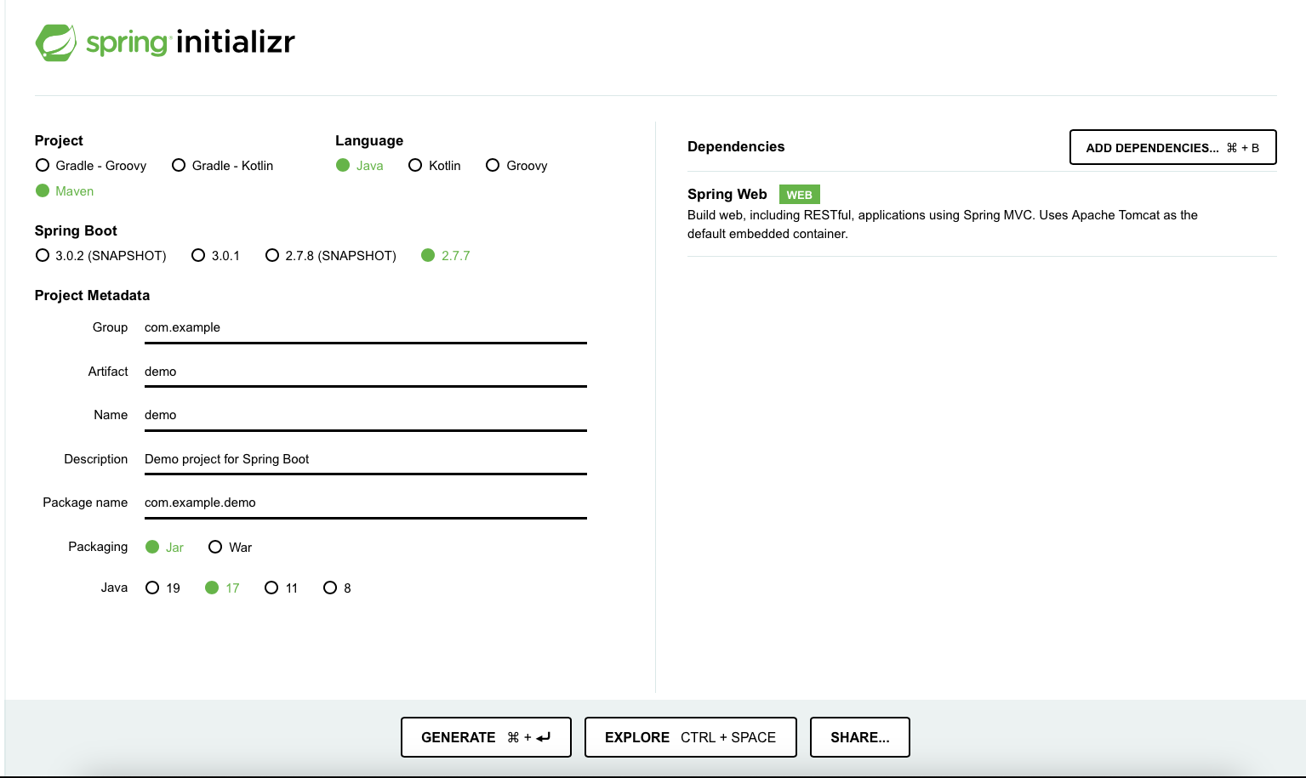
Initializing a Spring Boot application with Spring Initializr
Usually, Spring Boot applications are created using Spring Initializr site: just fill in your project details, pick your options, and download a bundled-up project as a zip file.
https://start.spring.io

Slide 49
Initializing a Spring Boot application: @SpringBootApplication
From SpringApplication.run, the application will create the application context, that contains all the required Beans. In the case of Web starter, it will also create an instance of Tomcat web server.
All Spring Boot application classes look like:
@SpringBootApplication public class DemoApplication { public static void main(String[] args) { SpringApplication.run(DemoApplication.class, args); } }

Slide 50
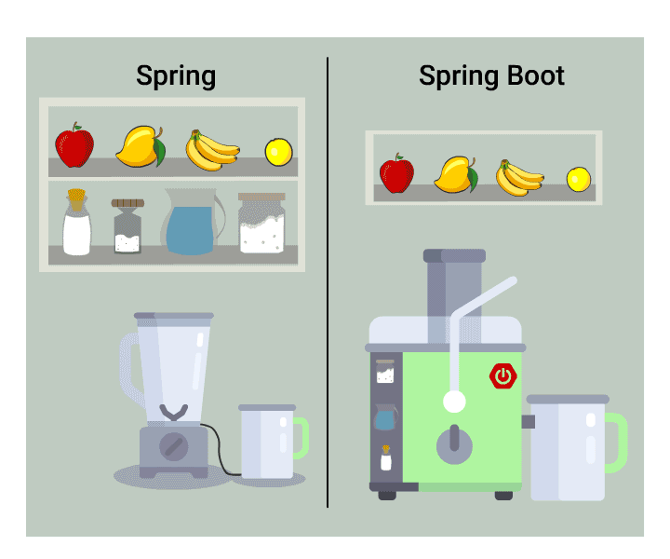
Spring vs. Spring Boot

Slide 51
Hands-on
Download from GIT the SpringDemo application
https://github.com/ybensman/SpringDemo
Enter the following changes to the application (ensure that it is compiled and running after every step):
Create classes for Keyboard, Mouse, and AmdCentralProcessingUnit. Define them as beans.
Add Keyboard and Mouse to Computer.
Change the bean Computer to work with AmdCentralProcessingUnit.

