Slide 1

Spring Core and Spring Boot
Yulia Bensman, 2023

Slide 2
What we will learn in the course:
Spring and Spring Boot
Inversion of Control and Dependency Injection: theory and how Spring does it
Spring Boot – why we need it, using Spring Boot Starters and Spring Initializer.
Spring Boot for REST Microservice
How to write microservice using Spring Boot (cont.)
How to test RestController with @SpringBootTest, MockMvcTest, @MockBean
Exception Handling in Spring
Configuration with Spring Boot
Validation in Spring
Additional Spring features

Slide 3
Spring
Spring is an umbrella of projects, that aim to solve and ease common problems in day-to-day development of enterprise applications
Spring Data
Spring Security
Spring Cloud
Spring….
Spring
Spring MVC
Spring Test
Spring Batch
Spring Mobile

Slide 4
Inversion of Control and Dependency Injection
Part 1

Slide 5
Inversion of Control (IoC) and Dependency Injection (DI)
The technology that Spring is most identified with is the Dependency Injection (DI) flavor of Inversion of Control (IoC).
IoC is a design principle which recommends the inversion of different kinds of controls in object-oriented design to achieve loose coupling between application classes. Here, controls refer to any additional responsibilities a class has, other than its main responsibility. This include control over the flow of an application, and control over the flow of an object creation or dependent object creation and binding.

Slide 6
Lets create a class using traditional OOP programming approach
In traditional OOP programming, upon creation of the object (e.g., Computer), it will also create (new) its dependent classes (e.g., Processor, RAM instances):
public class Computer {
private final Processor processor;
private final RandomAccessMemory randomAccessMemory;
private final GraphicsCard graphicsCard;
private final Coolers coolers;
public Computer() {
processor = new Processor(paramCpu1, paramCpu2);
randomAccessMemory = new RandomAccessMemory(paramRam1, paramRam2, paramRam3);
graphicsCard = new GraphicsCard(paramGDI1, paramGDI2);
coolers = new Coolers(paramCool1);
}
}

Slide 7
What could be the problems with this implementation:
Tight coupling between the Computer and its components:
We must know how to create every component, and what parameters exactly should be used in the constructor.
If I want to create a computer with a new CPU, I should create another class for the Computer.
How will I test my class, how I will inject mocks there?
Poor polymorphism
Leads to implementation-based design.
CPU
Computer
Wheel
Wheel
Wheel
Coolers
GPU
…

Slide 8
The Inversion of Control (IoC) principle inverts the control
Here it means to delegate the control to another class. In other words, invert the dependency creation control from the high-level class (Computer) to another class or framework.
Note: IoC is a principle, not a pattern. It just gives high-level design guidelines but does not give implementation details. The following pattern (but not limited) implements the IoC principle:
Factory
Strategy
Dependency Injection
Etc.

Slide 9
Lets use the Factory pattern
class GraphicsCardFactory { public static GraphicsCard getNVidiaGraphicsCard() { return new NVidiaGraphicsCard(); } } public class Computer { private GraphicsCard graphicsCard; public Computer() { this.graphicsCard = GraphicsCardFactory.getNVidiaGraphicsCard(); } }
Now Computer uses the GraphicCardFactory to get an object of graphicCard. Thus, we have inverted the the control of creating an object of an dependent class to the Factory.
But – now the Computer class uses the concrete GraphicCardFactory class. So – we have not achieved fully loosely coupled classes.
This is where the Dependency Injection pattern helps us.

Slide 10
Dependency Injection explained
Dependency Injection (DI) is a design pattern used to implement IoC. It allows the creation of dependent objects outside of a class and provides those objects to a class through different ways. Using DI, we move the creation and binding of the dependent objects outside of the class that depends on them.
The injector class injects the service (dependency) to the client (dependent).
Dependency injection is one of the SOLID object-oriented principles.

Slide 11
Dependency Injection illustrated
Instead of having the Computer object control its dependencies (new’ed them), let’s supply (inject) them for him!
CPU
Box CPU
CPU
Computer
Factory
RAM
RAM
Box RAM
GPU
Here Factory (the injector) creates an objects of CPU, RAM, GPU etc. and injects them to the Computer class. In this way, the DI pattern separates the responsibility of creating an objects of these classes out of the Computer class.

Slide 12
By using DI, we can rewrite the example without specifying the implementation of the components that we want:
public class Computer {
private final Processor processor;
private final RandomAccessMemory randomAccessMemory;
private final GraphicsCard graphicsCard;
private final Coolers coolers;
public Computer(Processor processor,
RandomAccessMemory randomAccessMemory,
GraphicsCard graphicsCard,
Coolers coolers) {
this.processor = processor;
this.randomAccessMemory = randomAccessMemory;
this.graphicsCard = graphicsCard;
this.coolers = coolers;
}
}

Slide 13
Spring Framework
Part 2

Slide 14
Part 2: Spring Framework
IoC and DI in Spring
Spring Terminology:
Application Context
Spring Beans Configuration
@Autowire
Constructor vs. Field vs. Setter injection

Slide 15
Inversion of Control (IoC) and Dependency Injection (DI) in Spring
The core of the Spring is the IoC (Inversion of Control) Container. It creates the objects, configures and assembles their dependencies, and manages their entire life cycle.
The Container uses Dependency Injection(DI) to manage the components that make up the application. It gets information about the objects from the Java Code and Annotations.

Slide 16
In other words:
Spring is a Container of objects, known as Beans
Spring controls the lifecycle of the managed Beans (creation \ injection \ destruction)
Spring implements dependency injection
Spring controls the scope of the Beans: singletons vs prototype
And the rest of it…

Slide 17
Spring Terminology
Bean – the managed object (instance) by Spring.
Spring manages bean creation\destruction
Spring manages bean dependencies (by injection)
Spring manages bean scope (singleton or prototype)
Container – is the core of Spring. It creates the objects (Beans), configures and assembles their dependencies, manages their entire life cycle.

Slide 18
ApplicationContext
ApplicationContext is the Spring interface representing the IoC container. ApplicationContext holds all beans and manages them.
To obtain a bean from ApplicationContext, use the getBean() function and specify bean ID or interface\class. In case of no ambiguity – Spring will automatically know which bean to extract for you…
AnnotationConfigApplicationContext ctx = new AnnotationConfigApplicationContext(
"com.att.course.spring.demo.components");
MyBean bean1 = ctx.getBean(MyBean.class);
MyBean bean2 = ctx.getBean(“MyBean”);

Slide 19
Spring IoC
Application Context
(IoC Container)
Java Code
Bean
F
Bean
A
Bean
B
Bean
C
Bean
G
Bean
H
Bean
E
Bean
D

Slide 20
Spring Beans configuration
An application should provide the bean configuration to the ApplicationContext container. A Spring bean configuration consists of one or more beans definitions.
Spring supports different ways of configuring beans:
@Bean-annotated methods within a @Configuration class
@Component-annotated classes

Slide 21
Beans configuration: @Bean-annotated methods within a @Configuration class
A class annotated with @Configuration indicates that it contains Spring bean configurations.
The @Bean annotation on a method indicates that the method creates a Spring bean.
public class MyComponent {
// the component code
}
@Configuration
public class ComponentsConfig {
@Bean public MyComponent myComponent() { return new MyComponent(); }
}
AnnotationConfigApplicationContext ctx = new AnnotationConfigApplicationContext(ComponentsConfig.class); MyComponent comp = ctx.getBean(MyComponent.class);

Slide 22
Beans configuration: @Component-annotated classes
Mark a class by one from the Spring annotations: @Component, @Controller, @Service, and @Repository.
@Controller, @Service and @Repository are special types of @Component annotation.
Spring will automatically detect these classes as beans.
@Component
public class MyComponent {
// the component code
}
AnnotationConfigApplicationContext ctx = new AnnotationConfigApplicationContext("com.att.course.spring.demo.components"); MyComponent comp = ctx.getBean(MyComponent.class);

Slide 23
@Bean vs @Component
@Component is a class-level annotation used to auto-detect and auto-configure beans using classpath scanning. There's an implicit one-to-one mapping between the annotated class and the bean (i.e., one bean per class).
@Bean is a method-level annotation, it is used to explicitly declare a single bean. You can use it, for example, to wire components from 3rd-party libraries (you don't have the source code so you can't annotate its classes with @Component), so automatic configuration is not possible.

Slide 24
Dependency Injection in Spring
Constructor Injection
Field Injection
Setter Injection

Slide 25
Constructor injection
@Component
public class Component1 {
// the Component1 code
}
@Component
public class Component2 {
private Component1 comp1; public Component2(Component1 comp1) { this.comp1 = comp1; }
}

Slide 26
Field injection
@Component
public class Component1 {
// the Component1 code
}
@Component
public class Component2 {
@Autowired private Component1 component1;
public Component2() { }
}

Slide 27
Setter injection
@Component
public class Component1 {
// the Component1 code
}
@Component
public class Component2 {
private Component1 component1;
@Autowired
public void setComponent1(Component1 component1) {
this.component1 = component1;
}
}

Slide 28
Constructor vs Field vs Setter Injection
Why prefer Constructor Injection:
An object must be created with the full and correct state.
The app can define for the object a mock dependency in a unit test.
An object can be specified as immutable (for example, to gain thread safety).
Why prefer Field Injection:
The most readable code; allows focusing on business logic.
When some of the object’s properties could be optional.
Why prefer Setter Injection:
When you need some “smart setter”, for example, for additional validation.
Note: Constructor Injection is the most straightforward and recommended way of dependency injection!

Slide 29
Dependency Injection - @Autowired
Spring @Autowired annotation is used for automatic dependency injection. Using the annotation, we instruct the Spring to inject the bean “auto-magically”. The process of Spring bean injection is called autowiring.
Note: @Autowired is generally used for field and setter injection. It can also be used with a constructor, to denote to Spring that this is the constructor to use for bean creation. But classes with a single constructor can omit the @Autowired annotation.
@Autowired on fields happens AFTER calling the constructor.
@Autowired is by default required and will fail in the case cannot be fulfilled. Change it by adding @Autowired(required = false).

Slide 30
How Spring looks for beans to wire?
There are different ways through which we can autowire a spring bean:
Match by Type
Match by Qualifier
Match by Name
Note: In case more than one bean is found – Spring will fail with the exception

Slide 31
Autowire behaviour: Match by Type
@Configuration
public class ComponentsConfig {
@Bean
public Component getComponent() {
return new Component();
}
}
@Component
public class Component {
// …
}
@Component
public class AnotherComponent {
private Component comp;
AnotherComponent(Component comp) {
this.comp = comp;
}
}

Slide 32
Autowire behaviour: Match by Qualifier
@Configuration
public class ComponentConfig {
@Bean
public Component component1() {
return new Component();
}
@Bean
public Component component2() {
return new Component();
}
}
@Component(“component1”)
public class Component {
}
@Component(“component2”)
public class Component {
}
@Component
public class AnotherComponent {
private Component comp1;
private Component comp2;
AnotherComponent(
@Qualifier(“component1”) comp1,
@Qualifier(“component2”) comp2) {
this.comp1 = comp1;
this.comp2 = comp2;
}
}

Slide 33
Autowire behaviour: Match by Name
@Configuration
public class ComponentConfig {
@Bean
public Component component1() {
return new Component();
}
@Bean
public Component component2() {
return new Component();
}
}
@Component(“component1”)
public class Component {
}
@Component(“component2”)
public class Component {
}
@Component
public class AnotherComponent {
private Component comp1;
private Component comp2;
AnotherComponent(
Component component1,
Component component2) {
this.comp1 = component1;
this.comp2 = component2;
}
}

Slide 34
Autowire behaviour: Match by Name (another example)
public class MyComponent extends BaseComponent {
}
@Configuration
public class ComponentsConfig {
@Bean(“myComponent”)
public BaseComponent getMyComponent() {
return new MyComponent();
}
}
@Component(“myComponent”)
public class MyComponent extends BaseComponent {
// some code
}
@Component
public class AnotherComponent {
private BaseComponent baseComponent;
AnotherComponent(BaseComponent myComponent) {
this.baseComponent = myComponent;
}
}

Slide 35
DEMO – Dependency Injection in Spring (Computer bean)

Slide 36
Spring Boot
Part 3

Slide 37
Part 3: Spring Boot
The motivation for Spring Boot
What is Spring Boot
Spring Boot Starters
Spring Initializr
Spring Application

Slide 38
How would I like to improve my application?
I would like Spring to automatically scan and register in the application context all my beans, like configurations, controllers, services, and other components I define.
I would like Spring to automatically create and register beans also from the jars that are added to my application. For example, if PostgreSQL is in the application classpath, I would like Spring to auto-configure an in-memory database (unless I defined it otherwise).

Slide 39
Spring Boot is the solution (and for plenty of other issues as well)
Use the annotation @ComponentScan to automatically scan and register for all beans, defined under the current package and all sub-packages.
Use the annotation @EnableAutoConfiguration to automatically create and register beans also from the jars that are added to my application.
But even better – use the annotation @SpringBootApplication, which enables @ComponentScan, @EnableAutoConfiguration, and @Configuration annotations.
Usually, these annotations are placed with the main application class (that’s why it is generally recommended to locate it in a root package above other classes).

Slide 40
DEMO – Computer in Spring Boot application

Slide 41
What problems Spring Boot solves:
Spring is a huge framework, supporting plenty of solutions.
Just take a look at: https://spring.io/projects
Where do I start? Which way to use?
Multiple setup steps
A lot of effort is required to start a new spring project.
Multiple configuration steps
Multiple build and deploy steps
Capability and flexibility come with a cost – you must specify what exactly you need.
No starting point, no ‘best practice’ pathway
Can we abstract these steps?
We need something simpler, that answers 80% of the cases

Slide 42
How Spring Boot solves them:
Spring Boot is a project that is built on top of the Spring Framework. It provides an easier and faster way to set up, configure, and run applications.
Spring Boot is based on the best practices and covers most of the use cases.
Spring Boot is used for creating a stand-alone Spring-based application that you can just run because it needs minimal Spring configuration:
No need for web servlets, it has Tomcat inside;
Configurations are packed inside;
Just run, and you have a Server on air.
Spring Boot provides opinionated 'starter' POMs to simplify our Maven configuration.
Spring Boot provides production-ready features such as metrics, health checks, and externalized configuration.

Slide 43
Spring Boot (cont.)
Spring Boot uses the ”convention over configuration” software design paradigm, which decreases the developer’s effort. Using Spring Boot, we avoid some of the boilerplate code and configurations required by Spring:
Just follow the convention and get it all for free
“Spring boot makes it easy to create stand-alone production-grade Spring-based Applications that you can ‘just run’.”
(from the Spring official site)

Slide 44
Spring Boot Starters
Spring Boot starters are built-in Spring dependency descriptors that make development easier and rapid.
Owing to the starters, a developer should not look for all frameworks that should be added to the application: just add the dependency to the starter in your pom.xml.
When starting the application, the starter will load all the relevant JARs (for example, if you entered to the pom.xml dependency to spring-boot-starter-web, the Spring would load all jar required for creating RESTful service).
<dependency>
<groupId>org.springframework.boot</groupId>
<artifactId>spring-boot-starter-web</artifactId>
</dependency>

Slide 45
Spring Boot Starters (cont.)
Spring Boot provides around 50+ starters, for various tasks and technologies. The official starters follow a naming convention spring-boot-starter-*, where * denotes application type.
For example: spring-boot-starter-test, spring-boot-starter-data-jpa, spring-boot-starter-actuator, spring-boot-starter-security, and so on.
https://docs.spring.io/spring-boot/docs/2.0.x/reference/html/using-boot-build-systems.html#using-boot-starter

Slide 46
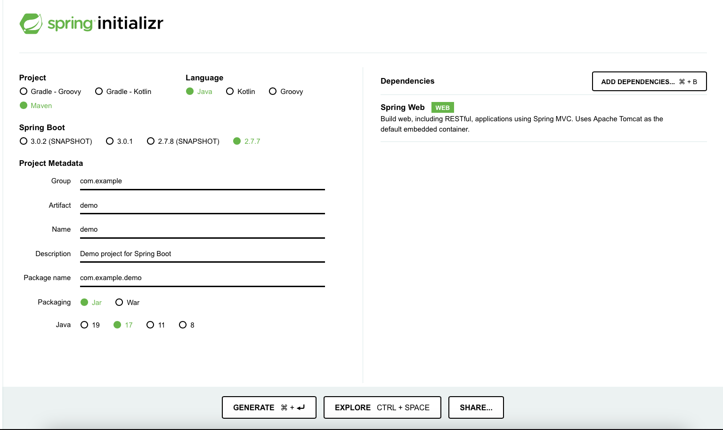
Initializing a Spring Boot application with Spring Initializr
Usually, Spring Boot applications are created using Spring Initializr site: just fill in your project details, pick your options, and download a bundled-up project as a zip file.
https://start.spring.io

Slide 47
Initializing a Spring Boot application: @SpringBootApplication
From SpringApplication.run, the application will create the application context, that contains all the required Beans. In the case of Web starter, it will also create an instance of Tomcat web server.
All Spring Boot application classes look like:
@SpringBootApplication public class DemoApplication { public static void main(String[] args) { SpringApplication.run(DemoApplication.class, args); } }

Slide 48
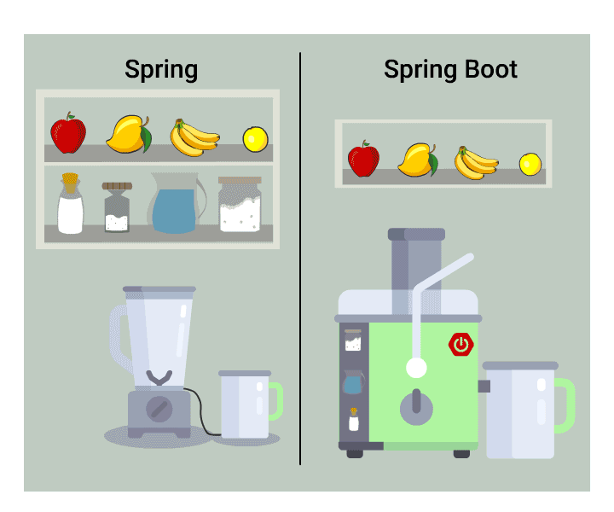
Spring vs. Spring Boot

Slide 49
Hands-on
Download from GIT the SpringDemo application
Create classes for Keyboard, Mouse, and AmdCentralProcessingUnit. Define them as beans.
Add Keyboard and Mouse to Computer.
Create a new bean AmdComputer with AmdCentralProcessingUnit.

Slide 50
Spring – additional features
Part 4

Slide 51
Part 4: Spring – additional features
Beans Scope
Collections
Post Construct, PreDestroy annotations
Lazy Bean Initialization

Slide 52
Beans Scope
Application Context
(container)
…
Xyz xyz = ctx.getBean(“xyz”, Xyz.class)
…
A
Bean
xyz
…
Xyz xyz = ctx.getBean(“xyz”, Xyz.class)
…
B
…
Xyz xyz = ctx.getBean(“xyz”, Xyz.class)
…
C

Slide 53
Beans Scope
Scope of a bean describes how many instances should the container manage
There are 6 types of beans scope. The most popular are:
Singleton (default) – the bean’s instance is created exactly once, and the same instance will be injected and used whenever it is requested
Prototype – whenever an instance of a certain bean is requested – a new instance of it will be created
The last four scopes are only available in a web-aware application:
Request – per Http call
Session – per user session
Application – per servlet context
WebSocket - per web socket connection

Slide 54
Beans Scope: examples
public class Person {
private String name;
// code
}
@Bean
@Scope("singleton")
public Person personSingleton() {
return new Person();
}
@Bean
@Scope("prototype")
public Person personPrototype() {
return new Person();
}

Slide 55
Spring Collections
Spring supports the automatic definition of various collections:
List (concrete class: ArrayList)
Set (concrete class: HashSet)
Map (concrete class: TreeMap)
Properties (concrete class: Properties)

Slide 56
Spring collections: example
@Configuration public class CollectionsConfig { @Bean public List<MyComponent> componentsList() {
return Array.asList(new MyComponent(“1”), new MyComponent(“2”));
}
}
public class ComponentsBean {
@Autowired private List<MyComponent> componentsList;
}

Slide 57
@PostConstruct
Sometimes you may need access to the bean once it is fully created:
Perform some logical validation and assertions
Setup non-spring dependencies based on injectable beans
Verify autowire decisions
How can you know when a bean is passed through the creation process?
In constructor – setters DI have not been set yet
In each setter – you can’t tell what is the status of other status
Solution - add special annotation (@PostConstruct) to any method you wish (JSR-250)

Slide 58
@PreDestroy
Similar to @PostConstruct, @PreDestroy can be added to a function, and it will be called before the bean is going to be destroyed.
Using @PreDestroy, you can supply a graceful shutdown for your bean.

Slide 59
@PostConstruct and @PreDestroy
Spring calls the methods annotated with @PostConstruct only once, just after the initialization of bean properties.
@Component
public class DbInit {
@Autowired
private UserRepository userRepository;
@PostConstruct
private void postConstruct() {
User admin = new User("admin", "admin password");
User normalUser = new User("user", "user password");
userRepository.save(admin, normalUser);
}
}
A method annotated with @PreDestroy runs only once, just before Spring removes our bean from the application context.
@Component
public class UserRepository {
private DbConnection dbConnection;
@PreDestroy
public void preDestroy() {
dbConnection.close();
}
}

Slide 60
Lazy initialization
By default, Spring’s container is created eagerly: it immediately aims to create all beans along with their relationships
Pros:
Fail fast: If there are any problems with wiring – they are discovered immediately when the app comes up
Performance: all beans are up and ready to use during the application lifecycle. No time will be spent for creating a bean as part of the runtime

Slide 61
Lazy initialization
For heavily created beans, and\or ones that are not sure to encounter during the application lifetime, Spring offers lazy bean creation. If the bean is defined as Lazy, Spring will create it only when needed.
Note:
Default is false
In case the bean is needed for another non-lazy bean – it will still be created eagerly…
Prototype beans are lazy by definition…
@Component
@Lazy
public class MyLazyBean {
//…
}
AnnotationConfigApplicationContext ctx = new AnnotationConfigApplicationContext();
MyLazyBean theBean = ctx.getBean(MyLazyBean.class);

Slide 62
Lazy initialization and @Autowired
@Component
@Lazy
public class MyLazyBean {
//…
}
@Component
public class AnotherBean {
@Lazy
@Autowired
private MyLazyBean theLazyBean;
public MyLazyBean getLazyBean() { return theLazyBean; }
}
AnotherBean anotherBean = ctx.getBean(AnotherBean.class);
anotherBean.getLazyBean();

