Slide 1

Spring Boot for Beginners
Lesson 1: Spring Core and Spring Boot
Yulia Bensman, 2024

Slide 2
Goals:
Getting to know Spring and Spring Boot
Why do we want to use it?
How do we use it? – basic features.
Be able to write a REST microservice using Spring, including:
Testing,
Configuration,
Validation,
Error Handling
Hands On…

Slide 3


Who am I?
Name: Yulia Bensman
14 years in AT&T
Mother tongue: C++
Experience in Java and Spring – since 2018
Currently: scrum master at Self-Service Productplace (SSP) at NET department
Hobbies: Historical Books

Slide 4
What we will learn in the course:
Day 1: Spring and Spring Boot
Inversion of Control and Dependency Injection
Spring Boot
Day 2: Spring Boot for REST Microservice
How to write microservice using Spring Boot
How to test microservice
Exception Handling
Day 3: Spring Boot for REST Microservice (cont.)
Configuration with Spring Boot
Validation in Spring
Additional Spring features

Slide 5
Lesson 1
Introduction to Spring
Inversion of Control and Dependency Injection
Spring Core
Spring Boot
Hands On

Slide 6
Spring
Spring is an umbrella of projects, that aim to solve and ease common problems in day-to-day development of enterprise applications
Spring Data
Spring Security
Spring Cloud
Spring….
Spring
Spring MVC
Spring Test
Spring Batch
Spring for Kafka

Slide 7
The Spring Framework: History and Motivation
The first version of Spring was written by Rod Johnson in October 2004. Spring Boot 1.0 was released in April 2014.
The purposes was to simplify and facilitate rapid Java server-side development.
Prior to Spring, Java developers used traditional Java EE, which caused several issues:
Extensive configurations;
Hard-coded dependencies;
Bloated code that slowed applications due to the need to support all Java EE features.
Notes:
JEE – A standard – collection of specifications that define JEE Application Server, Not just Web-server (includes JavaMail, JMS, JavaEESecurity etc.) Tomcat implements the WebServer part but it’s not JEE certified.
JEE implementations – JBoss, WebLogic, WebSphere
Prior to Spring, Java developers relied on traditional Java EE to create their applications. This led to three main problems:
Developers had to draw on countless configurations.
Developers had to hard-code all the dependencies each component required.
All of Java EE's features were supported, and thus needed to be configured. This led to very bloated code that slowed down applications.

Slide 8
Inversion of Control and Dependency Injection
Part 1

Slide 9
Inversion of Control (IoC)
Inversion of Control is a principle which transfers the control of objects or portions of a program to a container or framework.
In traditional (procedural) programming, our custom code makes calls to a library,
In IoC, a framework can take control of the flow of a program and calls to our custom code.
IoC inverts the different kinds of control:
Control Over the Flow of a Program
Control Over the Dependent Object Creation

Slide 10
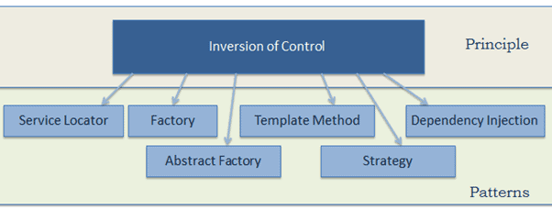
The Inversion of Control (IoC) - patterns
Note: IoC is a principle, not a pattern. It just gives high-level design guidelines but does not give implementation details. The following patterns (but not limited) implements the IoC principle: Callbacks, Event loops, Factory, Dependency Injection etc.

Slide 11
The advantages of Inversion of Control:
Decoupling Components
Enhancing Testability
Managing Component Lifecycle
Promoting Reusability and Modularity
Notes:
Decoupling Components
Reduces direct dependencies between components, promoting loose coupling.
Enhanced Testability
IoC simplifies testing by isolating a component and / or mocking its dependencies
Facilitates easier unit testing by allowing the use of mock objects.
Managing Component Lifecycle
IoC automatically handles the creation, initialization, and destruction of components.
Promoting Reusability and Modularity
IoC encourages the reuse of generic, less implementation-dependent components.

Slide 12
Lets create a class using traditional OOP programming approach
In traditional OOP programming, upon creation of the object (e.g., Computer), it will also create (new) its dependent classes (e.g., Processor, RAM instances):
public class Computer {
private final Processor processor;
private final RandomAccessMemory randomAccessMemory;
private final GraphicsCard graphicsCard;
private final Coolers coolers;
public Computer() {
processor = new Processor(paramCpu1, paramCpu2);
randomAccessMemory = new RandomAccessMemory(paramRam1, paramRam2, paramRam3);
graphicsCard = new GraphicsCard(paramGDI1, paramGDI2);
coolers = new Coolers(paramCool1);
}
}

Slide 13
What could be the problems with this implementation:
Tight coupling between the Computer and its components:
We must know how to create every component, and what parameters exactly should be used in the constructor.
If I want to create a computer with a new CPU, I should create another class for the Computer.
How will I test my class, how I will inject mocks there?
Poor polymorphism
Leads to implementation-based design.
CPU
Computer
Wheel
Wheel
Wheel
Coolers
GPU
…

Slide 14
IoC with the Factory pattern
class GraphicsCardFactory { public static GraphicsCard getNVidiaGraphicsCard() { return new NVidiaGraphicsCard(); } } public class Computer { private GraphicsCard graphicsCard; public Computer() { this.graphicsCard = GraphicsCardFactory.getNVidiaGraphicsCard(); } }
Now Computer uses the GraphicCardFactory to get an object of graphicCard. Thus, we have inverted the the control of creating an object of a dependent class to the Factory.
But – now the Computer class uses the concrete GraphicCardFactory class. So – we have not achieved fully loosely coupled classes.

Slide 15
Dependency Injection
Dependency Injection (DI) is a design pattern used to implement IoC.
DI allows to create and bind dependent objects outside of a class and provide them to the class.
The injector class injects the service (dependency) to the client (dependent).
Notes:
Note: Dependency injection is one of the SOLID object-oriented principles.

Slide 16
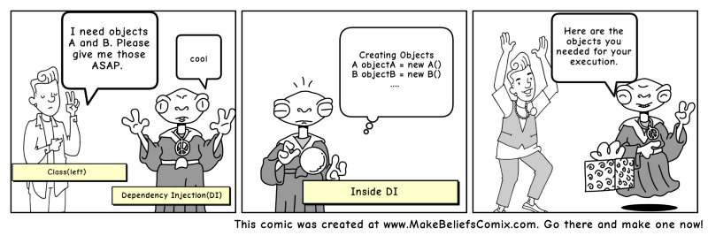

Slide 17
Dependency Injection illustrated
Instead of having the Computer object control its dependencies (new’ed them), let’s supply (inject) them for him!
CPU
Box CPU
CPU
Computer
Factory
RAM
RAM
Box RAM
GPU
Here Factory (the injector) creates an objects of CPU, RAM, GPU etc. and injects them to the Computer class. In this way, the DI pattern separates the responsibility of creating an objects of these classes out of the Computer class.

Slide 18
By using DI, we can rewrite the example without specifying the implementation of the components that we want:
public class Computer {
private final Processor processor;
private final RandomAccessMemory randomAccessMemory;
private final GraphicsCard graphicsCard;
private final Coolers coolers;
public Computer(Processor processor,
RandomAccessMemory randomAccessMemory,
GraphicsCard graphicsCard,
Coolers coolers) {
this.processor = processor;
this.randomAccessMemory = randomAccessMemory;
this.graphicsCard = graphicsCard;
this.coolers = coolers;
}
}

Slide 19
Spring Core
Part 2

Slide 20
Part 2: Spring Core
IoC and DI in Spring
Spring Terminology:
Application Context
Spring Beans Configuration
@Autowire
Constructor vs. Field vs. Setter injection
Beans Matching

Slide 21
Inversion of Control (IoC) and Dependency Injection (DI) in Spring
The core of the Spring is the IoC (Inversion of Control) Container. It creates the objects, configures and assembles their dependencies, and manages their entire life cycle.
The Container uses Dependency Injection(DI) to manage the components that make up the application. It gets information about the objects from the Java Code and Annotations.

Slide 22
Spring Bean
Bean – the managed object (instance) by Spring.
Spring manages bean creation\destruction
Spring manages bean dependencies (by injection)
Spring manages bean scope (singleton or prototype)

Slide 23
ApplicationContext
ApplicationContext is the Spring interface representing the IoC container. ApplicationContext holds all beans and manages them.
To obtain a bean from ApplicationContext, use the getBean() function and specify bean ID or interface\class.
ApplicationContext ctx = new AnnotationConfigApplicationContext(
"com.att.course.spring.demo.components");
MyBean bean1 = ctx.getBean(MyBean.class);
MyBean bean2 = ctx.getBean(“MyBean”);
In case of no ambiguity – Spring will automatically know which bean to extract for you…

Slide 24
Spring IoC
Application Context
(IoC Container)
Java Code
Bean
F
Bean
A
Bean
B
Bean
C
Bean
G
Bean
H
Bean
E
Bean
D

Slide 25
Spring Beans configuration
An application should provide the bean configuration to the ApplicationContext container. A Spring bean configuration consists of one or more beans definitions.
Spring supports different ways of configuring beans:
@Bean-annotated methods within a @Configuration class
@Component-annotated classes

Slide 26
Beans configuration: @Bean-annotated methods within a @Configuration class
A class annotated with @Configuration contains Spring bean configurations.
A method annotated with @Bean indicates that it creates a Spring bean.
public class MyComponent {
// the class implementation
}
@Configuration
public class ComponentsConfig {
@Bean public MyComponent myComponent() { return new MyComponent(); }
}
ApplicationContext ctx = new AnnotationConfigApplicationContext(
ComponentsConfig.class); MyComponent comp = ctx.getBean(MyComponent.class);

Slide 27
@Bean-annotated methods – bean name
public class MyComponent {
// the class implementation
}
@Configuration
public class ComponentsConfig {
@Bean public MyComponent myComponent() { return new MyComponent(); }
@Bean(“component”) public MyComponent anotherComponent() { return new MyComponent(); }
}
ApplicationContext ctx = new AnnotationConfigApplicationContext(
ComponentsConfig.class);
MyComponent comp1 = ctx.getBean(“myComponent”);
MyComponent comp2 = ctx.getBean(“component”);
The method name is the default bean id / name

Slide 28
Beans configuration: @Component-annotated classes
Mark a class by one from the Spring annotations: @Component, @Controller, @Service, and @Repository.
@Controller, @Service and @Repository are special types of @Component annotation.
Spring will automatically detect these classes as beans.
@Component
public class MyComponent {
// the component code
}
ApplicationContext ctx = new AnnotationConfigApplicationContext(
"com.att.course.spring.demo.components"); MyComponent comp = ctx.getBean(MyComponent.class);

Slide 29
@Component-annotated classes – bean name
@Component
public class MyComponent1 implements ComponentInterface {
// the component code
}
@Component(“myComponent2”)
public class MyComponent2 implements ComponentInterface {
// the component code
}
ApplicationContext ctx = new AnnotationConfigApplicationContext(
"com.att.course.spring.demo.components"); ComponentInterface comp1 = ctx.getBean(“myComponent1”);
ComponentInterface comp2 = ctx.getBean(“myComponent2”);

Slide 30
@Bean vs @Component
@Component is a class-level annotation used to auto-detect and auto-configure beans using classpath scanning.
There's an implicit one-to-one mapping between the annotated class and the bean (i.e., one bean per class).
@Bean is a method-level annotation, it is used to explicitly declare a single bean.
You can use it, for example, to wire components from 3rd-party libraries (you don't have the source code so you can't annotate its classes with @Component), so automatic configuration is not possible.

Slide 31
Dependency Injection in Spring
Constructor Injection
Field Injection
Setter Injection

Slide 32
Constructor injection
@Component
public class Component1 {
// the Component1 code
}
@Component
public class Component2 {
private Component1 comp1; public Component2(Component1 comp1) { this.comp1 = comp1; }
}

Slide 33
Field injection
@Component
public class Component1 {
// the Component1 code
}
@Component
public class Component2 {
@Autowired private Component1 component1;
public Component2() { }
}

Slide 34
Setter injection
@Component
public class Component1 {
// the Component1 code
}
@Component
public class Component2 {
private Component1 component1;
@Autowired
public void setComponent1(Component1 component1) {
this.component1 = component1;
}
}

Slide 35
Constructor vs Field vs Setter Injection
Why prefer Constructor Injection:
An object must be created with the full and correct state.
The app can define for the object a mock dependency in a unit test.
An object can be specified as immutable (for example, to gain thread safety).
Why prefer Field Injection:
The more readable code; allows focusing on business logic.
When some of the object’s properties could be optional.
Why prefer Setter Injection:
When you need some “smart setter”, for example, for additional validation.
Note: Constructor Injection is the most straightforward and recommended way of dependency injection!

Slide 36
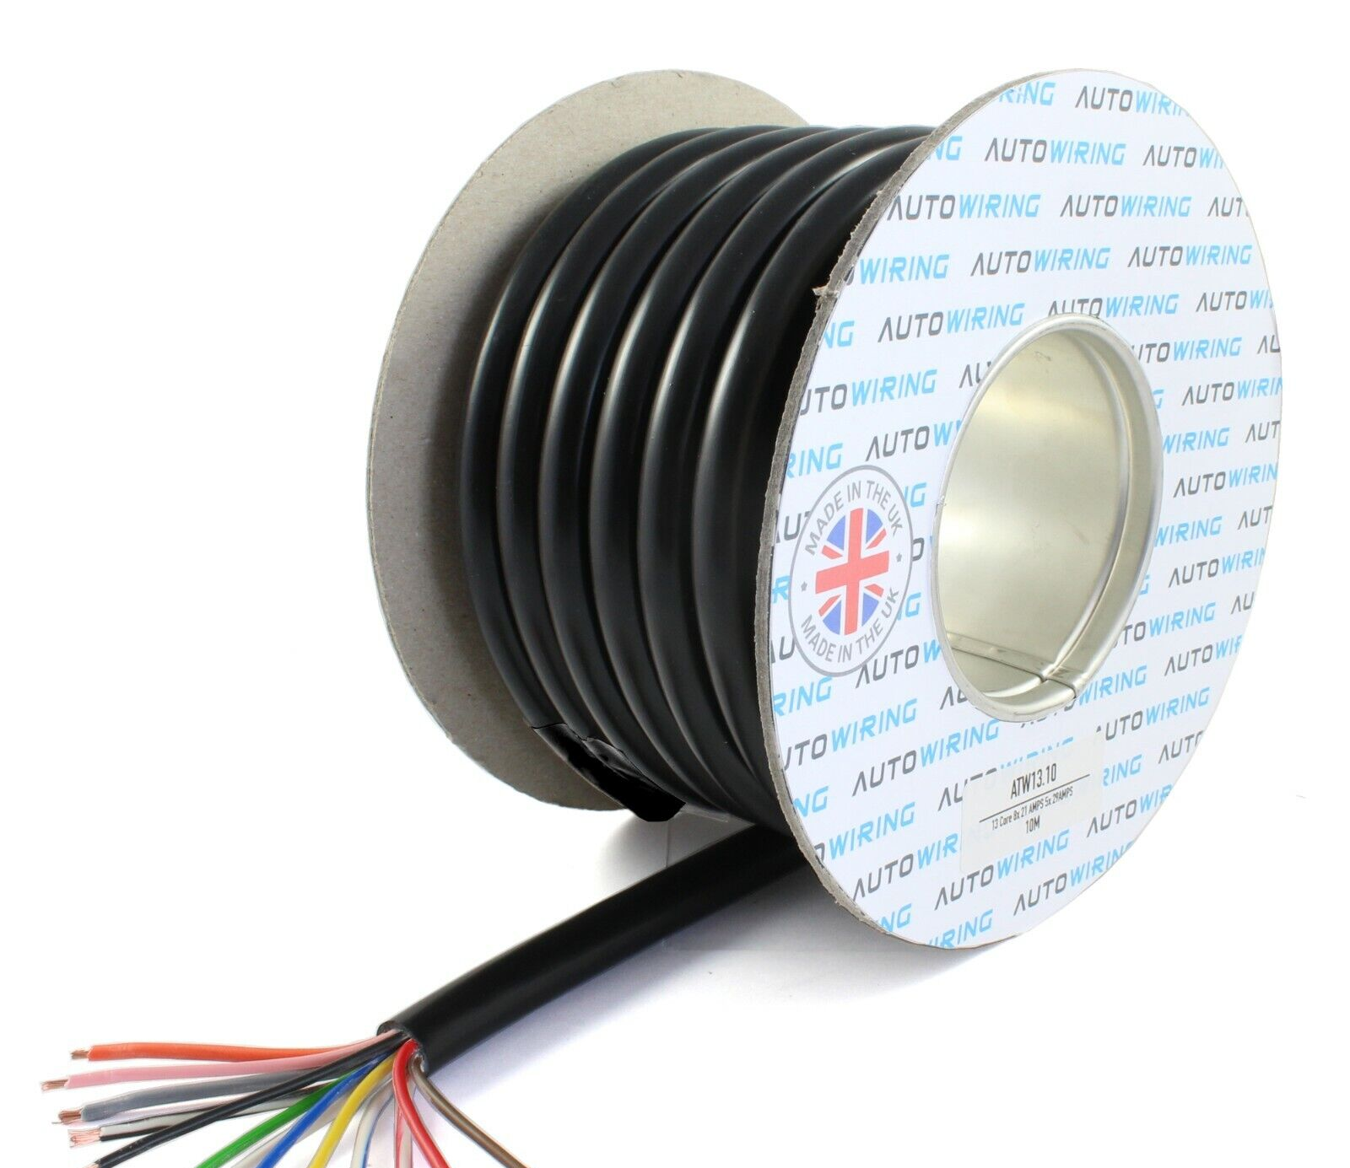
Dependency Injection – Autowiring
The process of Spring bean injection is called autowiring.
Autowiring is a mechanism in Spring that allows automatically detect and inject the dependent beans to the properties.

Slide 37
Dependency Injection - @Autowired
Spring @Autowired annotation is used for autowiring. Using the annotation, we instruct the Spring to inject the bean “auto-magically”.
@Autowired is generally used for field and setter injection.
It can also be used with a constructor, to denote to Spring that this is the constructor to use for bean creation. But classes with a single constructor can omit the @Autowired annotation.

Slide 38
Dependency Injection - @Autowired (cont.)
@Autowired on fields happens AFTER calling the constructor.
@Autowired is by default required and will fail in the case cannot be fulfilled. Change it by adding @Autowired(required = false).

Slide 39
How Spring looks for beans to wire?
There are different ways through which we can autowire a spring bean:
Match by Type
Match by Qualifier
Match by Name
Note: In case more than one bean is found – Spring will fail to autowire

Slide 40
Autowire behaviour: Match by Type
@Configuration
public class ComponentsConfig {
@Bean
public Component getComponent() {
return new Component();
}
}
@Component
public class Component {
// …
}
@Component
public class AnotherComponent {
private Component comp;
AnotherComponent(Component comp) {
this.comp = comp;
}
}

Slide 41
Autowire behaviour: Match by Qualifier
public class Component extends BaseComponent {
// the class implementation
}
@Configuration
public class ComponentConfig {
@Bean(“component1”)
public BaseComponent component1() {
return new Component(param1);
}
@Bean
public BaseComponent component2() {
return new Component(param2);
}
}
@Component
public class AnotherComponent {
private BaseComponent comp1;
private BaseComponent comp2;
AnotherComponent(
@Qualifier(“component1”) BaseComponent comp1,
@Qualifier(“component2”) BaseComponent comp2) {
this.comp1 = comp1;
this.comp2 = comp2;
}
}

Slide 42
Autowire behaviour: Match by Name
public class MyComponent extends BaseComponent {
}
@Configuration
public class ComponentsConfig {
@Bean(“myComponent”)
public BaseComponent getMyComponent() {
return new MyComponent();
}
}
@Component(“myComponent”)
public class MyComponent extends BaseComponent {
// some code
}
@Component
public class AnotherComponent {
private BaseComponent baseComponent;
AnotherComponent(BaseComponent myComponent) {
this.baseComponent = myComponent;
}
}

Slide 43
Spring Boot
Part 3

Slide 44
Part 3: Spring Boot
The motivation for Spring Boot
Spring Boot Auto Configurator
Spring Application
Spring Boot Starters

Slide 45
Motivation of Spring Boot
Spring is a huge framework, supporting plenty of solutions.
Just take a look at: https://spring.io/projects
Where do I start? Which way to use?
Multiple setup steps
A lot of effort is required to start a new spring project.
Multiple configuration steps
Multiple build and deploy steps
Capability and flexibility come with a cost – you must specify what exactly you need.
No starting point, no ‘best practice’ pathway
Can we abstract these steps?
We need something simpler, that answers 80% of the cases

Slide 46
Motivation of Spring Boot (cont.)
Spring Boot is used for creating a stand-alone Spring-based application that you can just run because it needs minimal Spring configuration:
No need for web servlets, it has Tomcat inside;
Configurations are packed inside;
Just run, and you have a Server on air.
Spring Boot provides opinionated 'starter' POMs to simplify our Maven configuration.
Spring Boot provides production-ready features such as metrics, health checks, and externalized configuration.
Notes:
Spring Boot 1.0 was released in April 2014
Spring Boot provides an easier and faster way to set up, configure, and run applications.
Spring Boot is based on the best practices and covers most of the use cases.

Slide 47
Spring Boot Auto Configurator
I would like Spring to automatically scan and register in the application context all my beans, like configurations, controllers, services, and other components I define.
I would like Spring to automatically create and register beans also from the jars that are added to my application. For example, if PostgreSQL is in the application classpath, I would like Spring to auto-configure an in-memory database (unless I defined it otherwise).

Slide 48
Spring Boot AutoConfigurator
We do not need to create Application Context, we do not need to create separate file for Spring Configuration…
Spring Boot Auto Configurator scans all my code and creates all the required beans automatically.

Slide 49
Spring Boot Application
The entry point of the Spring Boot application is the class contains @SpringBootApplication annotation and the main method:
From SpringApplication.run, the application will create the application context, that contains all the required Beans. In the case of Web starter, the application will create also an instance of Tomcat web server.
@SpringBootApplication public class DemoApplication { public static void main(String[] args) { SpringApplication.run(DemoApplication.class, args); } }

Slide 50
Spring Boot Application
@SpringBootApplication enables the following annotations:
@ComponentScan - automatically scan and register for all beans, defined under the current package and all sub-packages.
@EnableAutoConfiguration - automatically create and register beans also from the jars that are added to my application.
@Configuration
- Usually, these annotations are placed with the main application class (that’s why it is recommended to locate it in a root package above other classes).

Slide 51
Spring Boot Starters
Starter is a built-in dependency descriptors.
Owing to the starter, you should not look for all frameworks that should be added to the application: just add the dependency to the starter in your pom.xml.
When starting the application, the starter will load all the relevant JARs

Slide 52
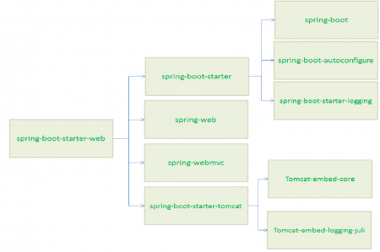
Spring Boot Starters: starter-web
For example, if you add dependency to spring-boot-starter-web to the pom.xml, the Spring will load all jar required for creating RESTful service:
<dependency>
<groupId>org.springframework.boot</groupId>
<artifactId>spring-boot-starter-web</artifactId>
</dependency>

Slide 53
Spring Boot Starters (cont.)
Spring Boot provides around 50+ starters, for various tasks and technologies.
The official starters follow a naming convention
spring-boot-starter-*, where * denotes application type.
For example: spring-boot-starter-test, spring-boot-starter-data-jpa, spring-boot-starter-actuator, spring-boot-starter-security, and so on.
https://docs.spring.io/spring-boot/reference/using/build-systems.html#using.build-systems.starters

Slide 54
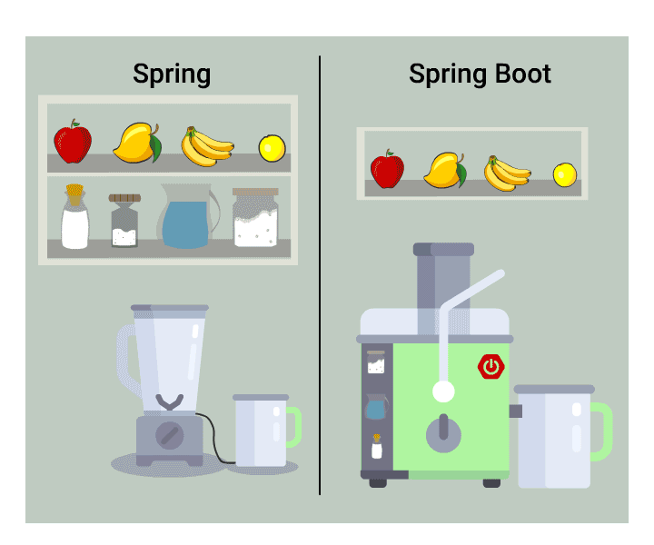
Spring vs. Spring Boot

Slide 55
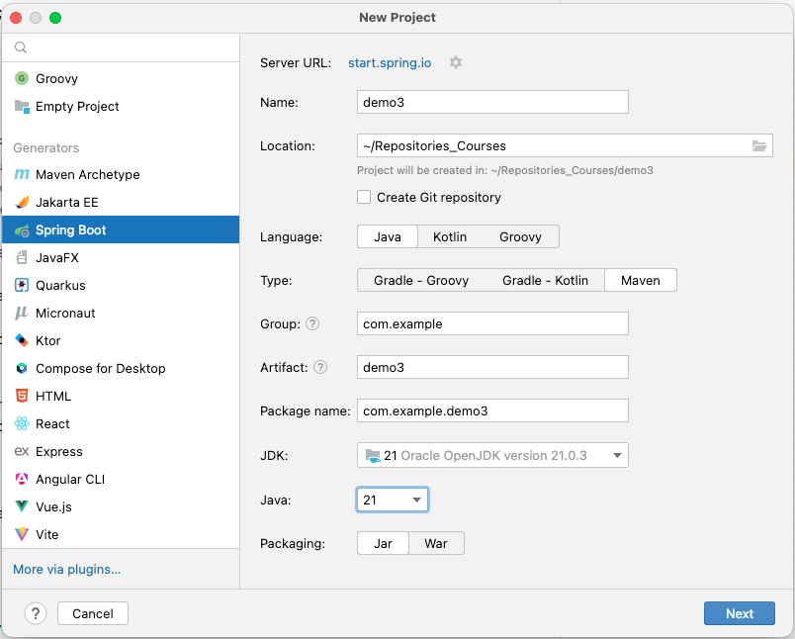
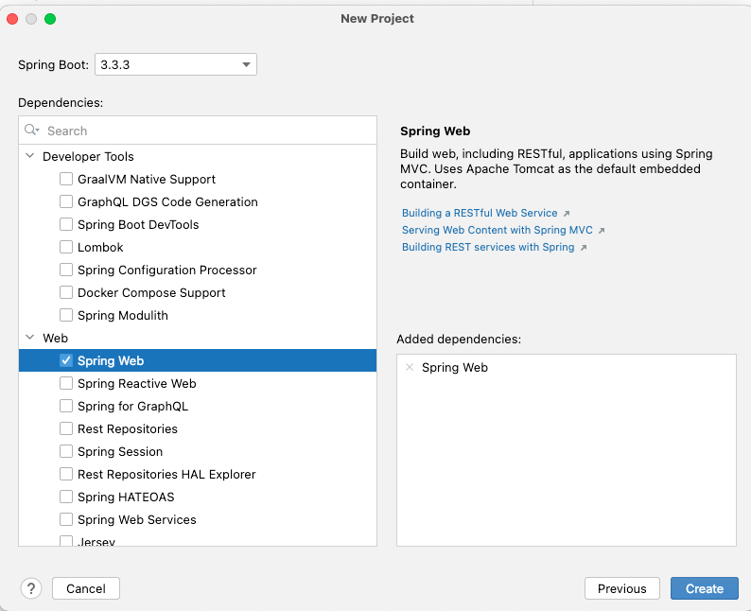
Create a new Spring Boot project from the IntelliJ
spring-boot-starter-web will be added to the POM.xml

Slide 56
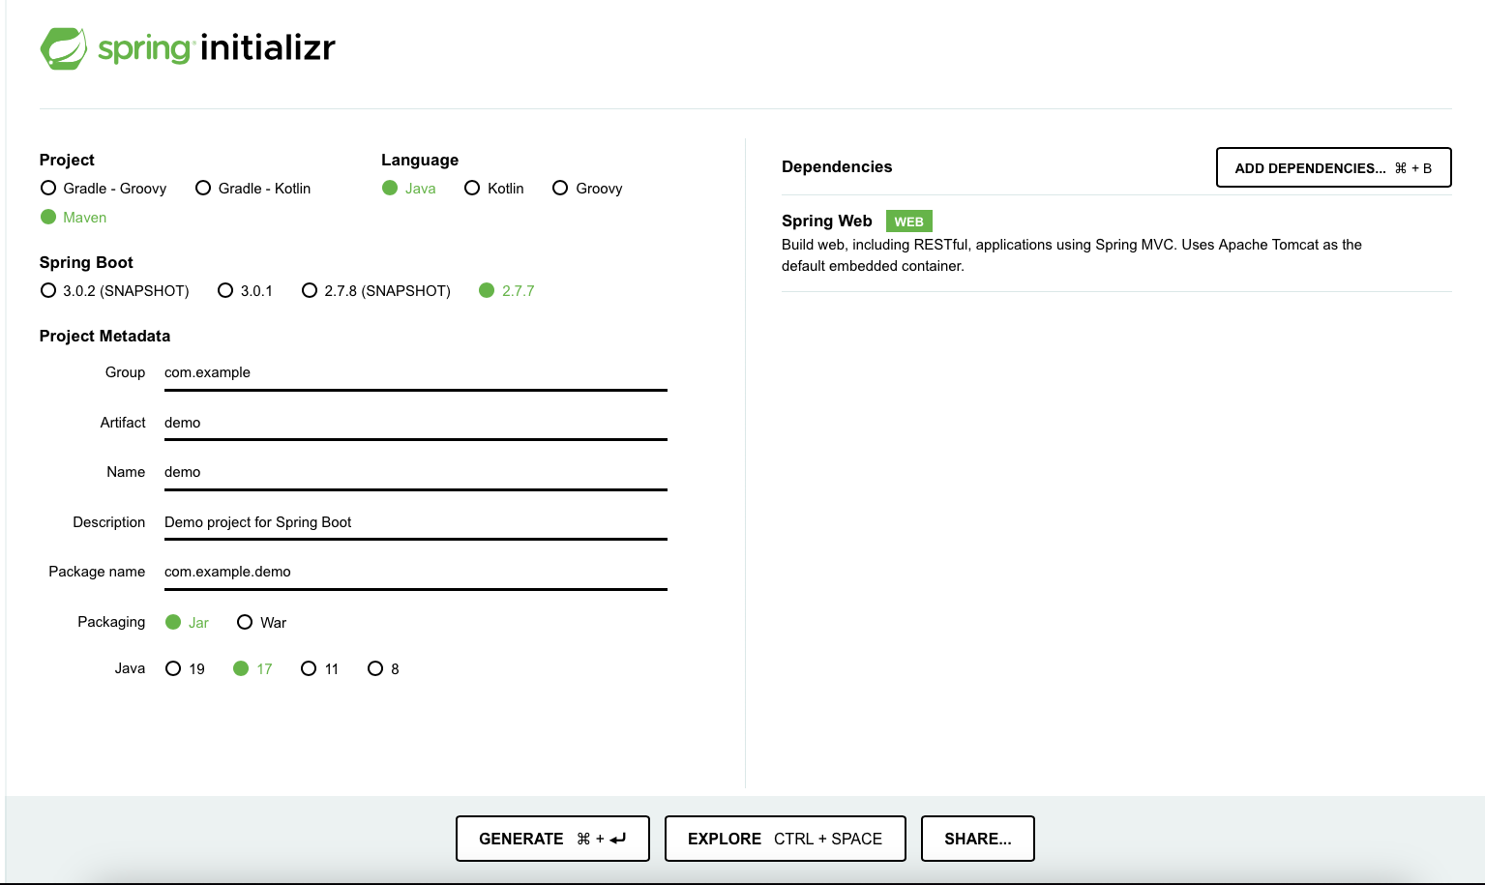
Initializing a Spring Boot application with Spring Initializr
You can also create a Spring Boot applications using Spring Initializr site: just fill in your project details, pick your options, and download a bundled-up project as a zip file.
https://start.spring.io

Slide 57
DEMO and Hands-on – Spring Boot application
Download from GIT the SpringDemo application from
https://github.com/ybensman/SpringDemo
Branch origin/hands-on-lessons-1

Slide 58
Homework
Enter the following changes to the application (ensure that it is compiled and running after every step):
Create classes for Keyboard, Mouse, and AmdCentralProcessingUnit. Define them as beans.
Add Keyboard and Mouse to Computer.
Change the bean Computer to work with AmdCentralProcessingUnit.

