Slide 1

Spring Boot for Beginners
Lesson 2: Spring Boot for REST Microservices
Yulia Bensman, 2023

Slide 2
Lesson 2
Create REST microservice with Spring Boot
Testing with Spring Boot
Error handling in REST with Spring Boot

Slide 3
Part 1: create REST microservice with Spring Boot
We will go through the following steps:
Creating a Spring Boot application
Running an “empty” application and checking it (sanity)
Adding and mapping our first RESTful microservice
Calling our microservice from the Postman

Slide 4
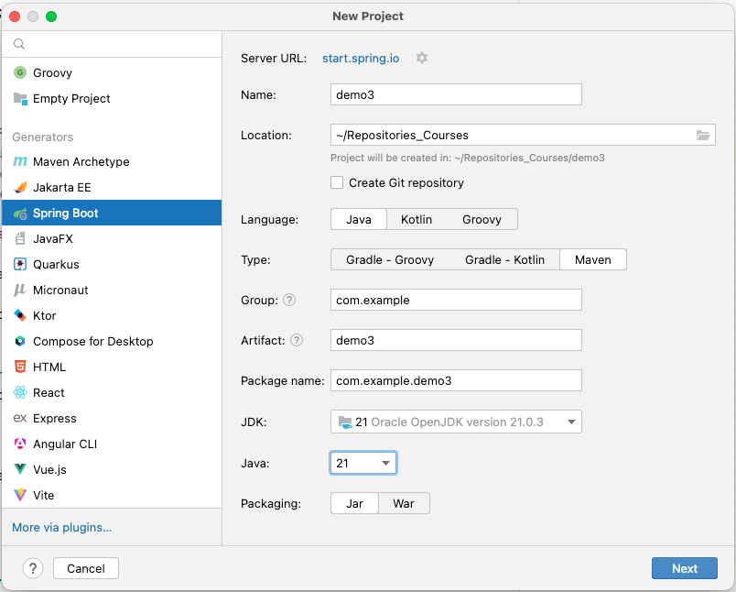
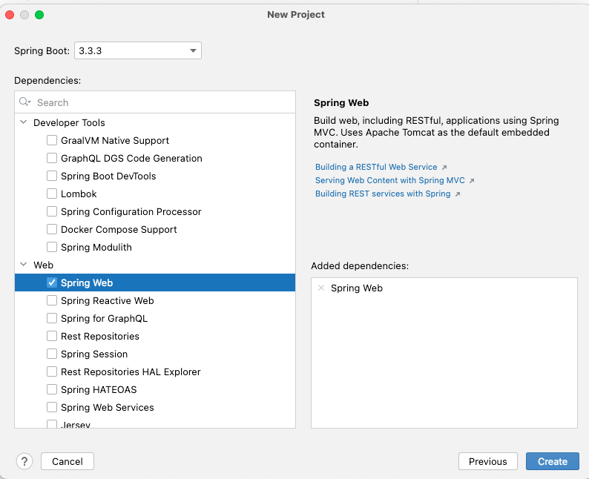
Create a new Spring Boot project from the IntelliJ
spring-boot-starter-web will be added to the POM.xml

Slide 5
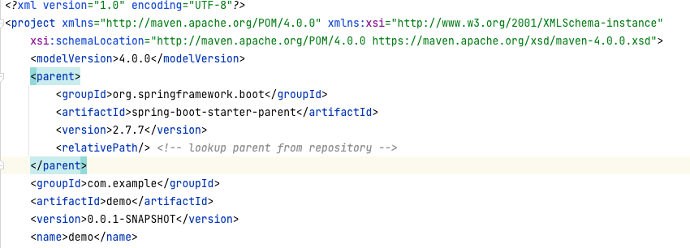
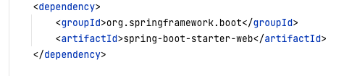
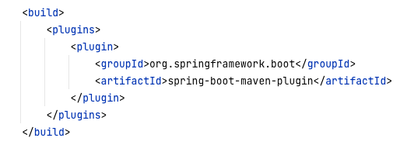
Initializing a Spring Boot application
What do we see in the that pom.xml we get:

Slide 6
Initializing a Spring Boot application: @SpringBootApplication
In the DemoApplication class we see:
@SpringBootApplication public class DemoApplication { public static void main(String[] args) { SpringApplication.run(DemoApplication.class, args); } }

Slide 7
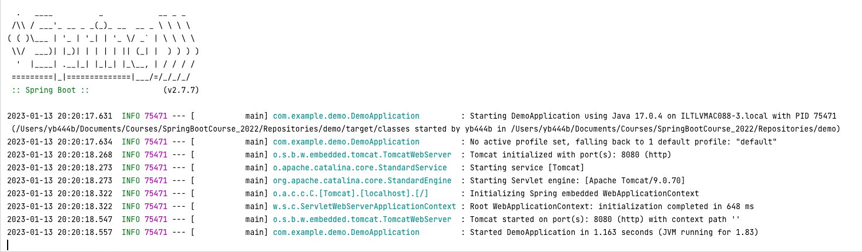
Run the Spring Boot application:
Log example:
Note that:
the application server (Tomcat) is already started;
the microservice is listening to port 8080 (default Tomcat configuration)

Slide 8
Spring actuator
Let’s add something that we can get back without any code… In pom.xml add:
<dependency>
<groupId>org.springframework.boot</groupId>
<artifactId>spring-boot-starter-actuator</artifactId>
</dependency>
Going now to http://localhost:8080/actuator/health
Should result with: {"status":"UP"}
Note: adding to src/main/resources/application.properties the line: management.endpoint.health.show-details=always will show more info for actuator/health

Slide 9
Adding our own microservice
Let's add a new class:
package com.example.demo; import org.springframework.web.bind.annotation.RequestMapping; import org.springframework.web.bind.annotation.RestController; @RestController
@RequestMapping("hello") public class HelloController { @GetMapping(”world") public String index() { return "Hello, world!"; } }
@RequestMapping, @GetMapping, @PostMapping map web requests to Spring Controller methods.
http://localhost:8080/hello/world -> returns “Hello, world!”

Slide 10
Spring annotations for Microservice Beans
@Component is a generic stereotype for any Spring-managed component. @Repository, @Service, and @Controller are specializations of @Component for more specific use cases (in the persistence, service, and presentation layers, respectively).
@RestController is a specialized version of the controller. It includes the @Controller and @ResponseBody annotations, and as a result, simplifies the controller implementation.

Slide 11
More complicated request: @PathVariable
@RestController @RequestMapping("calculate") public class CalculateController { @GetMapping("/add/{num1}/{num2}") int add1(@PathVariable int num1, @PathVariable int num2) { return num1 + num2; } }
http://localhost:8080/calculate/add/5/7/ -> returns 12

Slide 12
More complicated request: @RequestParam
@GetMapping("/add") int add(@RequestParam int num1, @RequestParam int num2) { return num1 + num2; }
http://localhost:8080/calculate/add?num1=5&num2=7 => 12
We can configure the @RequestParam to be optional, though, with the required attribute. (When the parameter isn't specified, the method parameter is bound to null).
int add(@RequestParam Integer num1, @RequestParam(required=false) Integer num2)
We can configure the @RequestParam to use a default value, using the defaultValue attribute (in this case, required is indeed set to false). Note: value is of String type.
int add(@RequestParam int num1, @RequestParam(defaultValue=“100”) int num2)

Slide 13
More complicated request: JSON on POST
public class CalculateRequest { public int num1; public int num2; }
@PostMapping("/add") public int create(@RequestBody CalculateRequest request) { return request.num1 +request.num2; }
{
"num1": 5,
"num2": 7
}

Slide 14
Complex response: a Map
// inside @RestController
@GetMapping("/numbers")
public Map<Integer, List<String>> numbers() {
var map = new HashMap<Integer, List<String>>();
map.put(1, List.of(new String[] {"One", "Echad"}));
map.put(2, List.of(new String[] {"Two", "Shtayim"}));
return map;
}
http://localhost:8080/numbers => {"1":["One","Echad"],"2":["Two","Shtayim"]}

Slide 15
Complex Response – our own object
public class CalculateResponse { public int result; CalculateResponse(int result) { this.result = result; } }
@PostMapping("/add") public CalculateResponse create(@RequestBody CalculateRequest request) { return new CalculateResponse(request.num1 + request.num2); }
http://localhost:8080/calculate/add => { "result": 3 }

Slide 16
Hands-on - Calculator
Implement the following APIs:
GET http://localhost:8080/add/{num1}/{num2}
GET http://localhost:8080/add/?num1={value}&num2={value}, where num2 is optional
POST http://localhost:8080/universalAdd?numeralSystem={DEC_or_HEX}, default value is DEC
The endpoint receives a JSON structure with two fields: num1 and num2 (of type String).
Converts them to integer, summarize and returns another structure – JSON with one field: result.
Recommendations: create a class CalculationService that has a field radix. Use the functions Integer.parseInt and Integer.toString to calculate result according to the radix.

Slide 17
Part 2: Testing with Spring Boot
Spring Boot provides several utilities and annotations to help when testing your application. Use spring-boot-starter-test starter (in the test scope).
The starter imports:
Spring Test & Spring Boot Test - utilities and integration test support for Spring Boot applications.
Junit - the de-facto standard for unit testing Java applications.
Mockito - a Java mocking framework.
AssertJ - a fluent assertion library.
Hamcrest - a library of matcher objects
a number of other useful testing libraries.
<dependency> <groupId>org.springframework.boot</groupId> <artifactId>spring-boot-starter-test</artifactId> <scope>test</scope> </dependency>

Slide 18
Testing with @SpringBootTest
The @SpringBootTest annotation is useful when we need to bootstrap the entire Spring application container.
This annotation creates an application context and loads all beans of the application.
It means we can @Autowire any bean that's picked up by component scanning into our test.
@SpringBootTest starts the embedded server and creates a web environment.

Slide 19
Testing With a Mock Environment
By default, @SpringBootTest does not start the server but instead sets up a mock environment for testing web endpoints.
With Spring, we can query our web endpoints using class MockMvc, as shown in the following example:
@AutoConfigureMockMvc @SpringBootTest class SpringMicroserviceDemoApplicationTests { @Autowired MockMvc mockMvc; @Test void testWithMockMvc() throws Exception { var result = mockMvc.perform(get("/hello/index")) .andExpect(status().isOk()) .andExpect(content().string("Hello, world")); } }
Use annotation @AutoConfigureMockMvc for operations with MockMvc
In this test mockMvc calls endPoint (“/hello/index”), implemented in the tested application, and verifies that it returns HTTP 200 OK and body “Hello World”.

Slide 20
Testing with @WebMvcTest
If you want to focus only on the web layer and not start a complete ApplicationContext, consider using @WebMvcTest instead.
@WebMvcTest auto-configures the Spring MVC infrastructure and limits scanned beans to @Controller-related beans.
So, if your controller has some dependency to other beans from your service layer, the test won't start until you either load that config yourself or provide a mock for it.
Notes:
Note: @WebMvcTest also auto-configures MockMvc.

Slide 21
@MockBean
Use @MockBean annotation to mock a bean object.
Often, @WebMvcTest is limited to a single controller and is used in combination with @MockBean to provide mock implementations for required dependencies.

Slide 22
Testing with @MockMvcTest
@MockMvcTest(HelloController.class) class SpringMicroserviceDemoApplicationTests { @Autowired MockMvc mockMvc;
@MockBean HelloService helloService; @Test void testWithMockMvc() throws Exception { var result = mockMvc.perform(get("/hello/index")) .andExpect(status().isOk()) .andExpect(content().string("Hello, world")); } }
@WebMvcTest also auto-configures MockMvc
Use @MockBean to provide mock implementations for required dependencies

Slide 23

Hands-on - Calculator
Write tests to the Calculator APIs.

Slide 24
Part 3: Error handling in REST with Spring
What do we expect from the REST microservice error handling?
Handle all possible errors and report to the client detailed information about the problem.
Build a centralized error-handling mechanism, to consolidate all errors we want to handle in one place.
Provide a default error handling for unexpected exceptions.

Slide 25
Error handling - solutions
Annotations:
@ResponseStatus,
@ExceptionHandler,
@RestControllerAdvice
And class ResponseEntityExceptionHandler.

Slide 26
@ExceptionHandler
@ExceptionHandler is a Spring annotation that provides a mechanism to treat exceptions thrown during execution of handlers (controller operations).
public class FooController{
//...
@ExceptionHandler({ CustomException1.class, CustomException2.class })
public void handleException() { //
}
}
Put the annotation on method(s) of controller classes; it will serve as the entry point for handling exceptions thrown within this controller only.
Notes:
If we will enter this annotation on methods of controller classes, it will serve as the entry point for handling exceptions thrown within this controller only.

Slide 27
@RestControllerAdvice
The most common approach is to use @ExceptionHandler on methods of @RestControllerAdvice classes so that the Spring Boot exception handling will be applied globally for all application controllers (or to a subset of controllers, if specified).
Create your exception handler and add annotation @RestControllerAdvice.
Extend it from ResponseEntityExceptionHandler, as it already provides some basic handling of Spring MVC exceptions.
@RestControllerAdvice
public class AppControllerAdvice extends ResponseEntityExceptionHandler
{
@ExceptionHandler({AccessDeniedException.class})
@ResponseStatus(FORBIDDEN)
protected String handleAccessDeniedException(AccessDeniedException ex) {
return “Access denied!”;
}
}
Define an exception handler function, specify a @ExceptionHandler and the list of exceptions you want to handle
Notes:
* @RestControllerAdvice is an annotation in Spring and, as the name suggests, is “advice” for multiple controllers.
* It enables the application of a single @ExceptionHandler to multiple controllers.
* With this annotation, we can define how to treat such an exception in a single place, and the system will call this handler for thrown exceptions on classes covered by this @RestControllerAdvice.

Slide 28
@ResponseStatus
As the name suggests, @ResponseStatus allows us to modify the HTTP status of our response. It can be applied in the following places:
On the exception class itself
Along with the @ExceptionHandler annotation on methods
Along with the @ControllerAdvice annotation on classes

Slide 29
Error Handling – handle custom exception
Create your exception handler and add annotation @RestControllerAdvice.
Extend it from ResponseEntityExceptionHandler, as it already provides some basic handling of Spring MVC exceptions. We’ll add handlers for new exceptions while improving the existing ones.
@RestControllerAdvice
public class AppControllerAdvice extends ResponseEntityExceptionHandler
{
@ExceptionHandler({AccessDeniedException.class})
@ResponseStatus(FORBIDDEN)
protected String handleAccessDeniedException(AccessDeniedException ex) {
return “Access denied!”;
}
}
Define an exception handler function, specify a @ExceptionHandler and the list of exceptions you want to handle
Response code will be HTTPStatus.FORBIDDEN

Slide 30
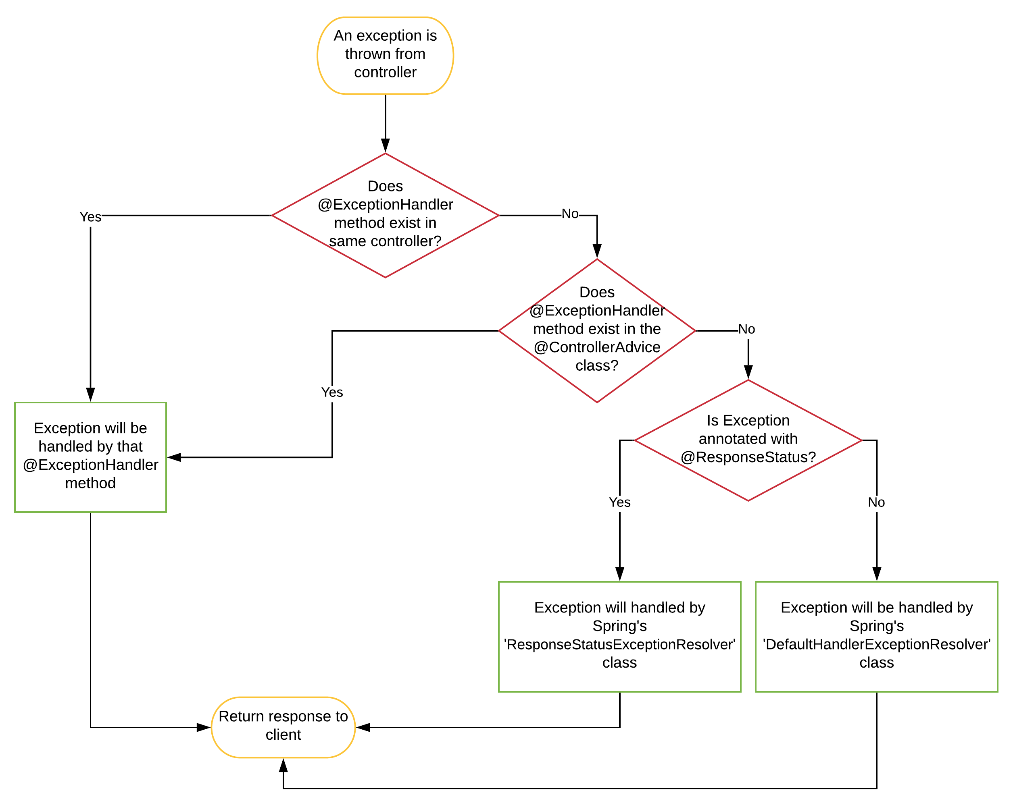
How does Spring process the exception
Have a look through the following flow chart that traces the process of the exception handling by Spring if we have not built our own exception handler:

Slide 31
Hands On – Calculator – error handling
Add error handling to the Calculator service:
Return the message “"Illegal number format exception” in the case invalid numeric value has been sent.
Return the message "Illegal Access!" in the case not supported numeral system has been sent.
See my repository:
https://github.com/ybensman/SpringMicroserviceDemo

