Slide 1
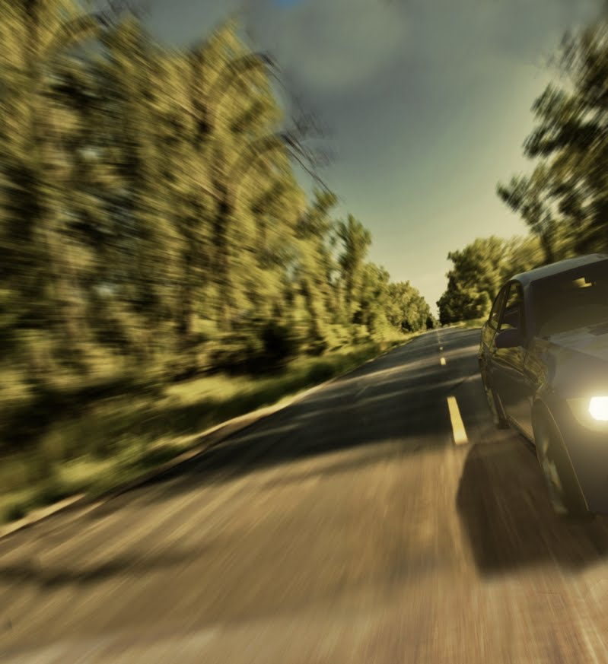
Training AI to drive in Formula FSE. Alon Kwart, Yoni bettan

Slide 2
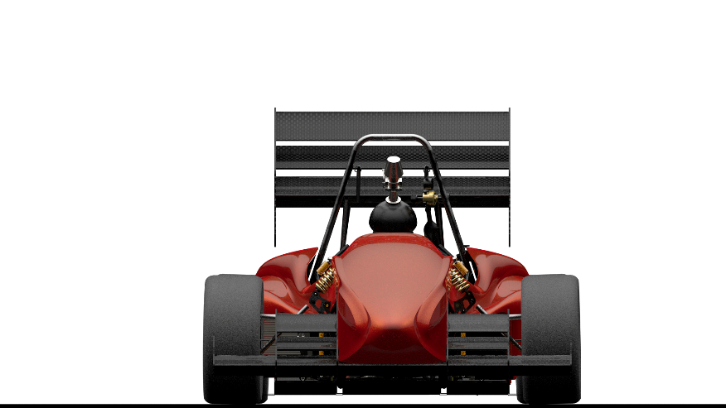
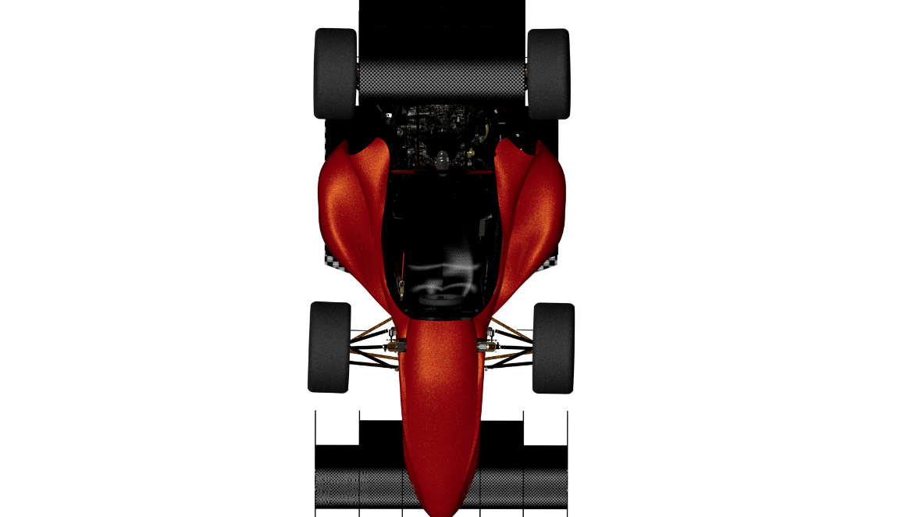
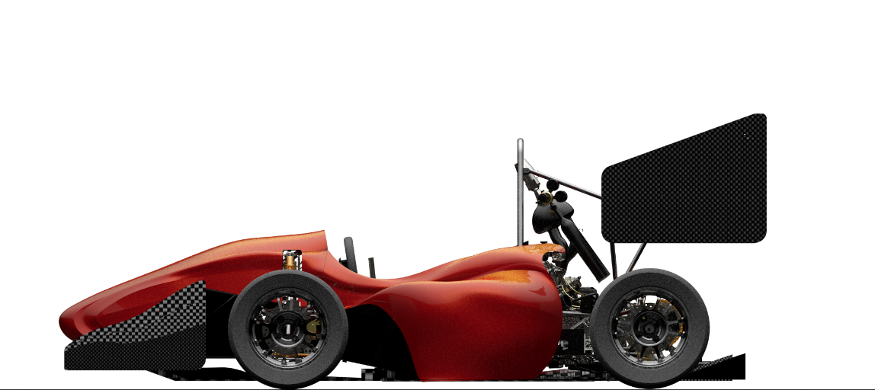
Background
This has been done
Machine Vision
Obstacle navigation
FSE challenge
Goal: Minimum time duration per task
Object Detection
Skid-Pad
Acceleration
Track-Drive

Slide 3
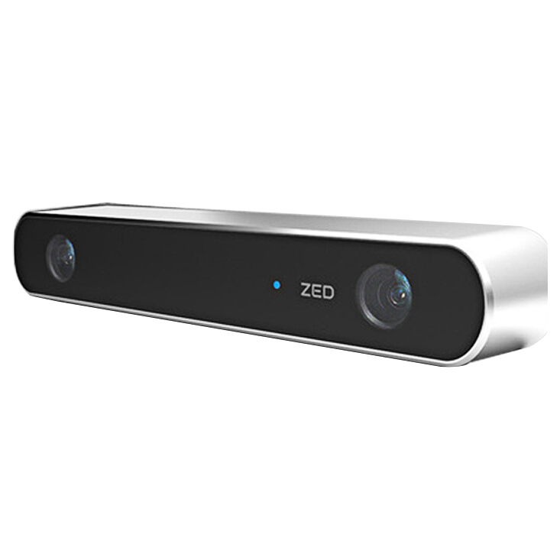
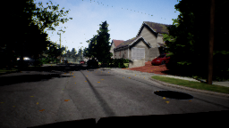
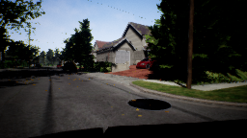
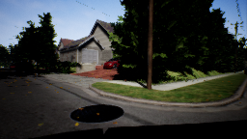
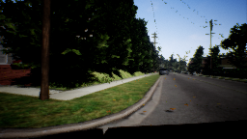
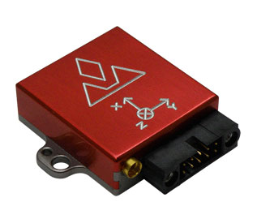
Introduction
Data
Simulated sensors

Slide 4


Introduction
Attitude centered ‘Birds eye’ view
$$Lanes$$
Lane Detection
Left lane
IMU
Camera + Lidar

Slide 5
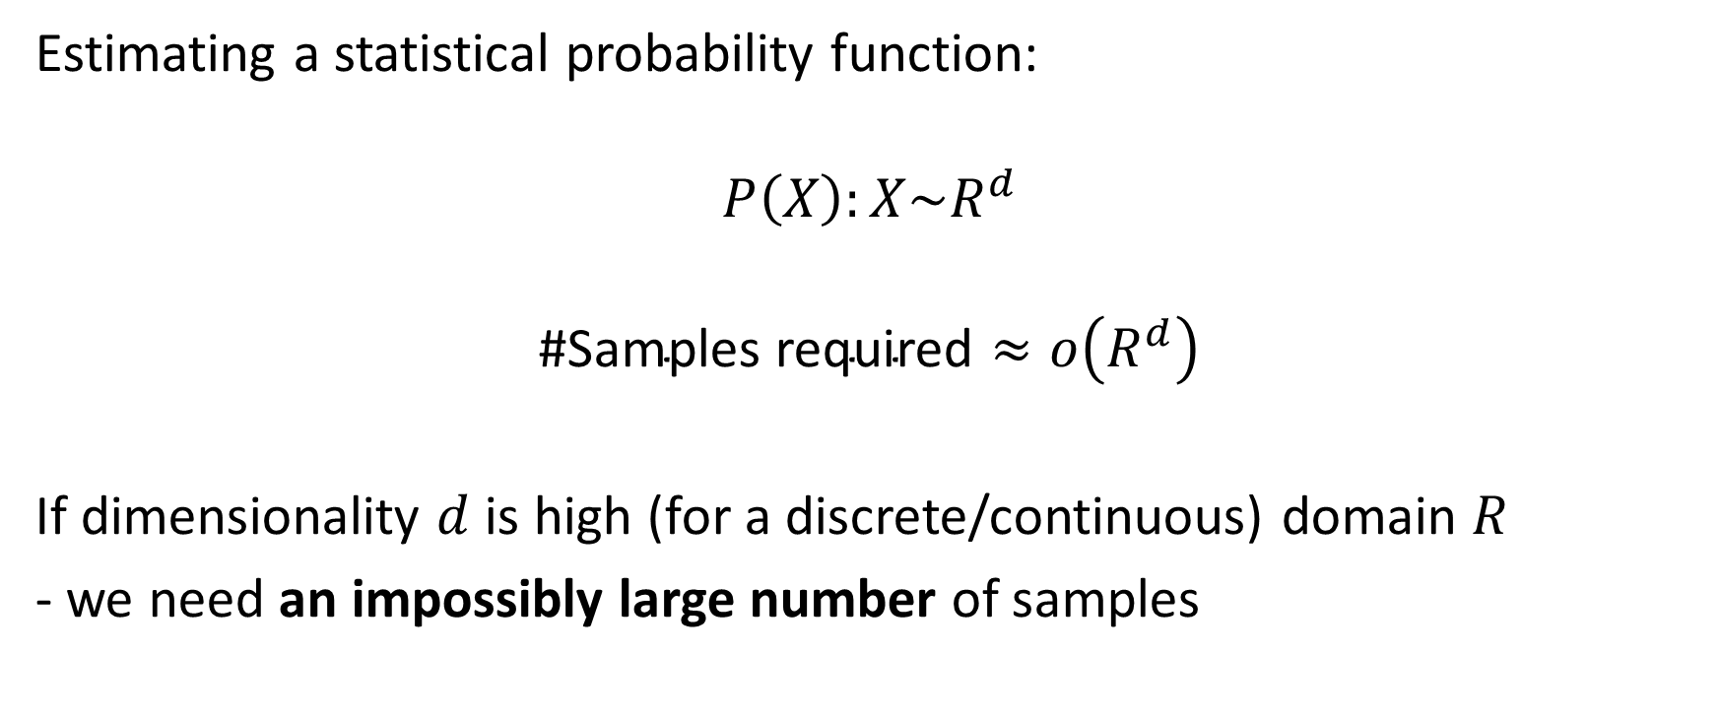
’Curse of Dimensionlity’
Estimating a statistical probability function:
$$P\left(X\right):X\sim R^{d}$$
$$\text{\#}\text{Samples} \text{required}≈o\left(R^{d}\right)$$
If dimensionality $d$ is high (for a discrete/continuous) domain $R$
- we need an impossibly large number of samples
https://en.wikipedia.org/wiki/Curse_of_dimensionality

Slide 6
Steps
Step 1: Research for best environment
Step 2: Proof of concept – AI learn how to stop before collision
Step 3: AI learn to drive on a road
Problem: data preparation is hard
Step 4: Use an environment with existing data
Step 5 (future): Build step 4 on the FST challenge environment

Slide 7
Step 1: Research for best training environment
AirSim
rFactor2
Carla (MIT)
Project A

Slide 8

Step 2: Proof of concept - stopping
Classifier to classify images as collision\no-collision
01 – no collision
10 - collision
…

Slide 9
Data collection + Testing the network
Video of the car stopping before collision (to large for slideshow)

Slide 10
Step 3: AI learn to drive on a road
Collecting data and preprocess it isn’t trivial
The network has some difficulties to learn
Lack of turning diversity
The network treats the small turning as noise

Slide 11
Network Architecture
…
steer
…
14
Location, velocity etc.
10

Slide 12
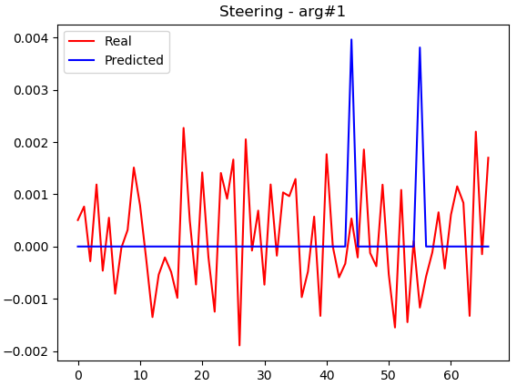
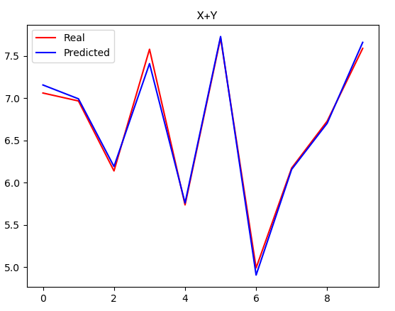
The problem
Conclusion:
the problem is the d-a-t-a and not the network !!

Slide 13
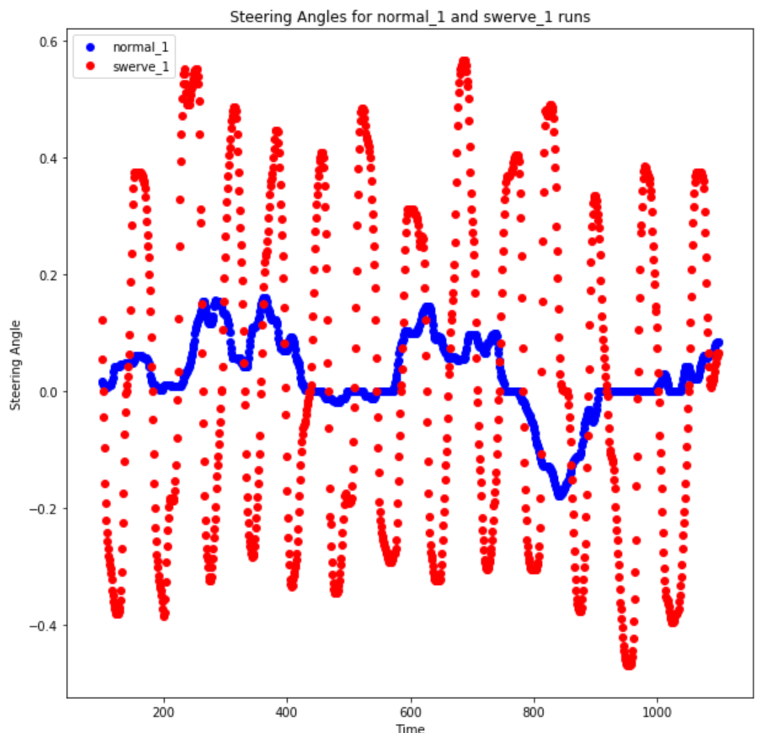
Step 4: Use an environment with existing data
The swerve part is the important part
It teaches the AI to TURN correctly
That was the missing part

Slide 14
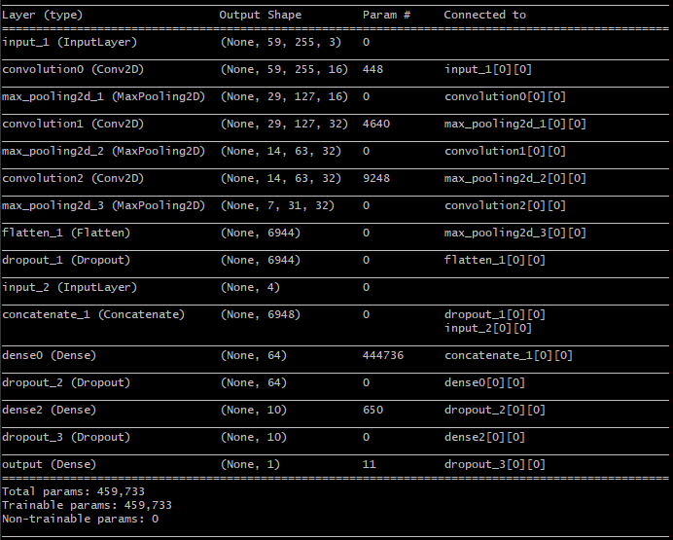
Microsoft architecture
Michael Nielsen’s book: http://neuralnetworksanddeeplearning.com

Slide 15
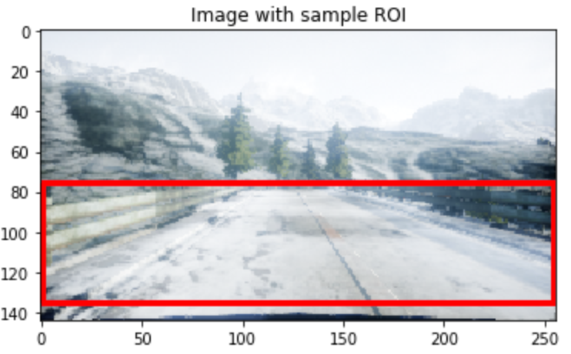
Training the model
Drop 90% of image with steering=0 for a balanced dataset
Change image brightness randomly up to 40% for invariance of lightning
Cut the images to include only the ROI (Range Of Interest)
Reduce learning rate on plateau to converge to minimum
Stop early if not improving to prevent overfitting

Slide 16
Performance
Final loss = 0.0013 after 38 epochs
We believe better can be done, didn’t reached the global minimum
Some package conflict occur when forcing tensorflow-gpu
Show loss improvement picture (to small for slideshow)

Slide 17
Testing the model
Video of the car AFTER learning (to large for slideshow)

Slide 18
Step 5: recommended future project
Take this network
Gather data with the same distribution of our data in the FST environment
Train this network
CROSS YOUR FINGER FOR IT TO WORK

Slide 19
Conclusions
Learning to drive is not an easy task
Data preprocessing is crucial
A lot of parameters to take into consideration
Inputs
Architecture
Scalability
Etc.
Questions ?

Slide 20
References
https://github.com/Microsoft/AirSim
https://github.com/FSTDriverless/AirSim
https://www.analyticsvidhya.com/blog/2016/12/21-deep-learning-videos-tutorials-courses-on-youtube-from-2016/

