Slide 1
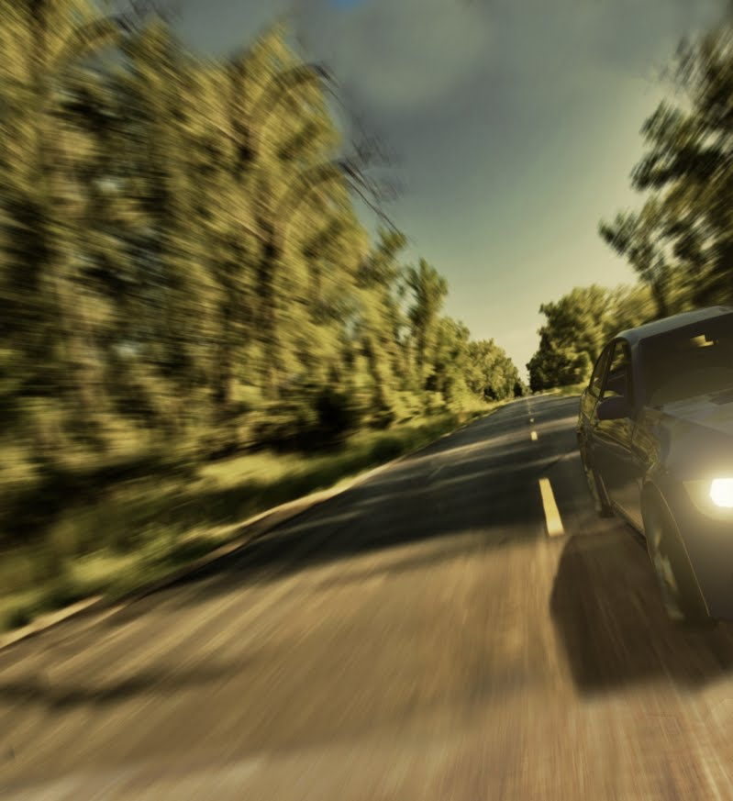
Training AI to drive in Formula FSE challenge Alon Kwart, Yoni bettan

Slide 2
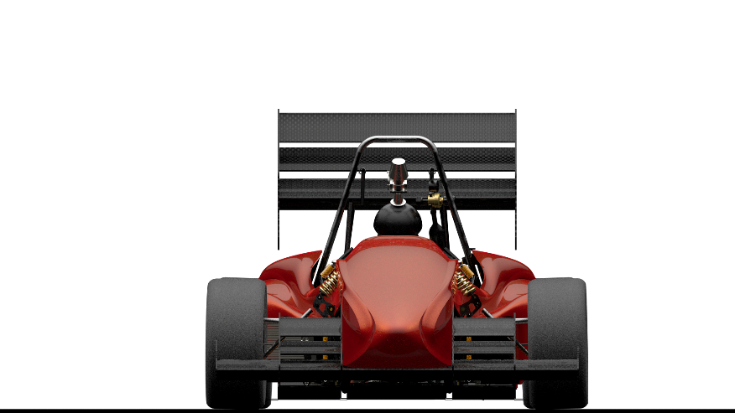
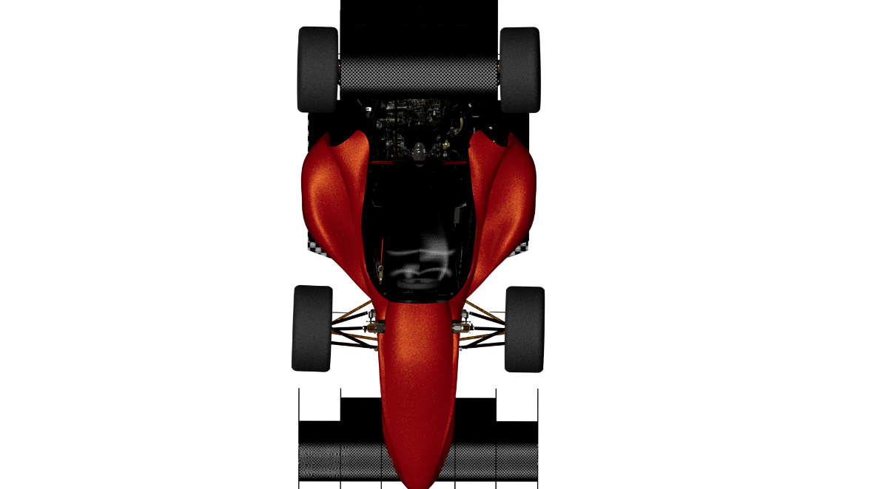
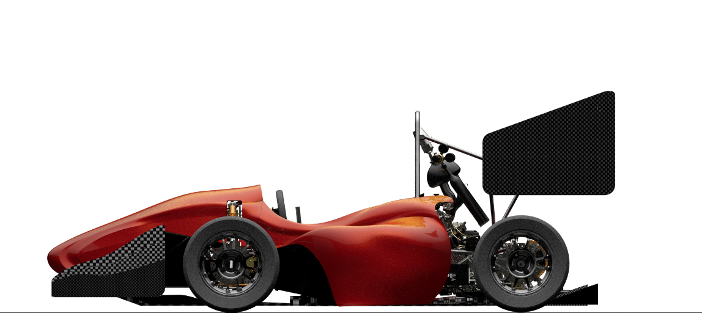
Background
This has been done
Machine Vision
Obstacle navigation
FSE challenge
Goal: Minimum time duration per task
Object Detection
Skid-Pad
Acceleration
Track-Drive

Slide 3
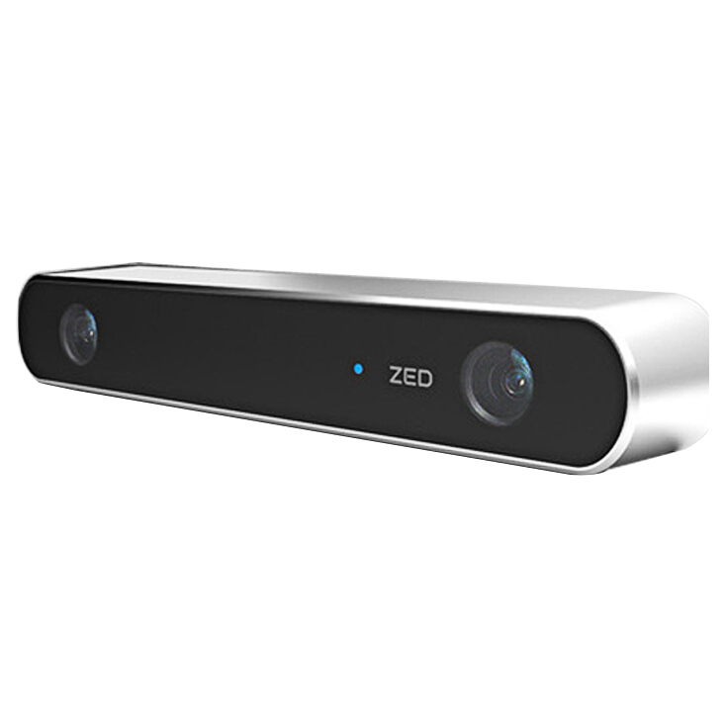
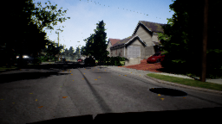
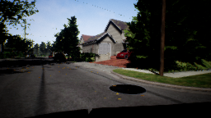
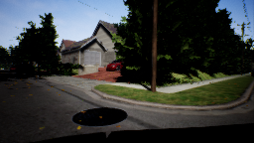
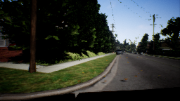
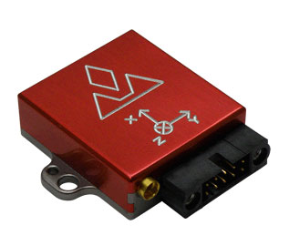
Introduction
Data
Simulated sensors

Slide 4

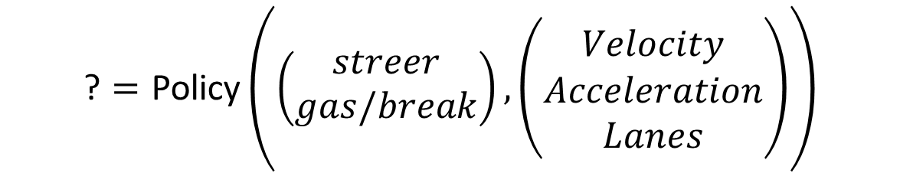

Introduction
Attitude centered ‘Birds eye’ view
$$Lanes$$
Lane Detection
$$\text{?}=\text{Policy}\left(\left(\begin{matrix}streer \\ gas/break\end{matrix}\right), \left(\begin{matrix}Velocity \\ Acceleration \\ Lanes\end{matrix}\right)\right)$$
IMU
Left lane
Action
Camera + Lidar

Slide 5
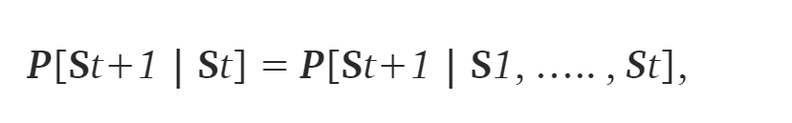
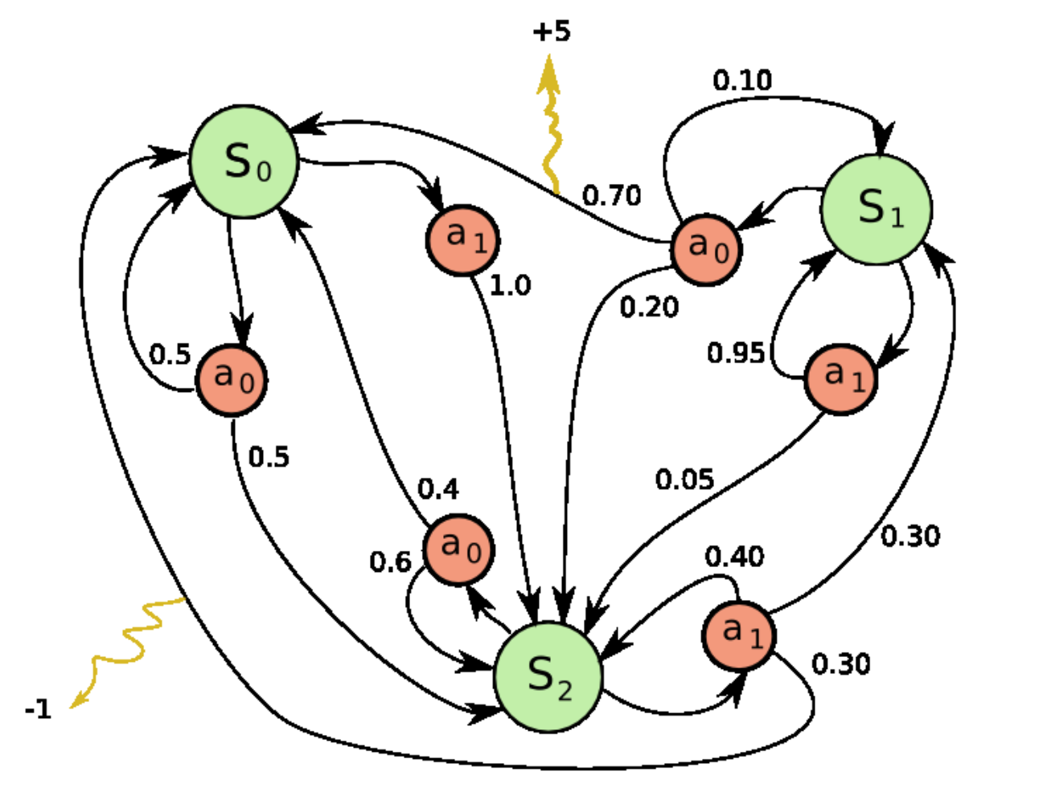
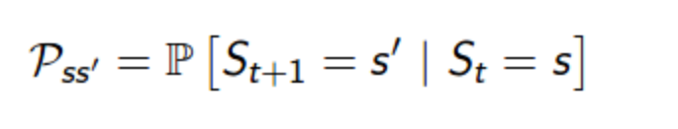


Markov Decision Process (MDP)
https://towardsdatascience.com/reinforcement-learning-demystified-markov-decision-processes-part-1-bf00dda41690

Slide 6
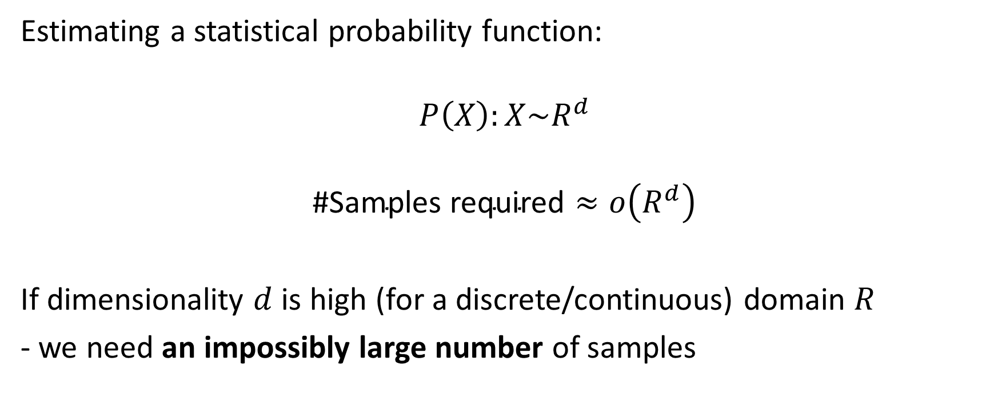
‘Curse of Dimensionlity’
Estimating a statistical probability function:
$$P\left(X\right):X\sim R^{d}$$
$$\text{\#}\text{Samples} \text{required}≈o\left(R^{d}\right)$$
If dimensionality $d$ is high (for a discrete/continuous) domain $R$
- we need an impossibly large number of samples
https://en.wikipedia.org/wiki/Curse_of_dimensionality

Slide 7
Exploration Exploitation trade-off
Random policy
Best policy
MCMC

Slide 8
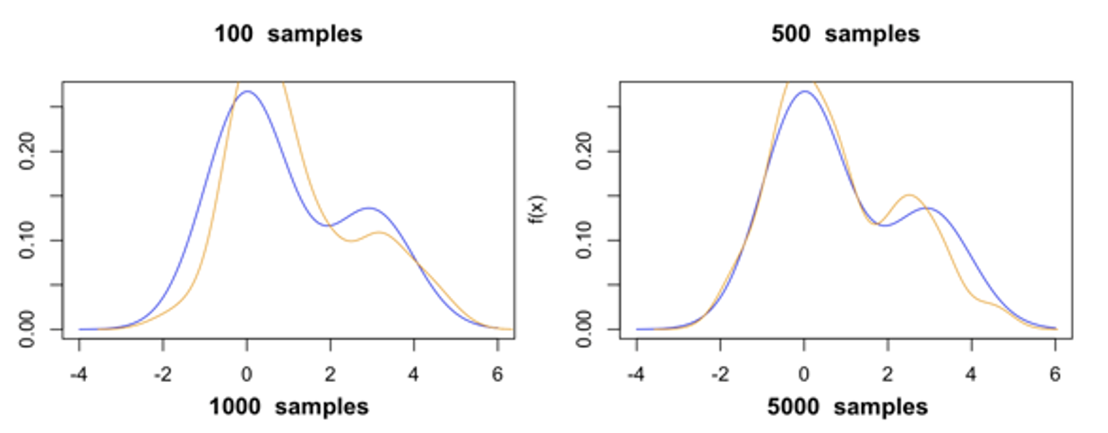
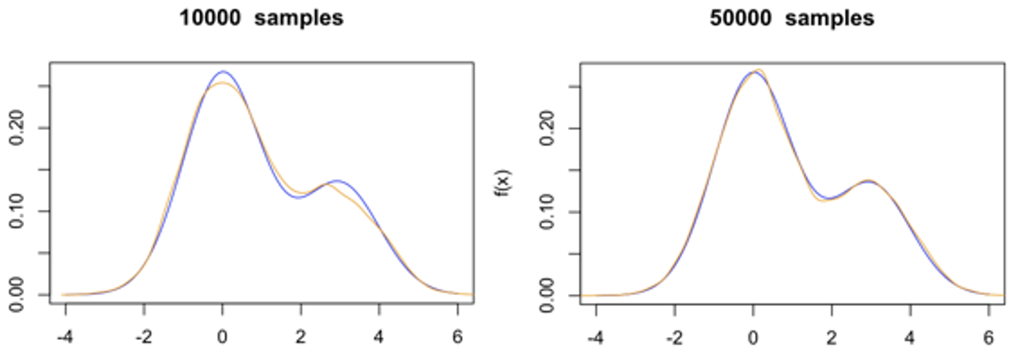
Markov Chain Monte’ Carlo (MCMC)
Sampling from a probability distribution (A family of sampling algo.)
https://en.wikipedia.org/wiki/Mean_field_particle_methods
https://en.wikipedia.org/wiki/Markov_chain_Monte_Carlo

Slide 9
Dynamic Programming algorithm (DP)
Explain in a sentence
https://www.geeksforgeeks.org/dynamic-programming/

Slide 10
Bellman eq.
Explain in a sentence

Slide 11
The Policy Gradient(PG) theorem

Slide 12

Q-functions ,Policy Gradients
(Q-tables are non-scalable..) Use NN instead:
Method1: Q-functions(DQN) (Train to predict action state values):
Method2: Policy Gradients (Train to predict a good Policy)
$$Value=Critic(state,action)$$
$$Policy=\{action_{1},action_{2},…action_{T}\}=Actor(state)$$

Slide 13
Drawbacks
What is a drawback of Q-function?
What is a drawback of Policy-Gradients?

Slide 14
Combining Q-functions and Policy-Gradients
Policy Gradient
Q-function
{Vaule1, Value2,….}
Deep State recover
Policy
Grad.
Deep State recover
Policy = {Action1, Action2,….}
Q
Input Data
Input Data

Slide 15

Actor-Critic (AC)
$$Policy=\{action_{1},action_{2},…action_{T}\}=Actor(state)$$
$$Value=Critic(state,action)$$

Slide 16
Drawbacks
Give a drawback about AC

Slide 17
Deep Deterministic Policy Gradient (DDPG)
Paper by David Silver
http://proceedings.mlr.press/v32/silver14.pdf
TF implementation:
https://github.com/slowbull/DDPG

Slide 18
Our implementation
Architecture
Explain each component
Why we think this is better (Using previous work)
Figure of the NN
Overfitting datasets
Performance
Training rates (Loss over #epochs)
Evaluation rates (Loss over #epochs)

Slide 19
Results
Video of an autonomous drive (Show input signals in the background)
Short description of the video (What do we see?)

Slide 20
Conclusions
This is the final slide to show.
Discuss the conclusion
Answer questions
All done

Slide 21
References
Don’t show this (Only if somebody asks)

