Slide 1
A few answers from Bob

Slide 2
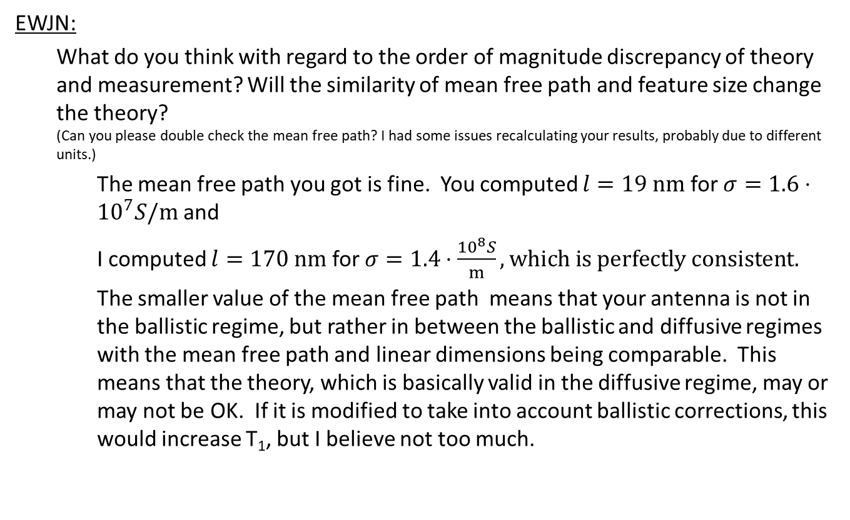
EWJN:
What do you think with regard to the order of magnitude discrepancy of theory and measurement? Will the similarity of mean free path and feature size change the theory? (Can you please double check the mean free path? I had some issues recalculating your results, probably due to different units.)
The mean free path you got is fine. You computed $l=19 nm$ for $σ=1.6⋅10^{7}S/m$ and
I computed $l=170 nm$ for $σ=1.4⋅\frac{10^{8}S}{m}, which is perfectly consistent.$
The smaller value of the mean free path means that your antenna is not in the ballistic regime, but rather in between the ballistic and diffusive regimes with the mean free path and linear dimensions being comparable. This means that the theory, which is basically valid in the diffusive regime, may or may not be OK. If it is modified to take into account ballistic corrections, this would increase T₁, but I believe not too much.

Slide 3
EWJN:
What is the evanescent wave decay length? Does the dielectric constant matter?
One of the non-intuitive things about EWJN is that there is no characteristic length scale. It’s more like van der Waals forces, which also always decay like a power law.
The dielectric constant probably does matter, and I have not included its effect in the expressions. This might be very important since it would increase T₁, possibly substantially, and I forgot about it. I do have some old calculations where I took it into account. I will have to find them and I will get back to you on that. Thank you very much for pointing it out!

Slide 4
EWJN:
What do you think explains the difference in magnitude between different samples? STM devices seem to show a similar trend with doped gates.
With a d⁻⁵ distance dependence, a factor of 3 or 4 in T₁ corresponds only to a 20 or 30% change in distance. The distance dependence may not be quite that strong, but even so a pretty small change in the geometry can make a significant change in T₁.
As to the STM samples, if I remember rightly there is not much metal around. This makes it a little surprising that the crossover from B to B⁵ behaviour is still at 1-2T, not that much lower than your implanted devices. But I’d have to know more about doped regions to say anything useful. I will have a look at those papers.

Slide 5
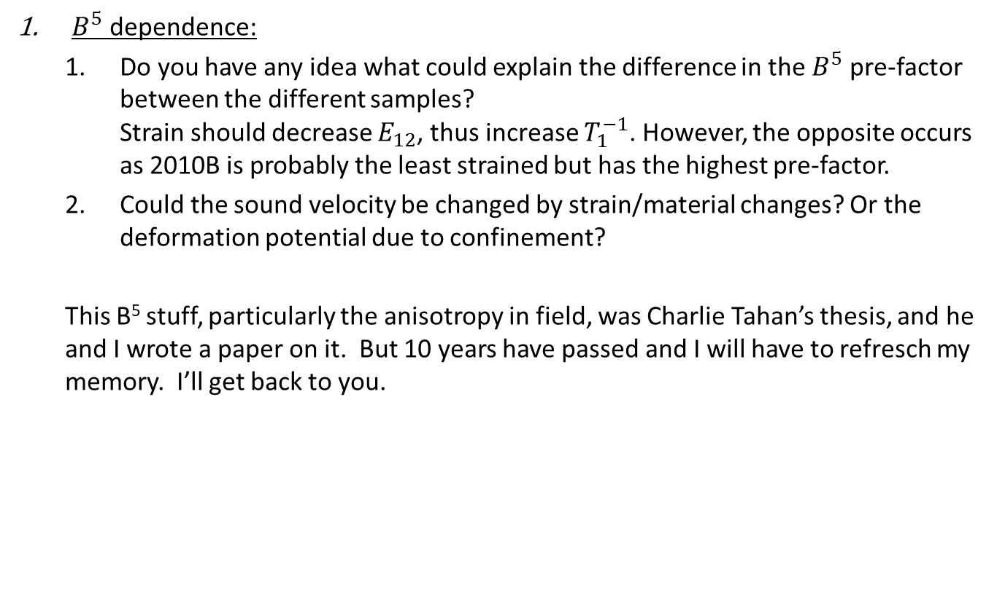
$B^{5}$dependence:
Do you have any idea what could explain the difference in the $B^{5}$ pre-factor between the different samples? Strain should decrease $E_{12}$, thus increase $T_{1}^{−1}$. However, the opposite occurs as 2010B is probably the least strained but has the highest pre-factor.
Could the sound velocity be changed by strain/material changes? Or the deformation potential due to confinement?
This B⁵ stuff, particularly the anisotropy in field, was Charlie Tahan’s thesis, and he and I wrote a paper on it. But 10 years have passed and I will have to refresch my memory. I’ll get back to you.

