Slide 1

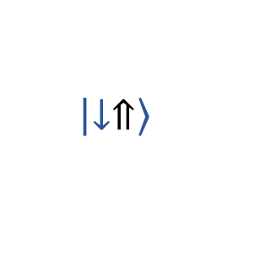










a)
b)
c)
Readout
$$\left|\left.↑⇑\right\rangle \right.$$
$$\left|\left.↑⇑\right\rangle \right.$$
$$\left|\left.↑⇓\right\rangle \right.$$
$$\left|\left.↑⇓\right\rangle \right.$$
NMR
E_{F}
$$\left|\left.↓⇓\right\rangle \right.$$
$$\left|\left.↓⇑\right\rangle \right.$$
ESR
ESR
Operation
NMR
$$\left|\left.↓⇓\right\rangle \right.$$
$$\left|\left.↑⇑\right\rangle \right.$$
$$\left|\left.↑⇓\right\rangle \right.$$
$$\left|\left.↓⇑\right\rangle \right.$$
$$\left|\left.↓⇓\right\rangle \right.$$
$$\left|\left.↓⇑\right\rangle \right.$$
N(E)

