Slide 1

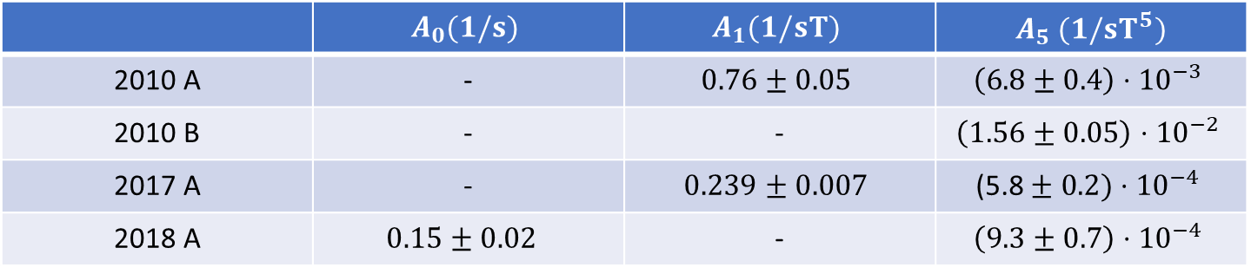
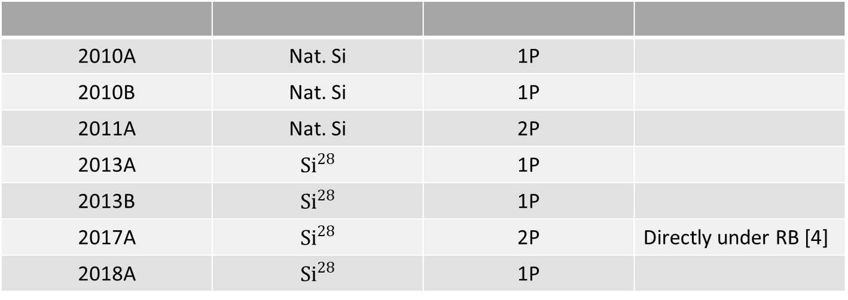
2010 device A nat. Si 2010 device B nat. Si 2011 device A nat. Si 2013 device A Si²⁸ 2013 device B Si²⁸ 2017 device A Si²⁸ 2018 device A Si²⁸ Morton
20
10
5
(s⁻¹)
_{T}−1
1
2
1
0.5
Relaxation rate
Fit ${ A}_{0}+A_{1}B_{z}+A_{5}B_{z}^{5}$
0.2
0.05
1
1.5 2 3
Magnetic field B_{z} (T)
4
5
 | $$A_{0}(1/s)$$ | $$A_{1}(1/sT)$$ | $A_{5}$ $(1/sT^{5})$
2010 A | - | $$0.76±0.05$$ | $$\left(6.8±0.4\right)⋅{10}^{−3}$$
2010 B | - | - | $$\left(1.56±0.05\right)⋅{10}^{−2}$$
2017 A | - | $$0.239±0.007$$ | $$\text{(5.8}±0.2)⋅{10}^{−4}$$
2018 A | $$0.15±0.02$$ | - | $$\left(9.3±0.7\right)⋅{10}^{−4}$$
2010A | Nat. Si | 1P
2010B | Nat. Si | 1P
2011A | Nat. Si | 2P
2013A | $$Si^{28}$$ | 1P
2013B | $$Si^{28}$$ | 1P
2017A | $$Si^{28}$$ | 2P | Directly under RB [4]
2018A | $$Si^{28}$$ | 1P

