Slide 1
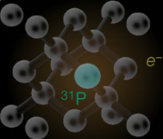
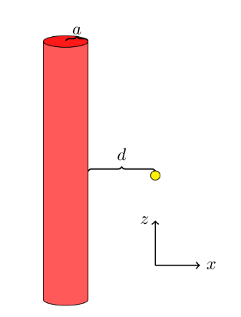
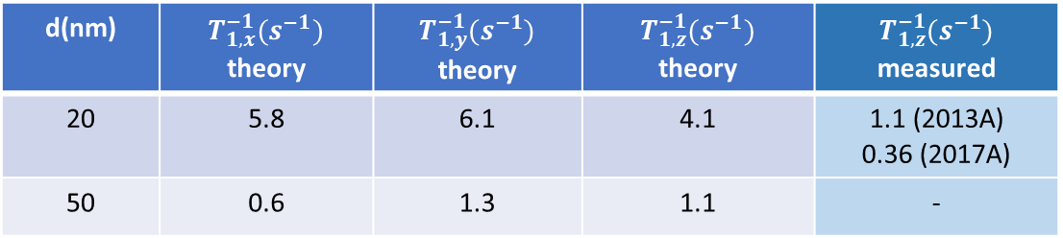
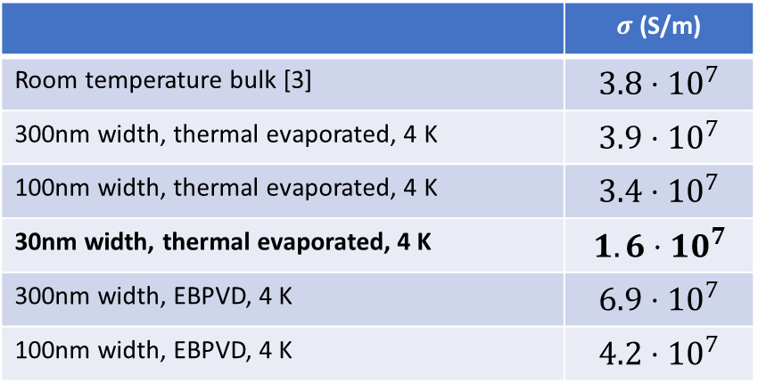
a)
b)
EM wave
metal
dielectric
30nm
Evanescent waves
c)
d)
 | $σ$(S/m)
Room temperature bulk [3] | $$3.8⋅10^{7}$$
300nm width, thermal evaporated, 4 K | $$3.9⋅{10}^{7}$$
100nm width, thermal evaporated, 4 K | $$3.4⋅{10}^{7}$$
30nm width, thermal evaporated, 4 K | $$1.6⋅10^{7}$$
300nm width, EBPVD, 4 K | $$6.9⋅{10}^{7}$$
100nm width, EBPVD, 4 K | $$4.2⋅{10}^{7}$$
e)
d(nm) | $T_{1,x}^{−1}(s^{−1})$ theory | $T_{1,y}^{−1}(s^{−1})$ theory | $T_{1,z}^{−1}(s^{−1})$ theory | $$T_{1,z}^{−1}(s^{−1})$$ measured
20 | 5.8 | 6.1 | 4.1 | 1.1 (2013A) 0.36 (2017A)
50 | 0.6 | 1.3 | 1.1 | -

