Slide 1
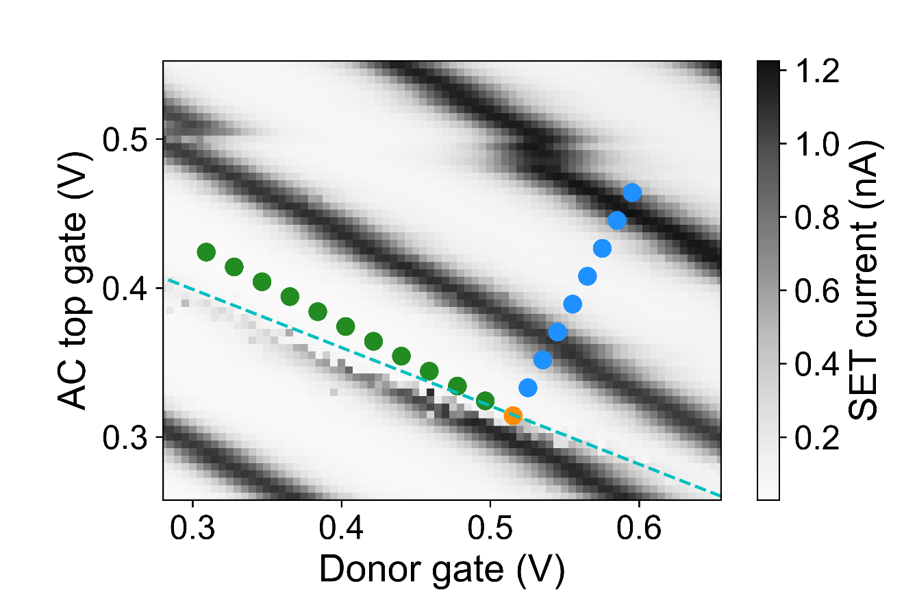

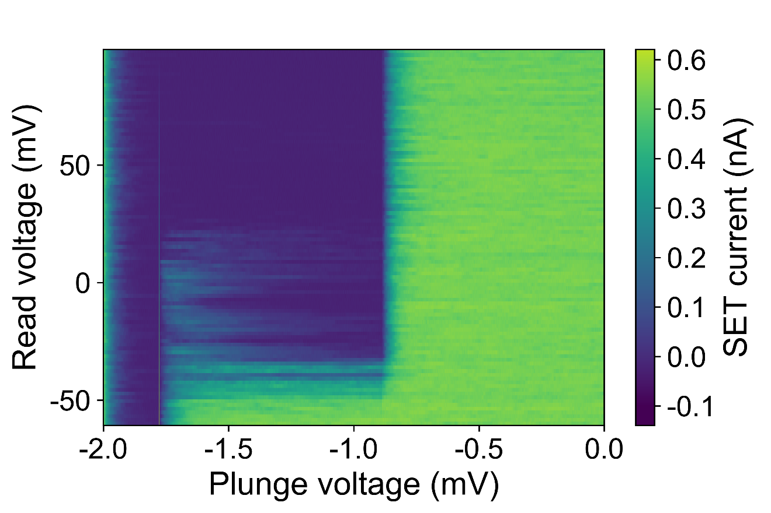


a)
b)
2
10
Compensated Uncompensated
Relaxation rate (s⁻¹)
d)
10
1
10
0
10
−1
0
25
50 75
100 125
150 175
d)
Plunge voltage (mV)
c)
direct tunnelling Compensated Uncompensated
Relaxation rate (s⁻¹)
10
1
$$\frac{E_{z}}{2}$$
$$E_{z}$$
10
0
10
−1
0
5
10 15
Plunge voltage (mV)
20
25

