Slide 1
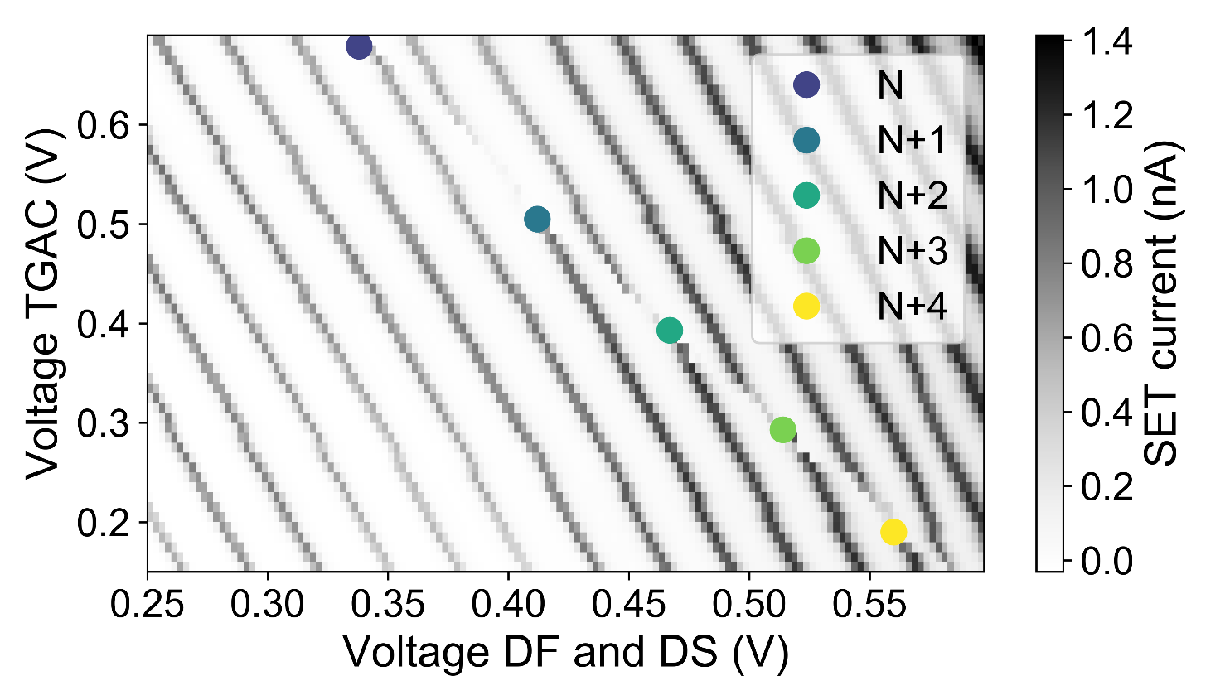

a)
b)
10
−1
N N-1
N-2
N-3
Relaxation rate (s⁻¹)
$$\frac{E_{z}}{2}$$
10
−2
10
−3
10
−4
4
6
8 10
Plunge voltage (mV)
12
14

