Slide 1
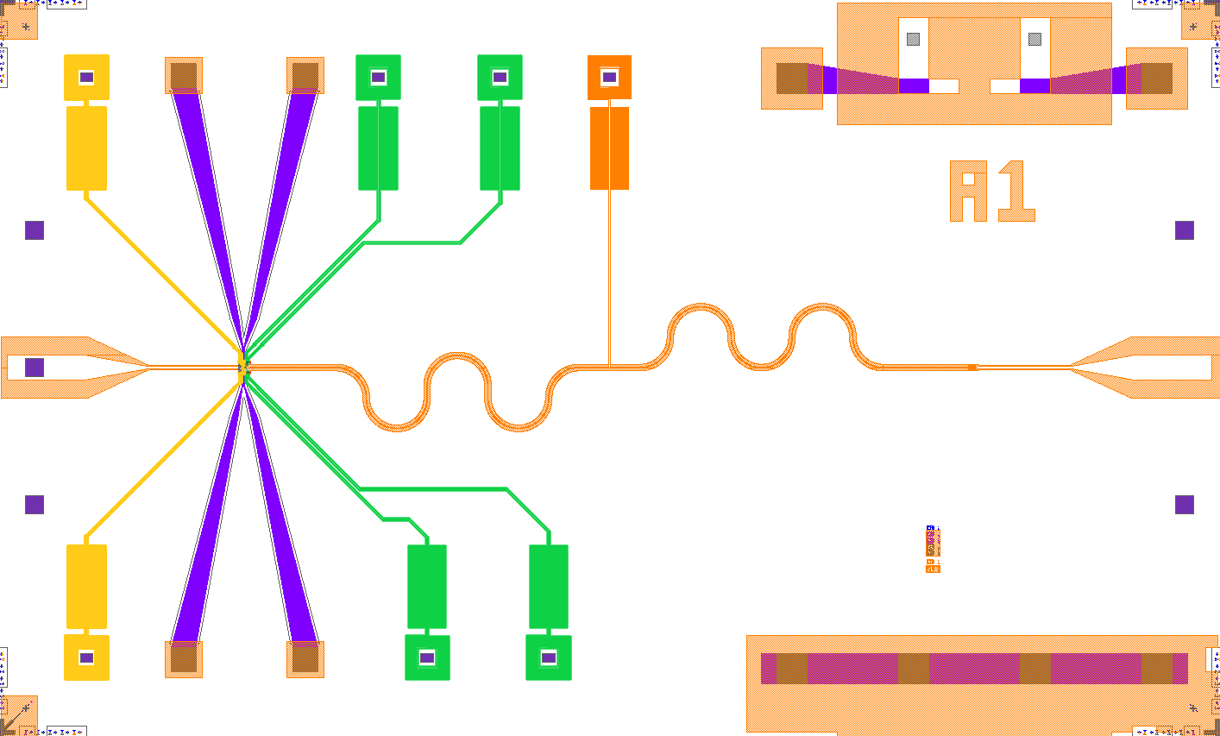
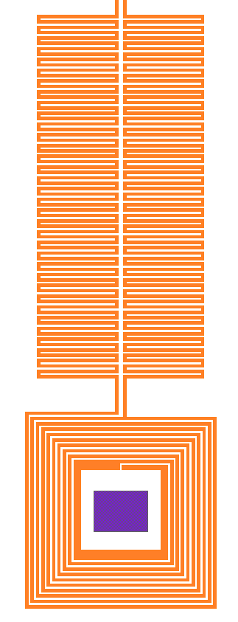
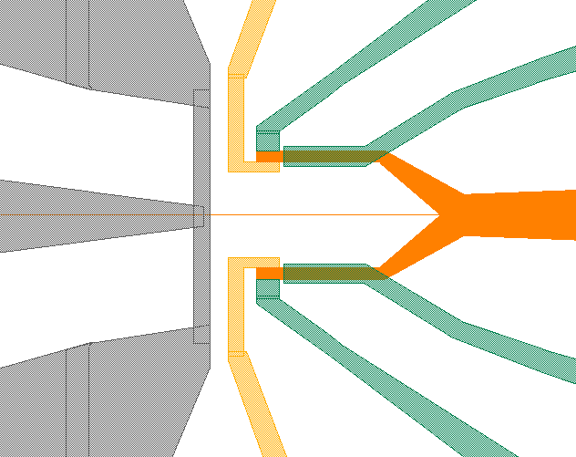
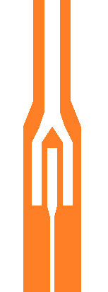
Resonator
Confinement
Reservoir
n+ region
Ohmic
a
Test structure
Qubit
Coplanar waveguide
Capacitor
Inductor
Test structure
b
Inductor
Capacitor
Qubit
RG
TC
CG
MW
CC
CG
RG
TC

Slide 2
