Slide 1
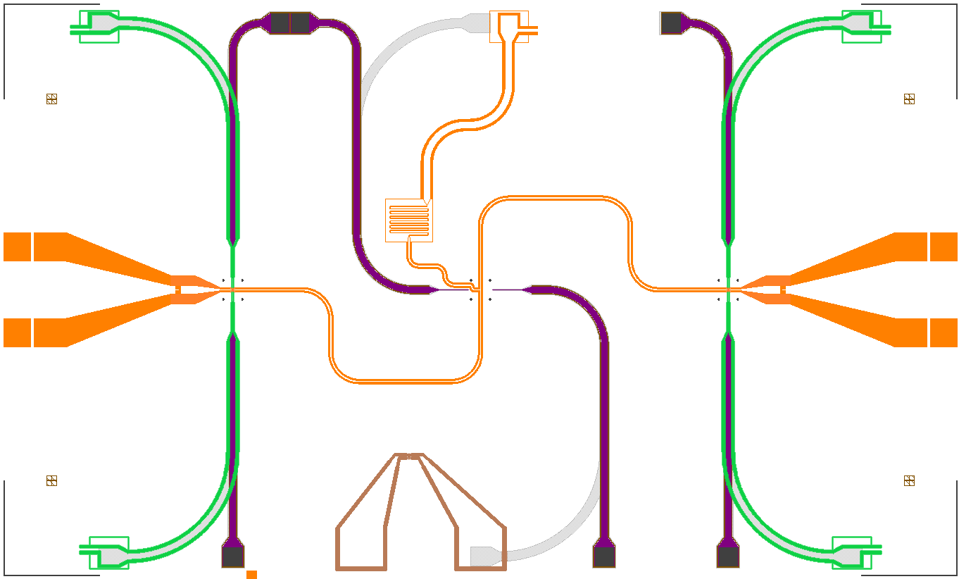

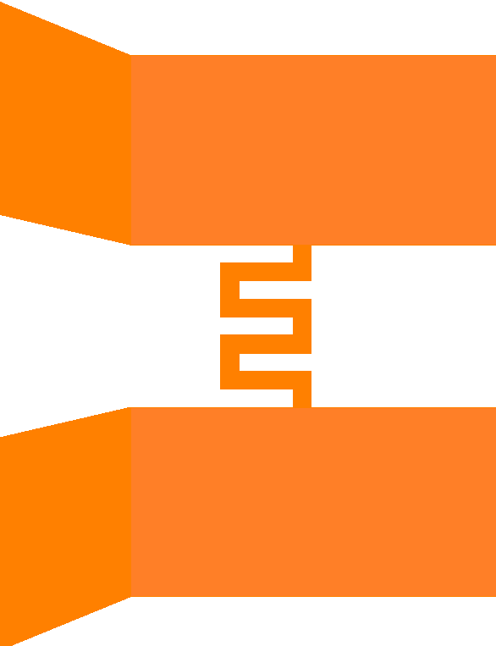
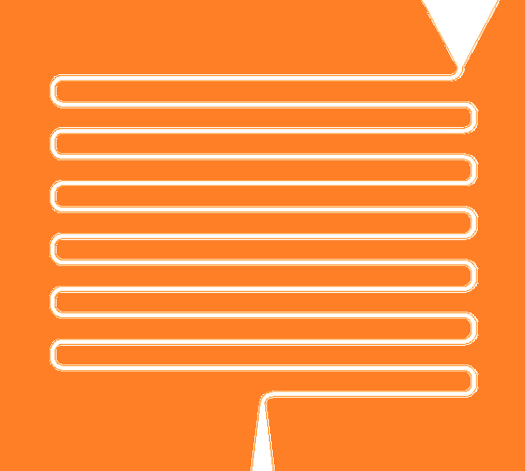
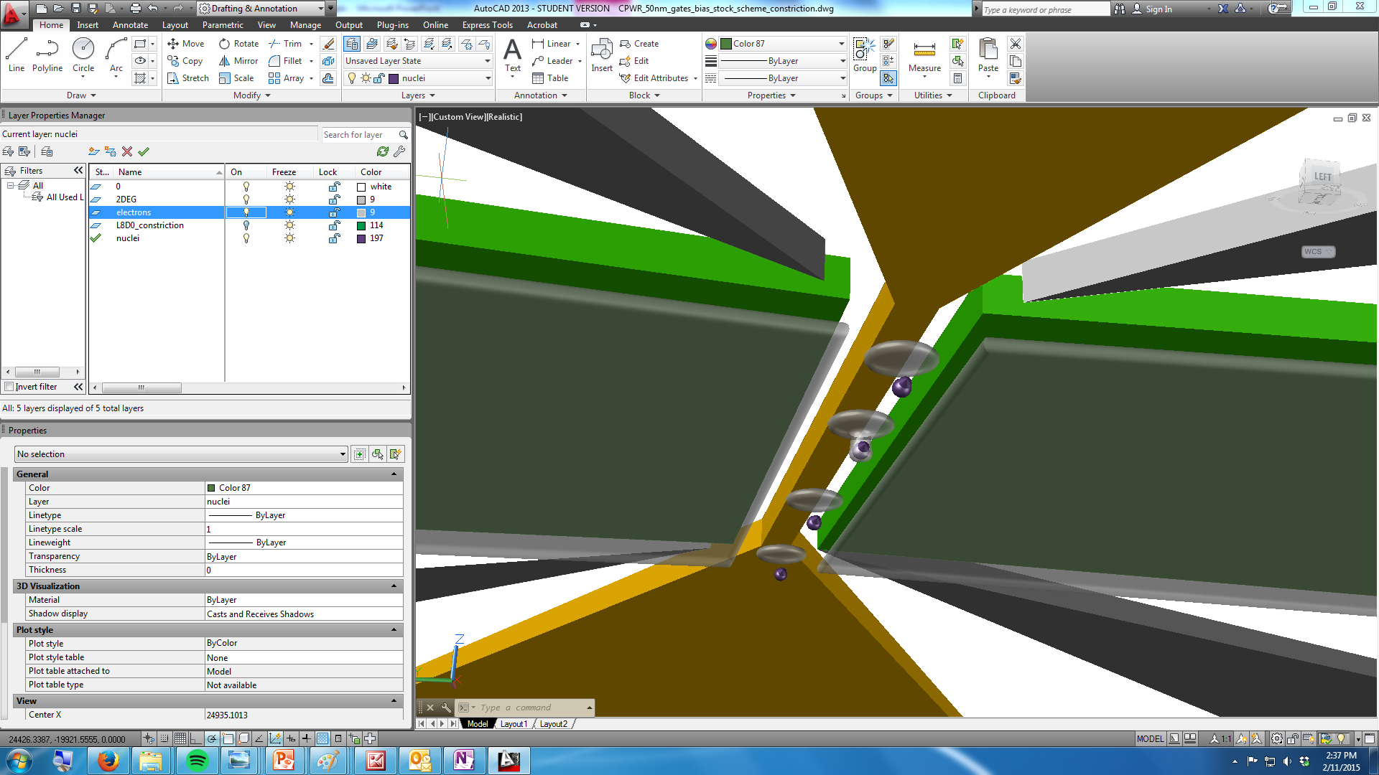
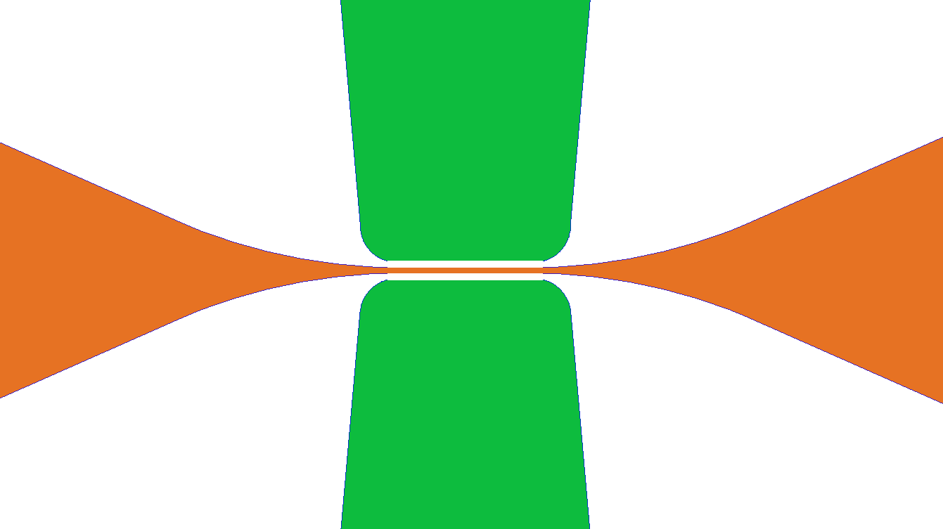
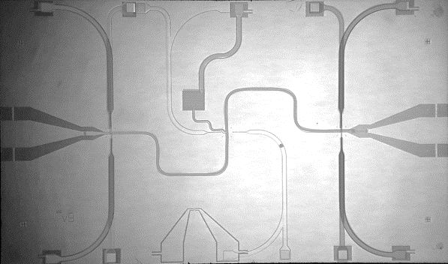
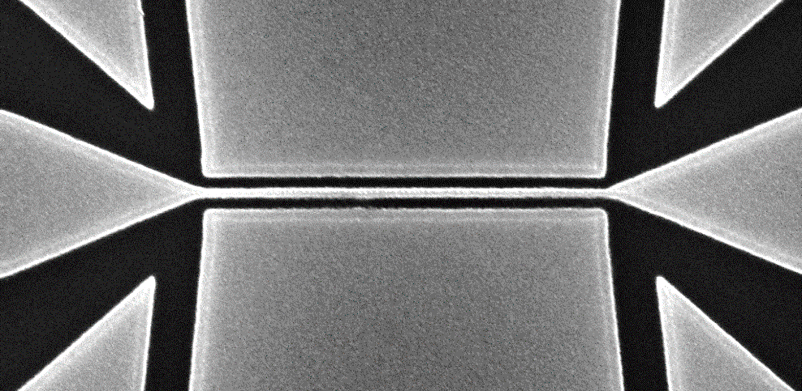
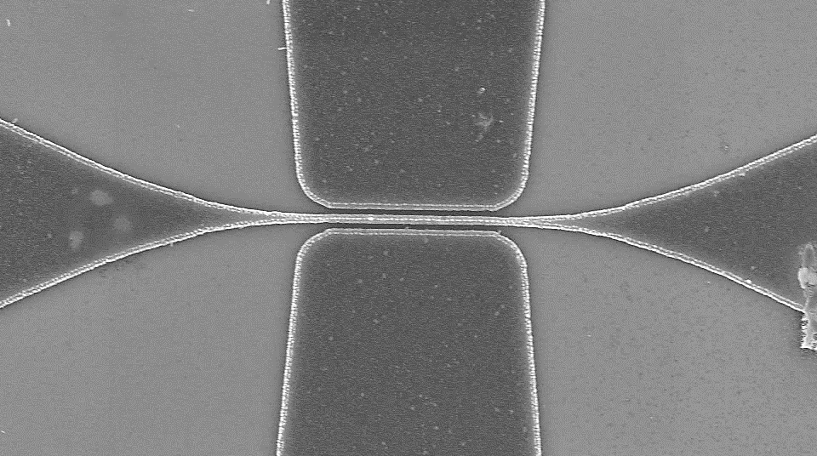
a
Resonator
Reservoir
n+ region
Ohmic contact
b
Inductor
Capacitor
Inductor
Qubit
Qubit
TT
Capacitor
Capacitor
Qubit
2DEG
Test structure
CC
2DEG
Implanted donors
200nm
TB
c
d
Donor gate
Resonator
Reservoir /
Confinement
200nm
e
1mm
200nm

Slide 2
