Slide 1
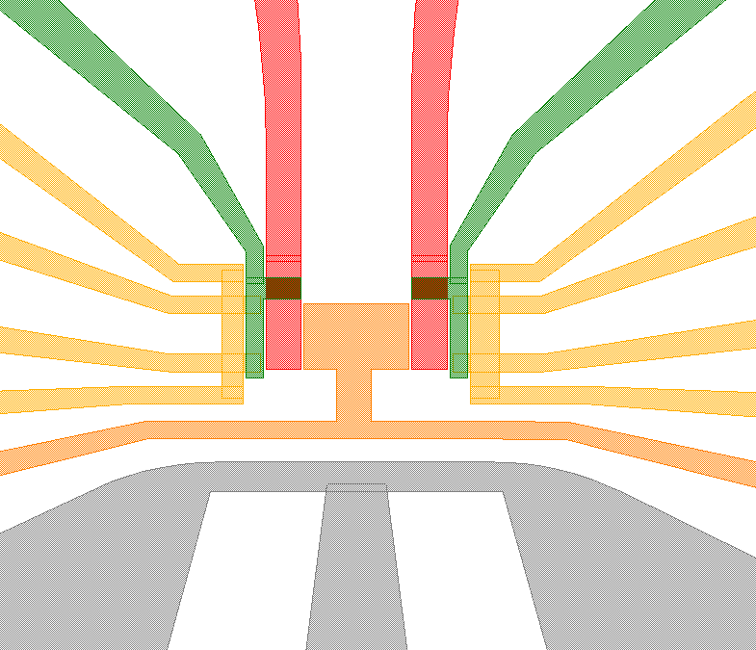
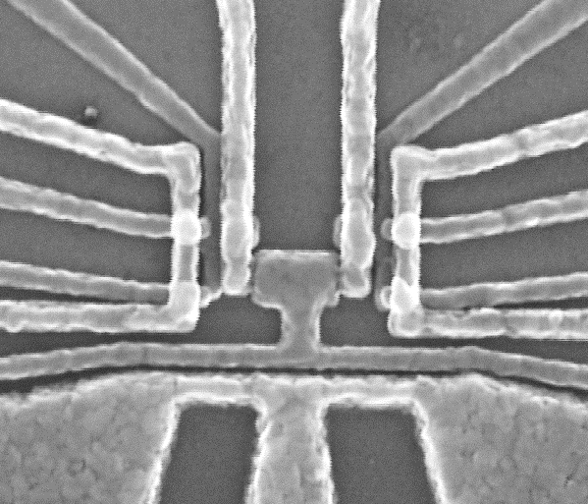
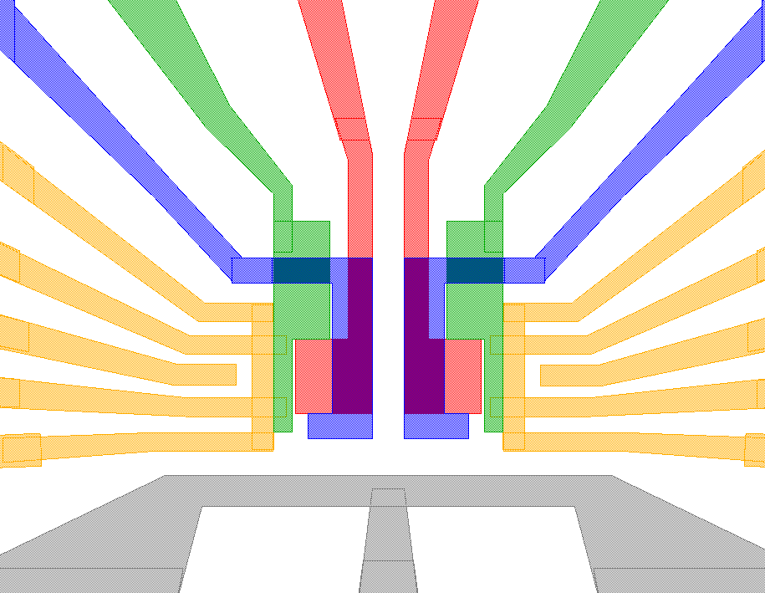
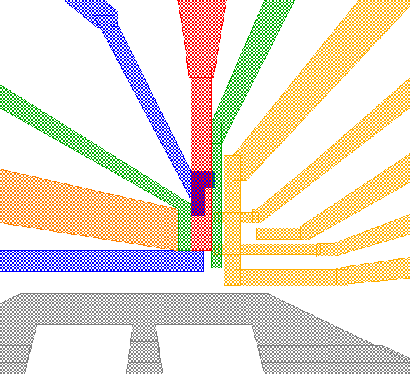
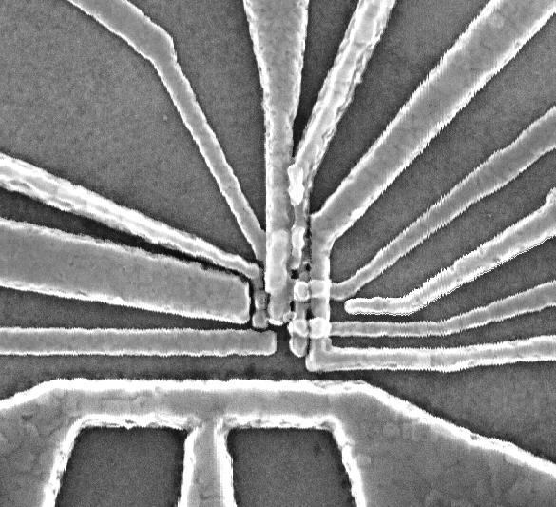
Read-out SET/Reservoir gate
Donor control
Confinement control
Tunnel coupling control
Microwave antenna
Implanted donors
a
RS
DG
TG
RB
LB
RG
200nm
MW
200nm
b
RS
DG
RTC
TG
RB
PL
LB
200nm
MW
200nm
c
DG
RS
RTC
TG
RR
RB
RG
PL
LB
LTC
200nm
MW
200nm

