Slide 1
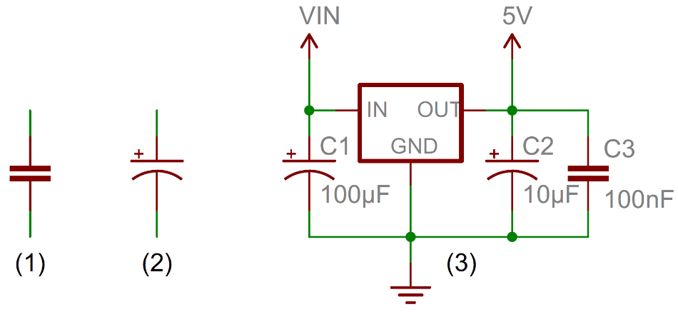

a
b
10
DC
10kOhm
0
AC
)
DC + AC
$$2.18 μF$$
dB
(
-10
t
u
p
t
u
-20
O
Output X, RT
Output X, 1.6 K
-30
Output Y, RT
Output Y, 1.6 K
-40
0
100
200
300
Input frequency (Hz)

