Slide 1
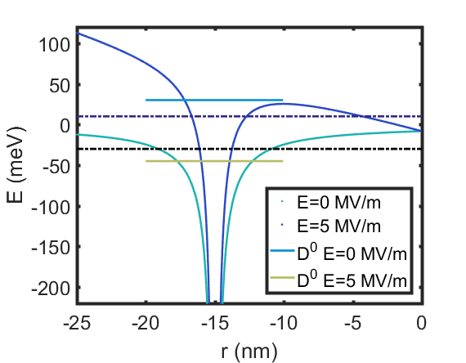


$$E_{F}^{QD}$$
$$E_{F}^{D}$$

