Slide 1

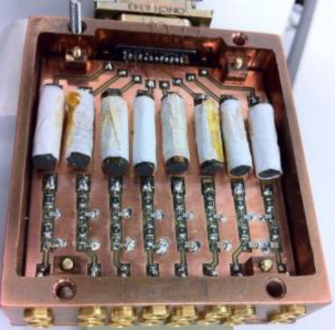
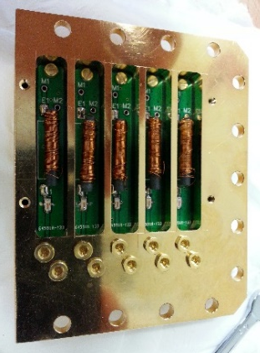
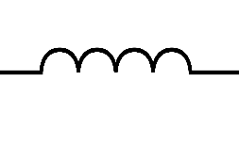
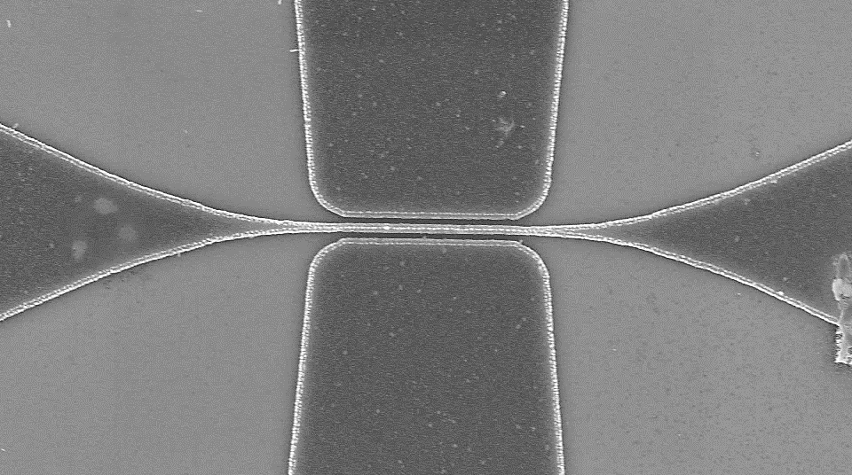
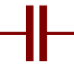
300K
VNA
TTL trigger
AWG
DC source
4 K
20dB
V/V amp
20dB
1 K
6dB
20dB
Base (mK)
20dB
20dB
4-8GHz
Bias T pic
20Hz
80MHz
TT
S
D
TB

