Slide 1

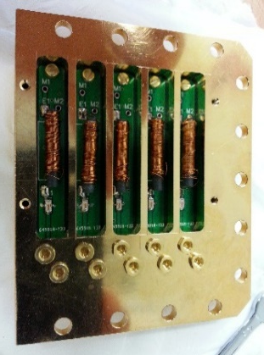
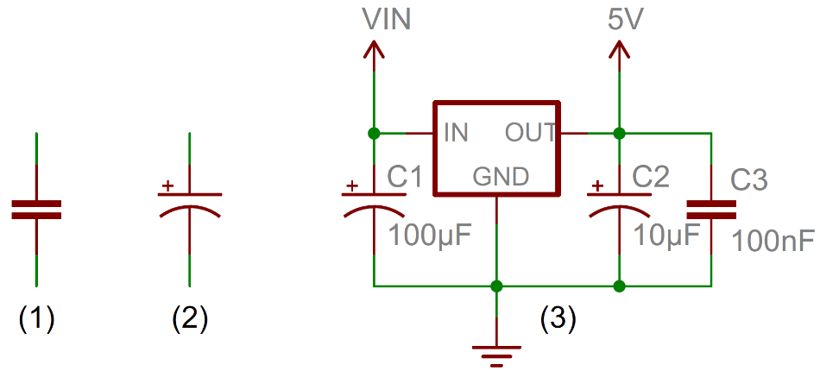
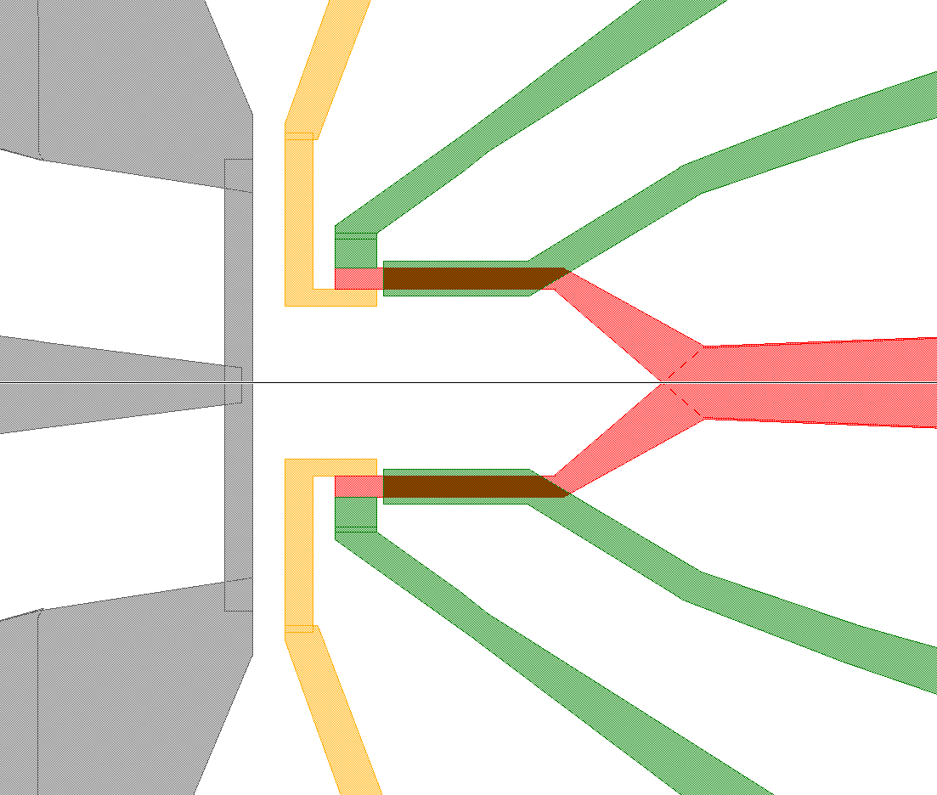
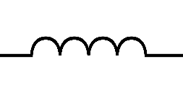
300K
TTL trigger
VNA
AWG
Double DC
block
MW source 1
DC source
MW source 2
V/V amp
4 K
10dB
20dB
20dB
1 K
10dB
20dB
Base (mK)
3dB
10dB
20dB
4-8GHz
DC
block
Circulator
Band pass
Filter
Bias T pic
Hybrid coupler
80MHz
RT
TLT
S
CB
MW antenna
lead
TWPA
CB
S
RB
TLB

