Slide 1

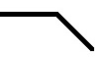
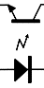
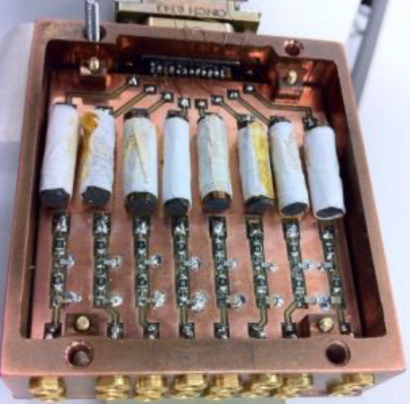
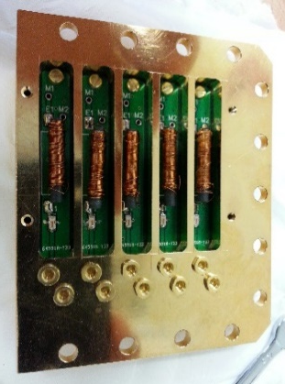
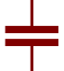
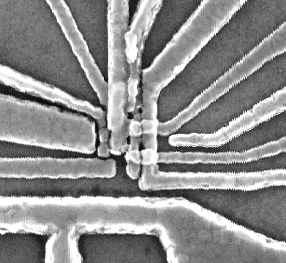

300K
Digitiser
50Hz
TTL trigger
V/V amp
Fast <18GHz
AWG
MW source 1
DC source
MW source 2
V/I amp
4 K
20dB
20dB
10dB
1 K
10dB
10dB
Base
(mK)
10dB
40dB
3dB
Bias T pic
Diplexer pic
20Hz
DC
block
$$I_{SET}$$
80MHz
TLC
DG
RS
D
RR
RB
R
PL
RG
LB
BC
TG
S
MW antenna

