Slide 1

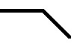
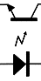
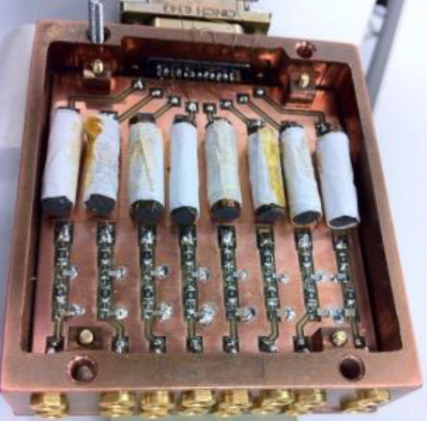
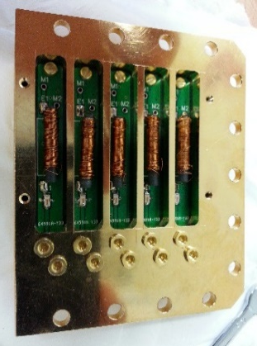
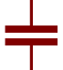
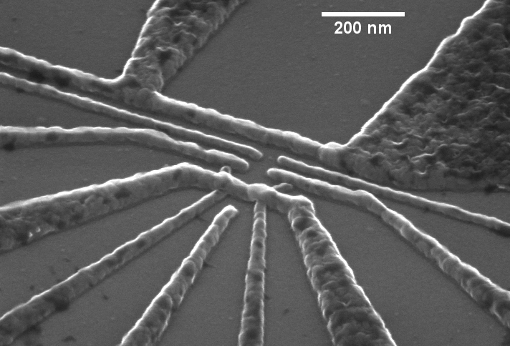

300K
Digitiser
50Hz
TTL trigger
V/V amp
DC source
AWG
RF source
V/I amp
4 K
10dB
1 K
Base (mK)
3dB
DC block
20Hz
80MHz
$$I_{SET}$$
MW antenna
DF1
DS1
S
DF2
LB
D
DS2
TGAC
RB
TG

