Slide 1
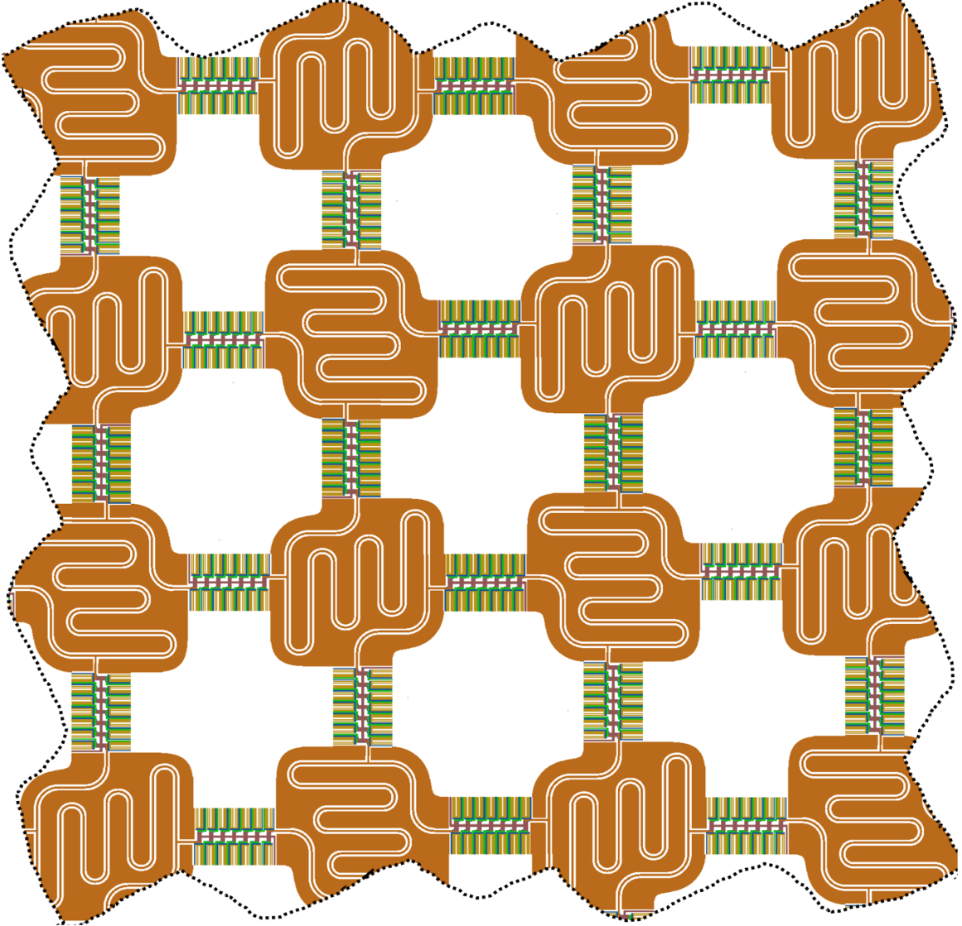
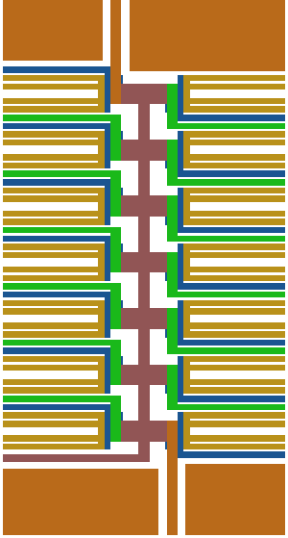
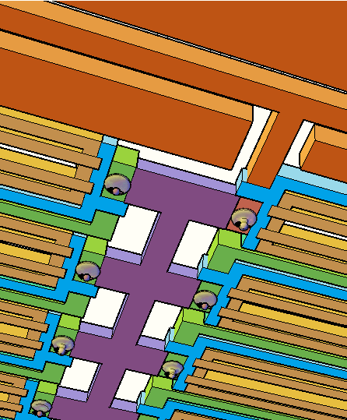
a
b
c
I/O
I/O
I/O
14-qubit cell
Bottom view
I/O
I/O
I/O
1 µm
I/O
I/O
I/O
Microwave resonator
100 µm

