Slide 1


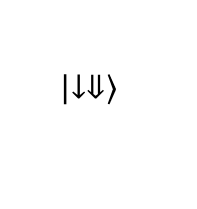
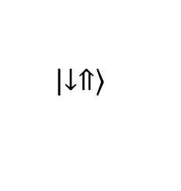
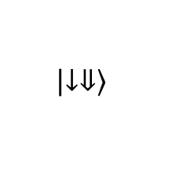
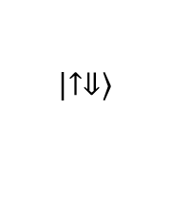
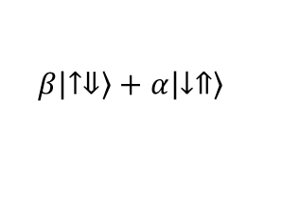
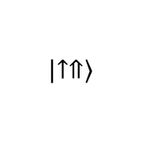
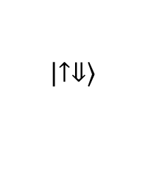
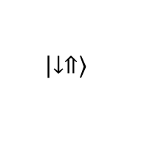
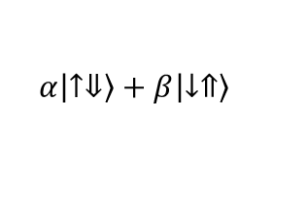
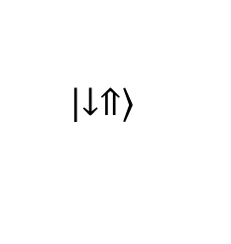


a
$$\left|\left.↑⇓\right\rangle \right.$$
$$\left|\left.↑⇑\right\rangle \right.$$
b
$$\left|\left.↓⇓\right\rangle \right.$$
$$\left|\left.↑⇓\right\rangle \right.$$
$$α\left|\left.↑⇓\right\rangle \right.+β\left|\left.↓⇑\right\rangle \right.$$
EDSR
ESR $⇓$
ESR $⇑$
$$π_{ν_{⇓}}$$
$${10ms}_{ ν_{ff}}$$
$$\left|\left.↓⇓\right\rangle \right.$$
$$\left|\left.↓⇑\right\rangle \right.$$
$$\left|\left.↓⇑\right\rangle \right.$$
$$β\left|\left.↑⇓\right\rangle \right.+α\left|\left.↓⇑\right\rangle \right.$$
$$\left|\left.↓⇑\right\rangle \right.$$
c
1
ESR
n
0.8
ESR
o
i
t
Flip-flop
r
o
p
0.6
o
r
p
p
u
0.4
-
n
i
p
s
0.2
0
43.3
43.32
43.34
43.36
43.38
43.4
f (GHz)

Slide 2
1
ESR
n
0.8
ESR
o
i
t
Flip-flop
r
o
p
0.6
o
r
p
p
u
0.4
-
n
i
p
s
0.2
0
27.95
28
28.05
f (GHz)

