Slide 1
Figures

Slide 2
a)
b)
c)
Readout regime
|↑⇑⟩
|↑⇓⟩
|↓⇓⟩
E_{F}
|↓⇑⟩
Operating regime
|↑⇑⟩
|↑⇓⟩
|↓⇓⟩
|↓⇑⟩
N(E)

Slide 3
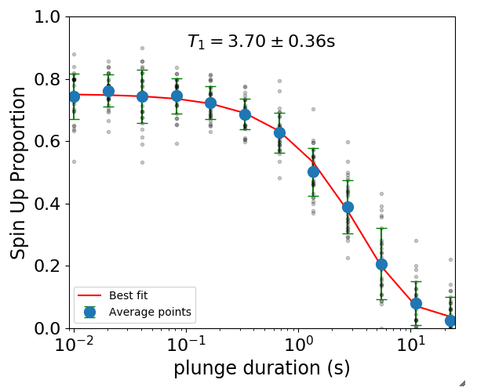





a)
b)
Init $|↑〉$
Plunge
Read-out
$$V_{p}$$
Inversion
Plunge
duration $τ$
Load $|↓〉$

Slide 4
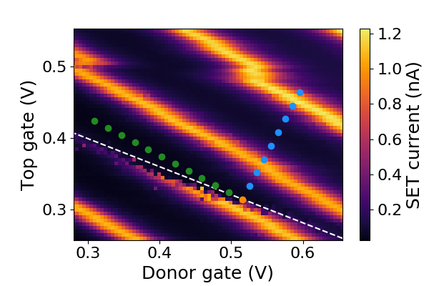
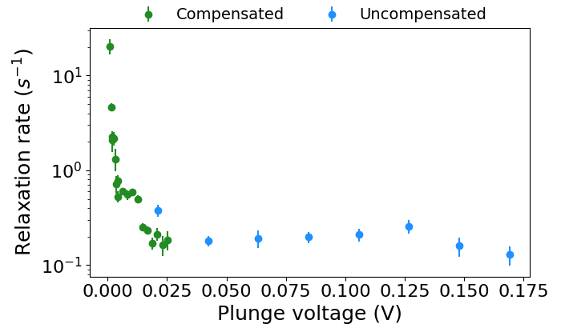
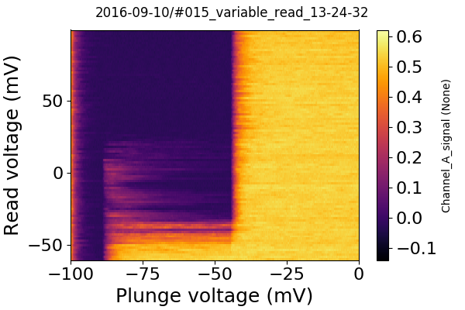
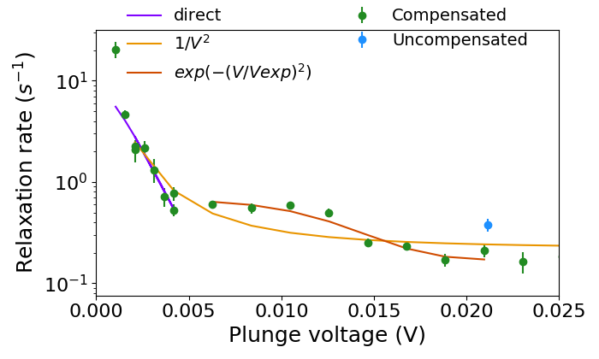

a)
b)
d)
c)
d)
$$\frac{E_{z}}{2}$$

Slide 5
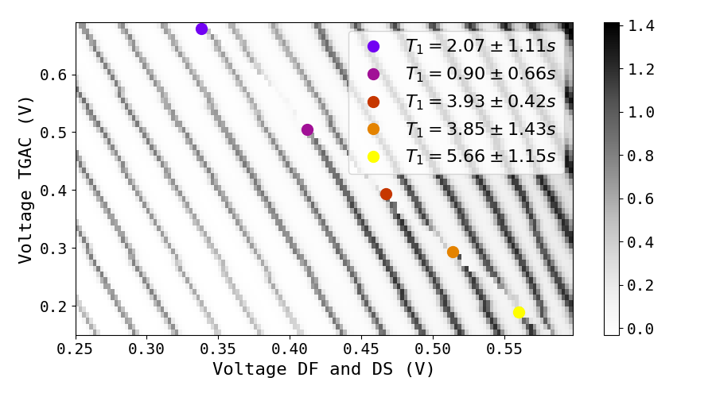
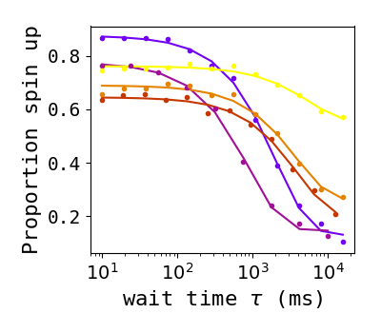
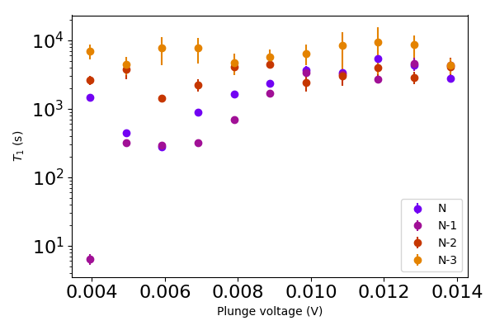


a)
$B_{ext}=1$T
b)
$$\frac{E_{z}}{2}$$

Slide 6
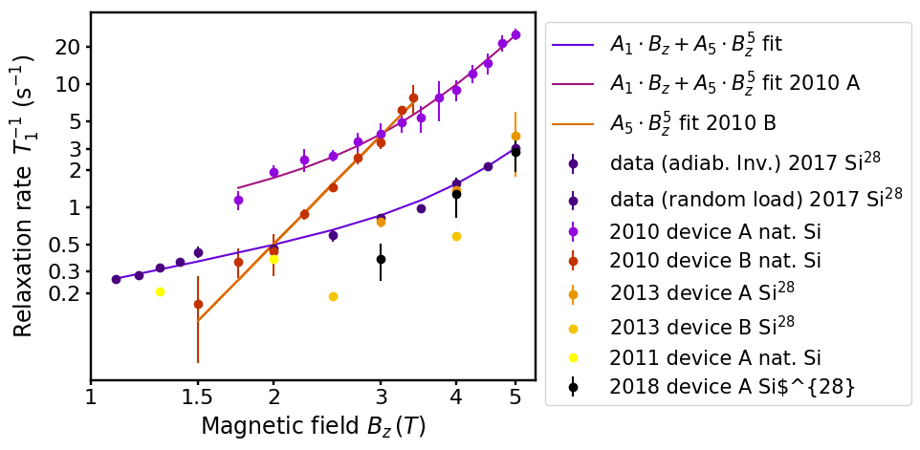
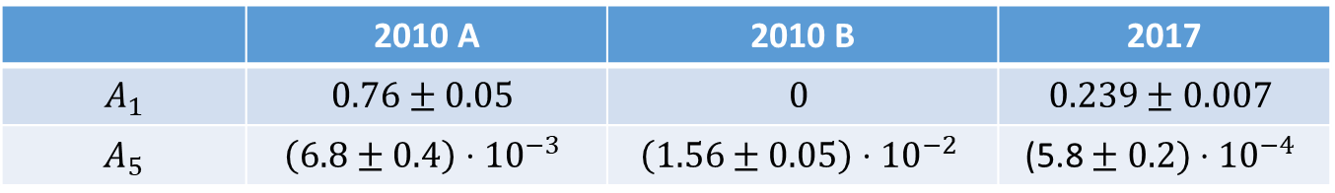
a)
b)
 | 2010 A | 2010 B | 2017
$$A_{1}$$ | $$0.76±0.05$$ | $$0$$ | $$0.239±0.007$$
$$A_{5}$$ | $$\left(6.8±0.4\right)⋅{10}^{−3}$$ | $$\left(1.56±0.05\right)⋅{10}^{−2}$$ | $$\text{(}\text{5.8}±0.2)⋅{10}^{−4}$$

Slide 7
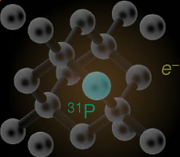
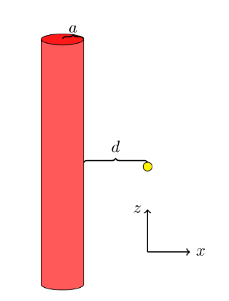
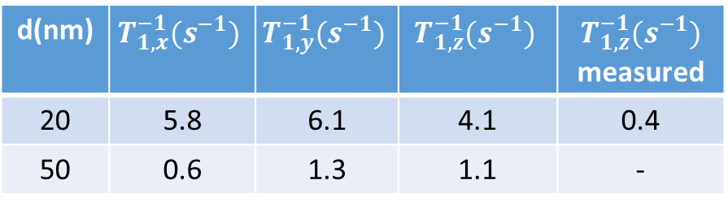
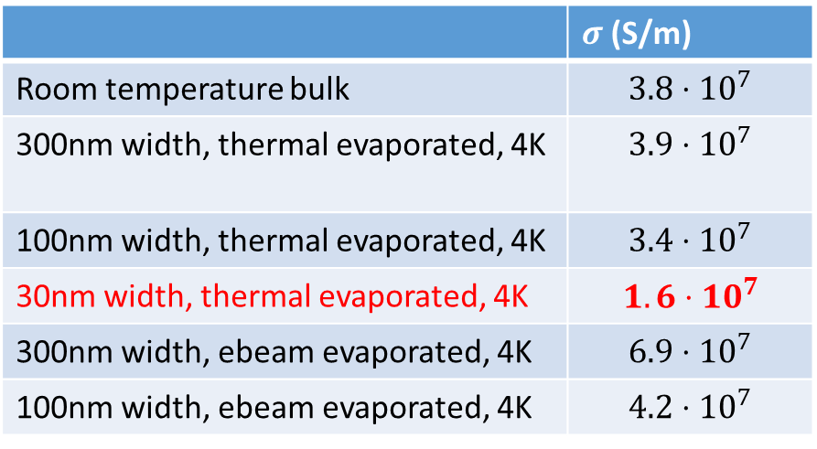
a)
b)
EM wave
metal
dielectric
Evanescent waves
c)
d)
 | $σ$(S/m)
Room temperature bulk | $$3.8⋅10^{7}$$
300nm width, thermal evaporated, 4K | $$3.9⋅{10}^{7}$$
100nm width, thermal evaporated, 4K | $$3.4⋅{10}^{7}$$
30nm width, thermal evaporated, 4K | $$1.6⋅10^{7}$$
300nm width, ebeam evaporated, 4K | $$6.9⋅{10}^{7}$$
100nm width, ebeam evaporated, 4K | $$4.2⋅{10}^{7}$$
e)
d(nm) | $$T_{1,x}^{−1}(s^{−1})$$ | $$T_{1,y}^{−1}(s^{−1})$$ | $$T_{1,z}^{−1}(s^{−1})$$ | $$T_{1,z}^{−1}(s^{−1})$$ measured
20 | 5.8 | 6.1 | 4.1 | 0.4
50 | 0.6 | 1.3 | 1.1 | -

