Slide 1



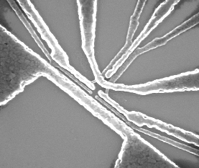
Electron spin relaxation effects of a single phosphorus donor in silicon at low temperatures: tunnel effects summary
Stefanie Tenberg,
Andrea Morello
CQC²T, UNSW
07/06/2018

Slide 2







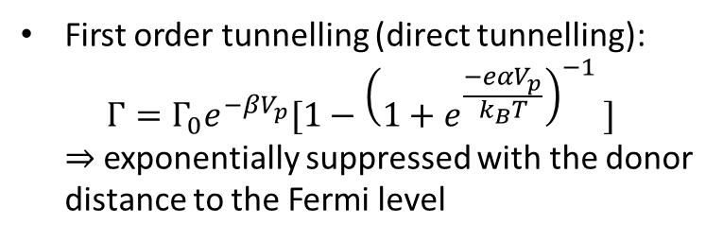
Tunnelling processes between donor and SET
$$E$$
First order tunnelling (direct tunnelling): $Γ=Γ_{0}e^{−βV_{p}}[1−{\left(1+e^{\frac{−eαV_{p}}{k_{B}T}}\right)}^{−1 }]$ $⇒$exponentially suppressed with the donor distance to the Fermi level
|↑⟩
$$E_{F}$$
|↓⟩
$$N(E)$$
Second order tunnelling (co-tunnelling):
$$E$$
$$E_{F}$$
Otsuka et. al. Scientific Reports 2017,
DOI:10.1038/s41598-017-12217-6
|↑⟩
|↓⟩
$$N(E)$$

Slide 3
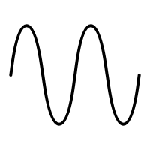
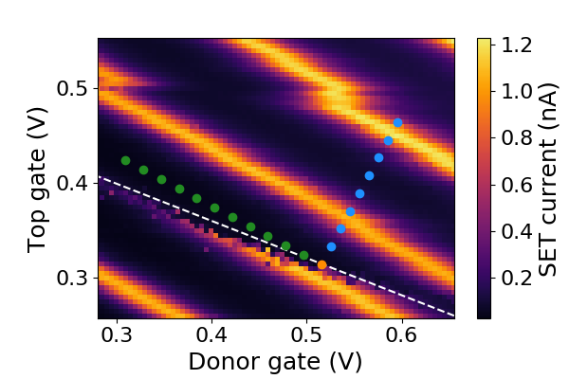




Sequence to measure relaxation times
$$V_{p}$$
Initialization $|↓ 〉$
Plunge
Read-out
0
Inversion
Pulse sequence
$$τ$$
Plunge voltages,
Fixed SET level (compensated) in green
Non compensated in blue
$$V_{p}′$$

Slide 4
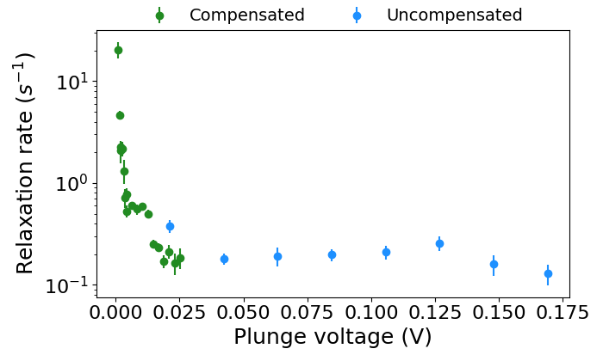
Relaxation rate with plunge depth
Plunge voltage here is distance $V_{p}$’ to the Fermi level

Slide 5
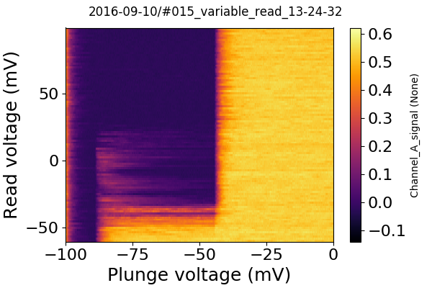
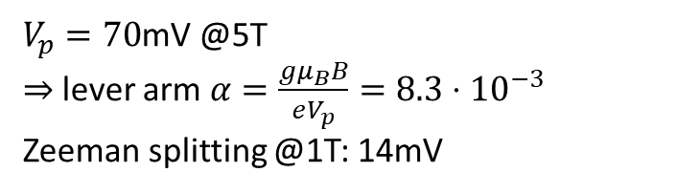
Relate voltages to energy
Spin tail measurement gives the lever arm and the Zeeman splitting in volts
$V_{p}=70$mV @5T
$⇒$lever arm $α=\frac{gμ_{B}B}{eV_{p}}=8.3⋅{10}^{−3}$
Zeeman splitting @1T: 14mV

Slide 6
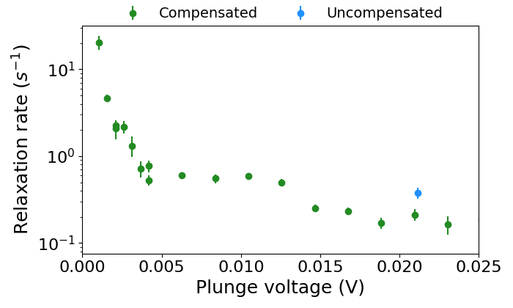
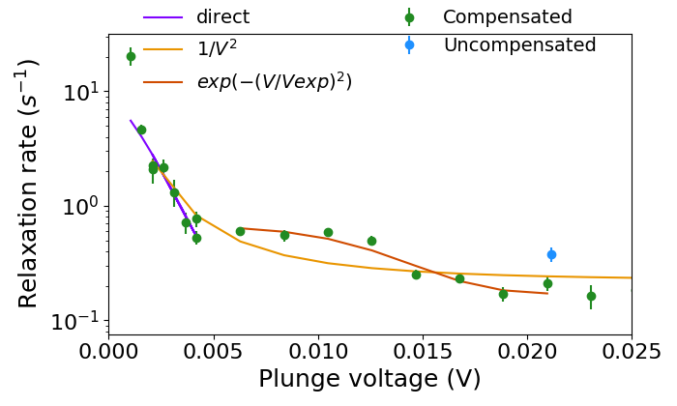
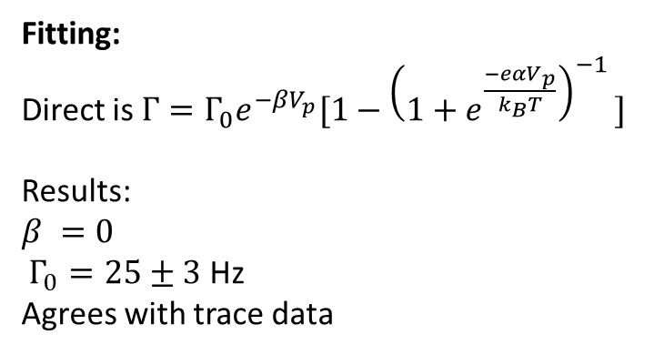

Zoomed in
Fitting:
Direct is $Γ=Γ_{0}e^{−βV_{p}}[1−{\left(1+e^{\frac{−eαV_{p}}{k_{B}T}}\right)}^{−1 }]$
Results:
$β =0$
$Γ_{0}=25±3$ Hz
Agrees with trace data
$$\frac{E_{z}}{2}$$
Co-tunnelling does not fit
What is going on here?
The exponential is a random fit we made up…

Slide 7
$$\frac{E_{z}}{2}$$

Slide 9
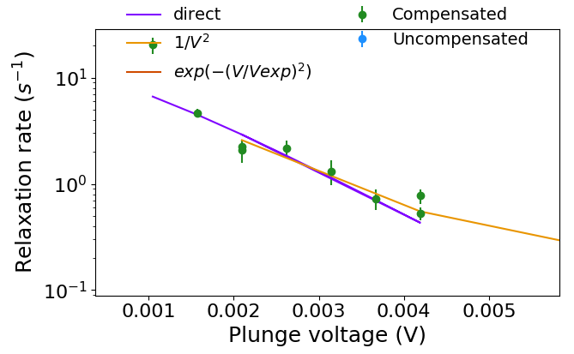

Slide 10
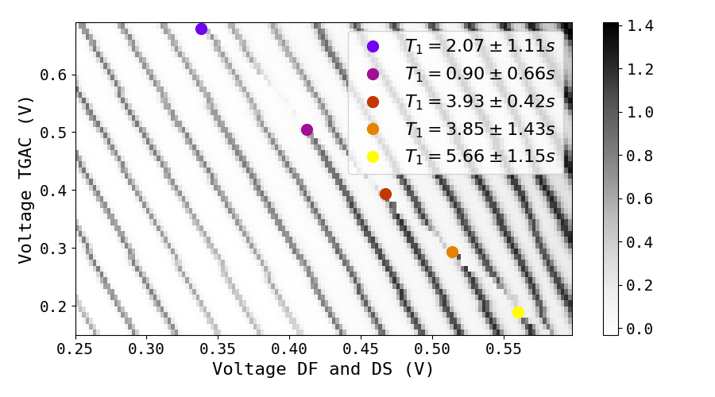


Dependence of $T_{1}$ on SET electron number
$B_{ext}=1$T
Tunnelling effects depend on the Fermi distribution in the SET
The SET is with 𝑛≈100 in the intermediate regime between few and many electrons ⇒ the Fermi distribution has some variation with electron number

Slide 11
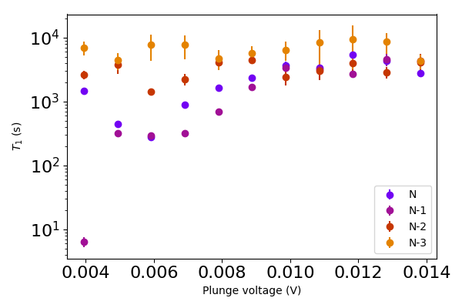

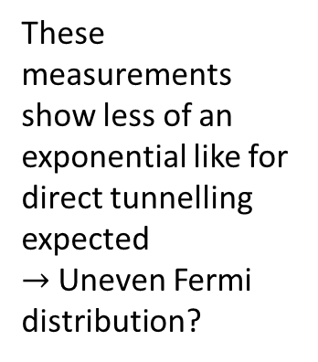

Dependence of $T_{1}$ on SET electron number
These measurements show less of an exponential like for direct tunnelling expected
$→$Uneven Fermi distribution?
$$\frac{E_{z}}{2}$$
For large plunge voltages all tunnelling processes are suppressed ⇒ relaxation is independent of electron number

Slide 12
Questions for Bill
Do you have any idea what is going on for plunge voltages deeper than half the Zeeman energy?
It seems that we observe direct tunnelling until the spin up moves below the Fermi level – as expected. Below that there is still a drop of up at a factor of 5 until the relaxation rate reaches the phonon relaxation plateau. What is going on here?
Additional information:
Unfortunately this specific sample died so we cannot take any more measurements. Also, as we were changing over our measurement software at that time, we do not have the traces for this specific measurement set. Although we should have general traces somewhere to dig up, which I’m in the process of doing.

