Slide 1


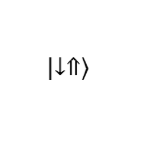







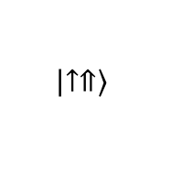

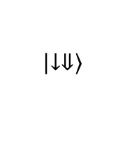
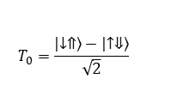


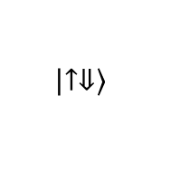
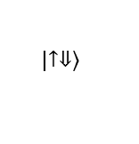



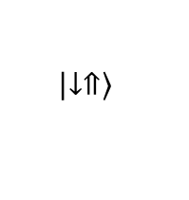
$$V_{t}$$
a
b
c
$$\left|\left.↑⇑\right\rangle \right.$$
$$\left|\left.↑⇓\right\rangle \right.$$
NMR
Energy
$$|\left.i\right\rangle$$
gate
$$|\left.d\right\rangle$$
SiO₂
EDSR
ESR
ESR
²⁸Si
z_{d}
z
³¹P
$$\left|\left.↓⇓\right\rangle \right.$$
NMR
$$\left|\left.↓⇑\right\rangle \right.$$
d
$E_{z}−E_{z}^{0}$ (kV/m)
-20
-10
0
10
20
100
$$|\left.i\right\rangle$$
$$\left|\left.↑⇓\right\rangle \right.$$
80
60
10 nm
Hyperfine (MHz)
$$γ_{+}B_{0}$$
40
$$\frac{|\left.i\right\rangle −|\left.d\right\rangle }{\sqrt{2}}$$
$$S$$
$$T_{0}$$
20
Tight-binding
$$A(E_{z})$$
$$|\left.d\right\rangle$$
Two-level approx.
0
4.07
4.08
4.09
4.1
4.11
$$\left|\left.↓⇑\right\rangle \right.$$
Electric field $Ez$ (MV/m)
$$T_{0}=\frac{\left|\left.↓⇑\right\rangle \right.−\left|\left.↑⇓\right\rangle \right.}{\sqrt{2}}$$
$$S=\frac{\left|\left.↓⇑\right\rangle \right.+\left|\left.↑⇓\right\rangle \right.}{\sqrt{2}}$$
Notes:
Hyperfine modulation with electric fields

