Slide 1
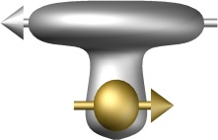


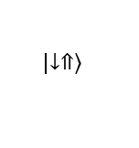



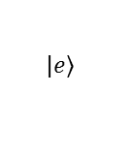


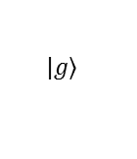


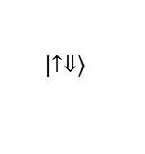

$$\left|\left.e\right\rangle \right.$$
100
$$\left|\left.↑⇓\right\rangle \right.$$
$$δ_{so}$$
$$δ_{E}$$
$τ_{π/2}$ (ns)
power (W)
$$E_{ac}$$
$$ε_{o}^{}$$
$E_{ac}^{}$ (V/m)
$$ε_{ff}^{}$$
$$g_{E}$$
$$ν_{E}$$
$$g_{so}$$
0
$E_{z}$noise
relax.
adiab.
$$\left|\left.↓⇑\right\rangle \right.$$
$$\left|\left.g\right\rangle \right.$$
1
flip-flop
position
charge
10²
0
error rate
$$K$$
-1
10¹
0
10
20
30
$V_{t}$ (GHz)
15
30
10¹
10²
10³
$time$ (ns)
$τ_{π/2}$ (ns)
$E_{z,rms}^{noise}$ (V/m)
$V_{t}$ (GHz)
$E_{z}^{}−E_{z}^{0}$(V/m)
a
d
e
b
f
c
g

