Slide 1
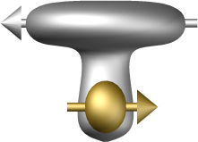



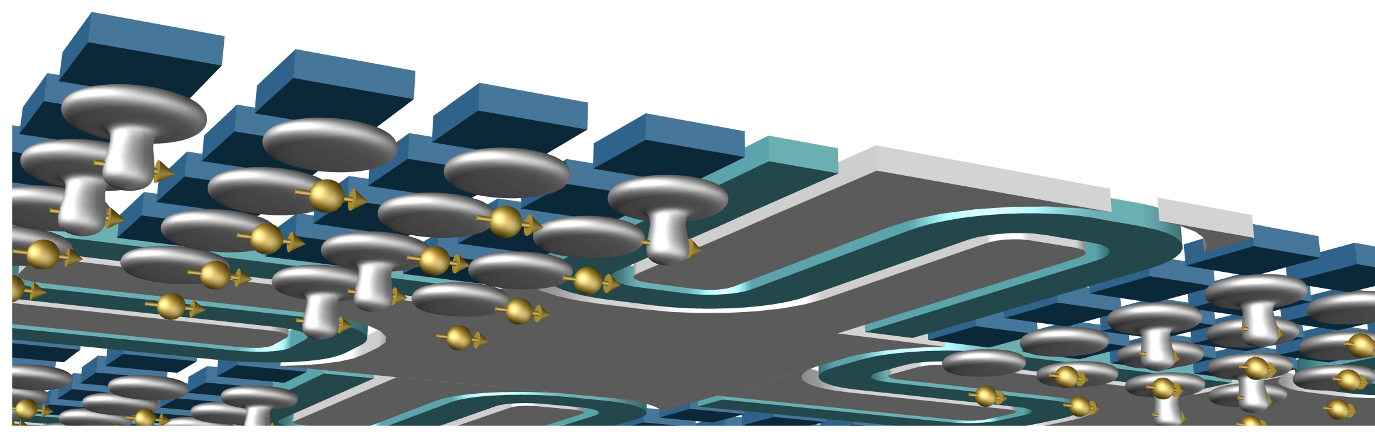

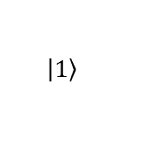

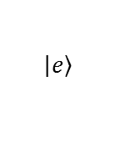


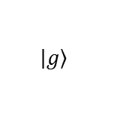
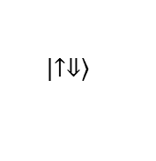

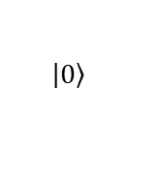



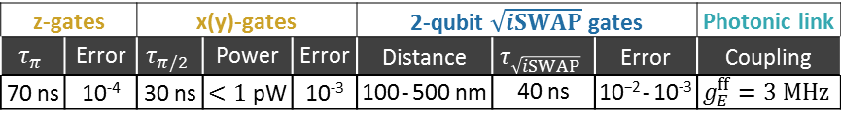
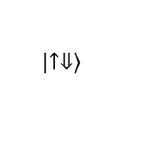

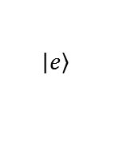

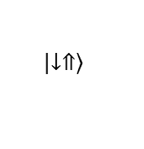
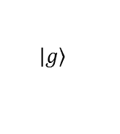
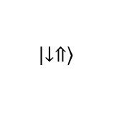

E_{vac}
a
b
z-gates |  | x(y)-gates |  |  | 2-qubit $\sqrt{iSWAP}$ gates |  |  | Photonic link
$$τ_{π}$$ | Error | $$τ_{π/2}$$ | Power | Error | Distance | $$τ_{\sqrt{iSWAP}}$$ | Error | Coupling
70 ns | 10⁻⁴ | 30 ns | $<1$ pW | 10⁻³ | $\text{10}\text{0}$ - 500 nm | 40 ns | $\text{10}\text{−}\text{2}$ - 10⁻³ | $$g_{E}^{ff}=3 MHz$$
$$\left|\left.e\right\rangle \right.$$
photon
$$\left|\left.e\right\rangle \right.$$
$$\left|\left.↑⇓\right\rangle \right.$$
$$δ_{E}$$
$$\left|\left.1\right\rangle \right.$$
$$\left|\left.↑⇓\right\rangle \right.$$
$$δ_{so}$$
$$δ_{E}$$
$$δ_{so}$$
$$ε_{o}^{}$$
$$ε_{o}^{}$$
$$ε_{ff}^{}$$
$$ν_{E}$$
$$ε_{ff}^{}$$
c
$$g_{so}$$
$$g_{E}$$
$$g_{E}$$
$$g_{so}$$
gate resonator ground resonator gate
$$\left|\left.↓⇑\right\rangle \right.$$
$$\left|\left.g\right\rangle \right.$$
$$\left|\left.0\right\rangle \right.$$
$$\left|\left.g\right\rangle \right.$$
$$\left|\left.↓⇑\right\rangle \right.$$
SiO₂
E_{vac}
²⁸Si
1 μm-1 cm
d

