Slide 1





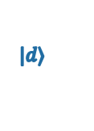

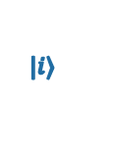


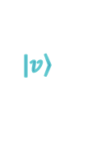
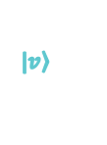

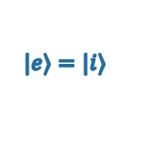


$E_{z}−E_{z}^{0}$ (kV m⁻¹)
-10
0
10
20
30
Tight binding
90
Two-level approx.
$$V_{t}^{v}$$
$$|\left.v\right\rangle$$
60
$|\left.e\right\rangle =|\left.d\right\rangle$
$$V_{s}^{}$$
30
Energy (GHz)
$$ε_{o}^{}$$
$|\left.g\right\rangle =|\left.i\right\rangle$
$$V_{t}^{}$$
0
$|\left.e\right\rangle =|\left.i\right\rangle$
z_{d}
SiO₂
$$|\left.v\right\rangle$$
$$V_{t}^{v}$$
Energy
Top Gate
V_{s}
-30
$|\left.g\right\rangle =|\left.d\right\rangle$
SiO₂
$$|\left.d\right\rangle$$
$$V_{t}^{}$$
0
$$|\left.i\right\rangle$$
|+〉
z
4.07
4.08
4.09
4.10
4.11
4.12
Electric Field $Ez$ (MV m⁻¹)

