Slide 1









a
b
-
+
𝓘_{n} = -1e
𝓘_{n} = 0.5e
+
-
𝓘_{e} = -0.5e
𝓘_{e} = 1e
Metal
SiO₂
-
Silicon
-
Silicon
𝓓_{e} = -1e
𝓓_{e} = -1e
+
𝓓_{n} = 1e
+
𝓓_{n} = 1e
c
e
top view
top view
y
x
d
y
x
f
g
$g_{dd}$ (MHz)
$g_{dd}$ (MHz)
400
600
20
20
300
400
displacement $y_{1}$ (nm)
displacement $x_{1}$ (nm)
0
200
0
200
-20
100
-20
0
-20
0
20
0
-20
0
20
-200
displacement $y_{2}$ (nm)
displacement $x_{2}$ (nm)

Slide 2
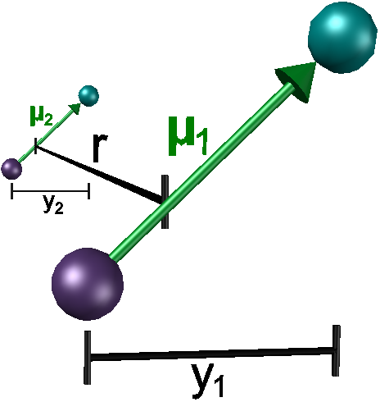


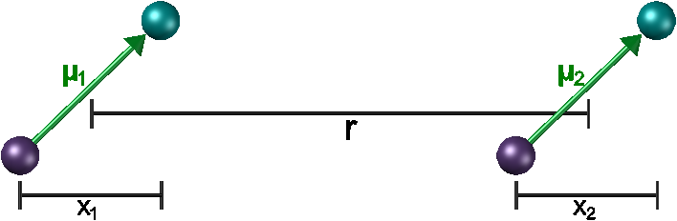







a
b
-
+
𝓘_{n} = -1e
𝓘_{n} = 0.5e
+
-
𝓘_{e} = -0.5e
𝓘_{e} = 1e
Metal
SiO₂
-
Silicon
-
Silicon
𝓓_{e} = -1e
𝓓_{e} = -1e
+
𝓓_{n} = 1e
+
𝓓_{n} = 1e
c
d
$g_{dd}$ (MHz)
400
20
300
displacement $y_{1}$ (nm)
0
200
-20
100
-20
0
20
0
displacement $y_{2}$ (nm)
e
f
g
$g_{dd}$ (MHz)
top view
600
20
400
displacement $x_{1}$ (nm)
0
200
-20
0
-20
0
20
-200
displacement $x_{2}$ (nm)

Slide 3











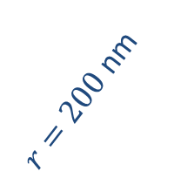



a
c
-
b
+
d
I_{n} = -1e
I_{n} = 0.5e
$g_{dd}$ (MHz)
$g_{dd}$ (GHz)
30
-
I_{e} = -0.5e
30
+
I_{e} = 1e
1.5
Metal
20
C = -1
SiO₂
20
C = 0.5
Silicon
Silicon
displacement $x_{1}$ (nm)
-
displacement $x_{1}$ (nm)
372
-
1
D_{e} = -1e
10
D_{e} = -1e
10
0.5
+
0
0
10
20
30
+
0
0
10
20
30
D_{n} = 1e
displacement $x_{2}$ (nm)
D_{n} = 1e
displacement $x_{2}$ (nm)
e
f
$g_{dd}$ (MHz)
30
400
20
350
displacement $x_{1}$ (nm)
C = -0.5
$$μ_{1}$$
300
$$x_{1}$$
10
250
$$μ_{2}$$
$r=200$ nm
0
$$x_{2}$$
0
10
20
30
displacement $x_{2}$ (nm)
z = 200 nm
d = 10 nm

Slide 4

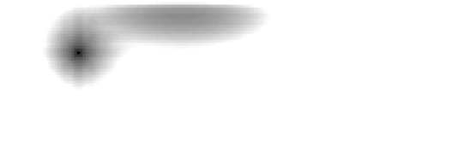




metal
SiO₂
Si
$$μ_{1,x}$$
$$μ_{1,z}$$
SiO₂
$$μ_{2,x}$$
$$μ_{2,z}$$
Si
SiO₂
Si

