Slide 1




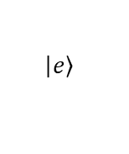

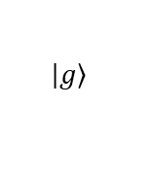





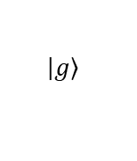

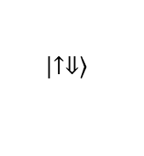


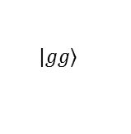
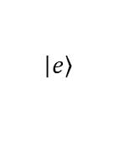


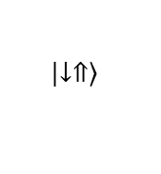


a
gate
gate
SiO₂
100-500 nm
b
c
$$\left|\left.e\right\rangle \right.$$
$$\left|\left.e\right\rangle \right.$$
$$−α\left|\left.ge\right\rangle \right.+β\left|\left.ge\right\rangle \right.$$
$$\left|\left.↑⇓\right\rangle \right.$$
$$\left|\left.↑⇓\right\rangle \right.$$
$$D_{dd}$$
$$δ_{so,1}$$
$$δ_{so,2}$$
$$δ_{so,2}−δ_{so,1}$$
$$ε_{o,1}^{}$$
$$ε_{o,2}^{}$$
$$D_{dd}$$
$$ε_{ff}^{}$$
$$ε_{ff}^{}$$
$$g_{so,1}$$
$$g_{dd}$$
$$g_{so,2}$$
$$β\left|\left.eg\right\rangle \right.+α\left|\left.ge\right\rangle \right.$$
$$ε_{o,1}^{}$$
$$\left|\left.↓⇑\right\rangle \right.$$
$$\left|\left.g\right\rangle \right.$$
$$\left|\left.g\right\rangle \right.$$
$$\left|\left.↓⇑\right\rangle \right.$$
$$\left|\left.gg\right\rangle \right.$$

