Slide 1


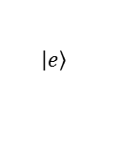

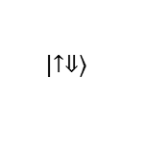
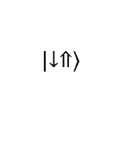


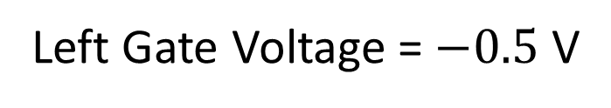
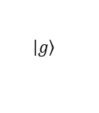

$$\left|\left.e\right\rangle \right.$$
$$\left|\left.↑⇓\right\rangle \right.$$
$$δ_{so}$$
$$ε_{ff}$$
$$ε_{o}$$
$$g_{so}$$
$$\left|\left.↓⇑\right\rangle \right.$$
$$\left|\left.g\right\rangle \right.$$
a
b
Left Gate Voltage = $−0.5$ V
Al₂O₃
Al
Left Gate
Top
Gate
Right Gate
SiO₂
SiO₂
³¹P
Si
Silicon
30 nm

