Slide 1
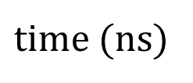

100
$E_{ac}^{}$ (V/m)
0
1
flip-flop
position
charge
0
-1
0
10
20
30
$time$ (ns)

