Slide 1


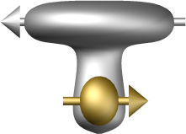

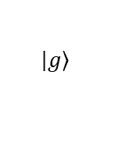


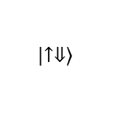
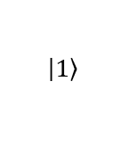


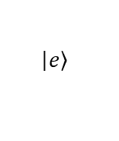

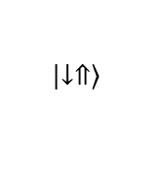
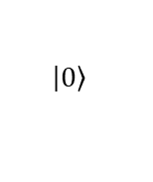
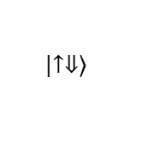


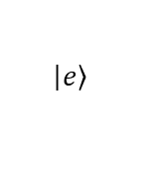
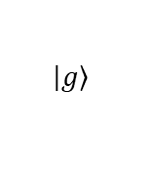
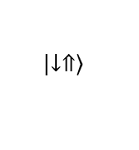





a
$$\left|\left.e\right\rangle \right.$$
photon
$$\left|\left.e\right\rangle \right.$$
$$\left|\left.↑⇓\right\rangle \right.$$
$$\left|\left.1\right\rangle \right.$$
$$\left|\left.↑⇓\right\rangle \right.$$
$$δ_{so}$$
$$δ_{E}$$
$$δ_{E}$$
$$δ_{so}$$
$$ε_{o}^{}$$
$$ε_{o}^{}$$
$$ν_{E}$$
$$ε_{ff}^{}$$
$$ε_{ff}^{}$$
$$g_{so}$$
$$g_{E}$$
$$g_{E}$$
$$g_{so}$$
$$\left|\left.↓⇑\right\rangle \right.$$
$$\left|\left.g\right\rangle \right.$$
$$\left|\left.0\right\rangle \right.$$
$$\left|\left.g\right\rangle \right.$$
$$\left|\left.↓⇑\right\rangle \right.$$
b
gate resonator ground resonator gate
SiO₂
E_{vac}
²⁸Si
1 μm-1 cm

