Slide 1
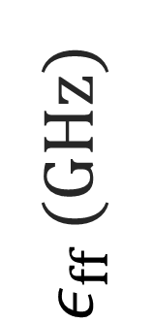
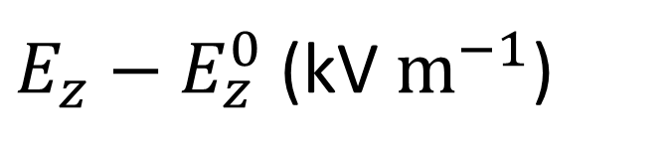
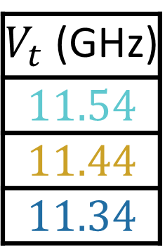
$V_{t}$ (GHz)
$$11.54$$
$$11.44$$
$$11.34$$
11.194
2nd order CT
11.193
$ε_{ff}$ (GHz)
11.192
11.191
1st order CT
$E_{z}−E_{z}^{0}$(kV $m^{−1}$)

