Slide 1
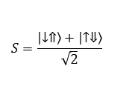
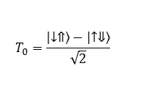
$$T_{0}=\frac{\left|\left.↓⇑\right\rangle \right.−\left|\left.↑⇓\right\rangle \right.}{\sqrt{2}}$$
$$S=\frac{\left|\left.↓⇑\right\rangle \right.+\left|\left.↑⇓\right\rangle \right.}{\sqrt{2}}$$
Notes:
Hyperfine modulation with electric fields

