Slide 1





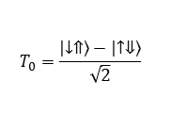

$E_{z}−E_{z}^{0}$ (kV/m)
-20
-10
0
10
20
100
$$|\left.i\right\rangle$$
80
60
10 nm
Hyperfine (MHz)
40
$$\frac{|\left.i\right\rangle −|\left.d\right\rangle }{\sqrt{2}}$$
20
$$|\left.d\right\rangle$$
Tight-binding
Two-level approx.
0
4.07
4.08
4.09
4.1
4.11
Electric field $Ez$ (MV/m)
$$T_{0}=\frac{\left|\left.↓⇑\right\rangle \right.−\left|\left.↑⇓\right\rangle \right.}{\sqrt{2}}$$
$$S=\frac{\left|\left.↓⇑\right\rangle \right.+\left|\left.↑⇓\right\rangle \right.}{\sqrt{2}}$$
Notes:
Hyperfine modulation with electric fields

