Slide 1
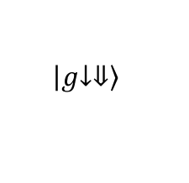
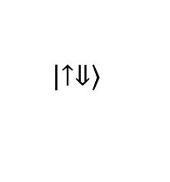
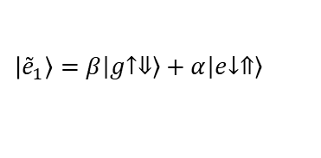

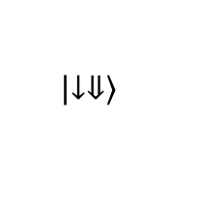


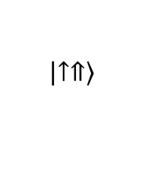
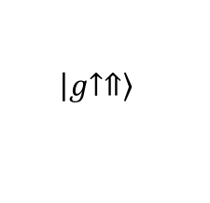
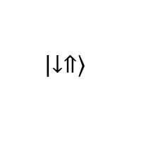
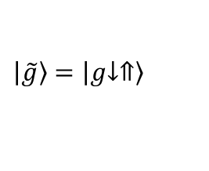
coupling spin to charge
$$\left|\left.↑⇑\right\rangle \right.$$
$$\left|g\left.↑⇑\right\rangle \right.$$
$$|{\tilde{e}}_{2}〉=−α\left|g\left.↑⇓\right\rangle \right.+β\left|e\left.↓⇑\right\rangle \right.$$
$$D_{so}$$
$$\left|\left.↑⇓\right\rangle \right.$$
$$δ_{so}$$
$$D_{so}$$
$$|{\tilde{e}}_{1}〉=β\left|g\left.↑⇓\right\rangle \right.+α\left|e\left.↓⇑\right\rangle \right.$$
$$\left|\left.↓⇓\right\rangle \right.$$
$$\left|g\left.↓⇓\right\rangle \right.$$
$$\left|\left.↓⇑\right\rangle \right.$$
$$|\tilde{g}〉=\left|g\left.↓⇑\right\rangle \right.$$

