Slide 1
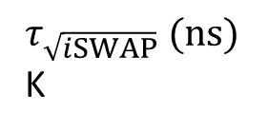







10²
10¹
error rate
$E_{z}$noise
relax.
adiab.
10⁰
$τ_{\sqrt{iSWAP}} (ns)$
K
40
80
10¹
10²
10³
0
4
$$V_{t}^{} \text{(}\text{G}\text{Hz}\text{)}$$
-10
a
$$g_{2q}^{ff}\text{(}\text{MHz}\text{)}$$
b
c
2
$$E_{z}^{}−E_{z}^{0}\text{(}\text{k}\text{V}\text{/}\text{m}\text{)}$$
-20
0
1
flip-flop 1
flip-flop 2
position 1
position 2
charge 1
charge 2
$$K$$
$$τ_{\sqrt{iSWAP}} (ns)$$
$E_{z,rms}^{noise}$ (V/m)
0
-1
0
20
40
Time (ns)

