Slide 1

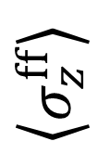


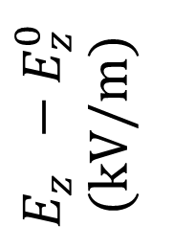
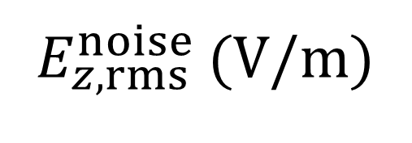
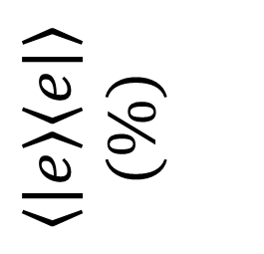
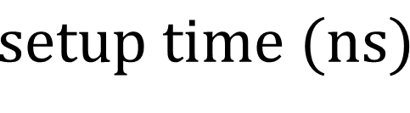
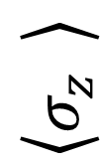

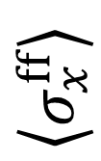
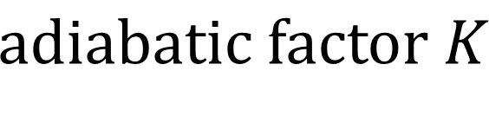
adiabatic setup
a
b
$$E_{z}^{}−E_{z}^{0}$$
(kV/m)
0
electric field
$$setup time (ns)$$
-40
$$\left\langle σ_{z}^{ff}\right\rangle$$
0
flip-flop $z$ state
-0.01
$$adiabatic error$$
1
$$\left\langle σ_{x}^{ff}\right\rangle$$
(rot. frame)
c
-1
flip-flop $x$ state
1
$$\left\langle σ_{z}^{}\right\rangle$$
electron position
0
$$adiabatic factor K$$
$$\left\langle \left.\left|e\right.\right\rangle \left\langle \left.e\right|\right.\right\rangle$$
($\%$)
$$setup time (ns)$$
0.5
charge excitation (%)
0
0
10
20
30
40
50
60
$E_{z,rms}^{noise}$ (V/m)
Time (ns)

